Slide 1


RAISING HEALTHY CHILDREN GOD’S WAY
Lesson- 7

Slide 2
Raising healthy children god’s way
OBJECTIVES OF THE LESSON
To understand that the most important responsibility of a parent is to teach their children about Christ
To understand the importance of parenting
To know that being a parent is rewarding, but it also very hard work
DISCUSSION QUESTIONS AT END

Slide 3


Raising healthy children god’s way
KEY VERSE
…we will tell the next generation the praiseworthy deeds of the LORD, his power, and the wonders he has done…so the next generation would know them, even the children yet to be born, and they in turn would tell their children. Then they would put their trust in the God and would not forget his deeds but would keep his commands.
Psalm 78:4, 6-7

Slide 4

Raising healthy children god’s way
REPRESENT CHRIST TO CHILDREN
More than anything else, parents are commissioned to represent Christ to their children. First and foremost, they are to be followers of Christ and ambassadors of Him (2 Corinthians 5:20).
As parents look at fulfilling their responsibilities, they must do so in the light of representing Christ in their home. This involves several important things:
Becoming the lens which determines how their children see God
Becoming the building plans which determine how their children will build their lives
Becoming a mirror that determines how their children see themselves

Slide 5


Raising healthy children god’s way
REPRESENT CHRIST TO CHILDREN
BECOMING THE LENS FOR HOW YOUR CHILDREN SEE GOD
Lenses in glasses enable a person to see objects more clearly. Children look to their parents to see what God is like.
If the lens is distorted or cracked, it will distort the object trying to be seen. This is why many children grow up to be adults who have trouble trusting God.
A child cannot see God or fully understand Him on their own. God gave parents to represent Himself to their children. If parents are dishonest, untrustworthy, unforgiving, or full of criticism then children will see God this way. But if parents are available, loving and forgiving then their child will view God in these ways.

Slide 6

Raising healthy children god’s way
REPRESENT CHRIST TO CHILDREN
BECOMING PLANS FOR HOW YOUR CHILD BUILDS THEIR LIFE
Just as a builder needs a plan to give him proper direction and guidance, so children need a plan for how to build their lives.
A child’s “building plans” are the actions and behaviors
of their parents.
Psalm 78:1-8 shows us how important it is for parents to provide a good building plan through Biblical and spiritual understanding and modeling. This is done so they will put their trust, hope, and confidence in God.

Slide 7

Raising healthy children god’s way
REPRESENT CHRIST TO CHILDREN
BECOMING A MIRROR FOR HOW YOUR CHILD SEES THEMSELF
A mirror’s purpose is to reflect the exact image of the person looking into it. It reveals what they look like.
Children learn about themselves through their parent “mirrors.” How the parents treat them is how they view themselves. Constantly point out their flaws and they view themselves as flawed and failures. Speak harshly and without love and respect and they may feel worthless and unlovable. Conversely, if you treat them with respect, remind them they are loved, value their successes, and help them through trials they will feel significant, cherished, and wanted and mature into spiritually healthy adults.
It all depends on how a father an mother relate to their children over time.

Slide 8

Raising healthy children god’s way
REPRESENT CHRIST TO CHILDREN
These responsibilities are actually a blessing. When fathers and mothers accept the challenge of raising healthy and godly children, joy will come as they see their children grow up to serve Christ. It is challenging, demanding, time consuming and many times exhausting. The promise of God, however, is that a person will reap what they sow (Galatians 6:8). When a parents loves, nurtures and protects their children, the foundations of their lives will be established. They will be grounded in the truth and love. Their lives will be fruitful and their children will inherit the blessing as well.

Slide 9
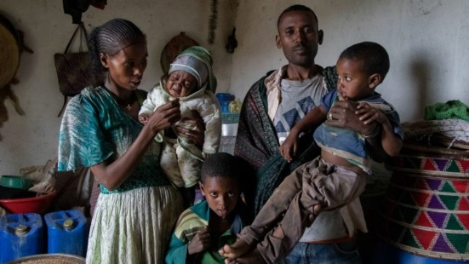
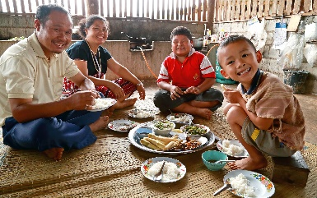
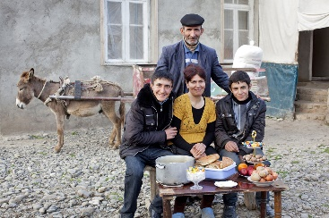

Raising healthy children god’s way
PARENTING TODAY
Parenting in today’s world is not easy. Parenting is one of the greatest challenges one can face, especially in a time when there is a breakdown of the family around the world.
Every Christian parent desires to raise healthy, godly children. But this does not happen by accident, it takes hard work. And there are several critical things that must take place. Two of these are a proper environment and responsibility to prepare the soil of children’s hearts.

Slide 10
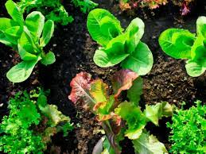

Raising healthy children god’s way
PARENTING TODAY
PROPER ENVIRONMENT
In nature, the environment in which a thing lives is very influential. The environment affects the growth of that thing. A plant will not grow healthy and fruitful in a bad environment.
This principle is true of the family as well. If parents develop a proper environment in which their children live and grow, they will become healthy, productive and stable individuals.

Slide 11
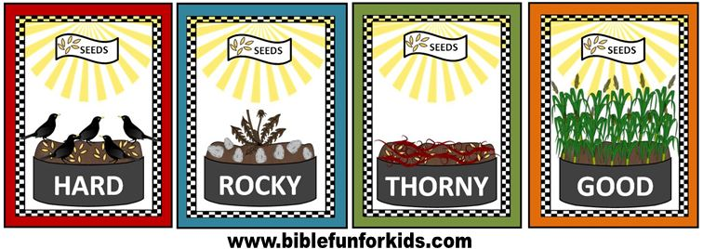
Raising healthy children god’s way
PARENTING TODAY
PROPER ENVIRONMENT
Jesus told a story in Mark 4:1-20 called the Parable of the Sower. (A parable is a heavenly story with an earthly meaning) This story is about a man who sowed seeds in a place with different types of soil. Jesus talked about how the soil determined the growth and fruit bearing of the seed.
Hard soil—seed would not grow (Mark 4:15)
Rocky soil—seed grew, but unhealthy (Mark 4:16-17)
Weed/Thorn soil—seed grows, but is killed by the bad things around it (Mark 4:18-19)
Rich soil—seed grows healthy and produces fruit (Mark 4:20)
Jesus explained that the soil was like the environments of people’s hearts. The seed is like the Word of God. When the environment (soil) is good, God’s Word can take hold and prosper.

Slide 12

Raising healthy children god’s way
PARENTING TODAY
PREPARE THE SOIL OF CHILDREN’S HEARTS
Just like a gardener needs to prepare the soil for proper growth, parents must prepare the hearts of their children to bear God’s fruit in their lives. Parents determine the environment in which their children live.
Parents want their children’s hearts to be open so they can influence their lives by imparting values and truth. They do NOT want their children to be resentful, rebellious, or hardened.
Deuteronomy 6:1-9 shows the instructions given by God to Moses for parents to learn how to prepare their children’s hearts.

Slide 13
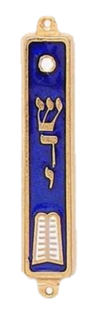
Raising healthy children god’s way
PARENTING TODAY
PREPARE THE SOIL OF CHILDREN’S HEARTS
These are the commands, decrees and laws the LORD your God directed me to teach you to observe in the land that you are crossing the Jordan to possess, so that you, your children and their children after them may fear the LORD your God as long as you live by keeping all his decrees and commands that I give you, and so that you may enjoy long life. Hear, O Israel, and be careful to obey so that it may go well with you and that you may increase greatly in the land flowing with milk and honey, just as the LORD, the God of your fathers, promised you. Hear, O Israel; The LORD our God, the LORD is one. Love the LORD your God with all your heart and with all your soul and with all your strength. These commandments that I give you today are to be upon your hearts. Impress them on your children. Talk about them when you sit at home and when you walk along the road, when you lie down and when you get up. Tie them as symbols on your hands and bind them on your foreheads. Write them on the doorframes of your houses and on your gates. (Deuteronomy 6:1-9 emphasis added)

Slide 14

Raising healthy children god’s way
PARENTING TODAY
PREPARE THE SOIL OF CHILDREN’S HEARTS
Moses was writing God’s instructions to teach the Israelite children. This was done when they were preparing to enter a land filled with idolatrous and pagan people. Moses gives important information to the parents about how to teach their children. God knew they would be surrounded by a culture contrary to the righteous, truthful living God had called them to. God knew that if they were to remain faithful to Him, they would need to establish a godly heritage in their children.
According to Moses, the following things prepare the soil of children’s hearts: clear guidance, consistency, demonstrated example and unconditional love.

Slide 15

Raising healthy children god’s way
PARENTING TODAY
CLEAR GUIDANCE
Parents are the ones called to teach their children. All children need direction—to know what is right and wrong. Children resent it when they do not have boundaries or clear direction. (Proverbs 29:15)
A child left to their own devices will simply adopt the values and behaviors around them. Parents are to be the primary teachers appointed by God to instruct their children’s lives.
Parents are commanded to make sure their children learn God’s truth. If they are not taught His truth at a young age, they may embrace wrong teachings and it is very hard to change their mind as they grown older.

Slide 16

Raising healthy children god’s way
PARENTING TODAY
CONSISTENCY
Children are greatly affected by the consistency they see in their parents. Moses tells parents to “impress them on your children.” This can also be translated as “teach them diligently.” The word “diligently” comes from a Hebrew word meaning “to sharpen.” Just as a knife must be run over a stone many times to sharpen it, children must be taught over and over about God’s truths.
Parenting should also be as fair as possible. Do not discipline one time and then not another. Do not demand something of one child and not another. The hearts of children will be open when their parents are consistent.
These commands are to be carried out:
…when you sit at home
…when you walk along the road
…when you lie down
…when you get up
In other words, ALL THE TIME. Consistency is what makes the difference.

Slide 17

Raising healthy children god’s way
PARENTING TODAY
DEMONSTRATED EXAMPLE
Parents are commanded to live what they teach. The admonition is to be doers of the Word before attempting to teach His Word. (Luke 6:47-49, John 13:17, James 1:22, 1 John 2:17)
Parents are to know God’s Word and obey His commands. They were to live out their faith as a testament to their unbelieving neighbors, merchants and other people they met. Living this example showed their children how to live properly in a land that was opposed to God and how to share God’s love with others as well.
Children are not manipulated by popular culture nearly as much when they see their parents living out what they say they believe. Parents have the incredible privilege of molding godly values into the hearts of their children simply by living consistent lives.

Slide 18

Raising healthy children god’s way
PARENTING TODAY
UNCONDITIONAL LOVE
Moses instructs parents to love God “with all their heart.” This unconditional love is to be expressed in human relationships as well.
Jesus affirmed this commandment. (Matthew 22:36-40)
Parents are instructed to love their children and communicate acceptance to them at all times—unconditionally. The command “love your neighbor as yourself” should first be practiced in the home. Practicing this love will open their hearts and make them “good soil” for planting Godly “seed.”

Slide 19

Raising healthy children god’s way
PARENTING TODAY
Parents do not intend to hurt their children, but many times they wound them without realizing it. If these wounds are not corrected, they can be carried into adulthood and affect future generations.
How do parents wound their children? What can parents do to help heal their children’s hearts when they do get hurt?

Slide 20

Raising healthy children god’s way
PARENTING TODAY
Fathers, do not exasperate [provoke] your children; instead, bring them up in the training and instruction of the Lord. (Ephesians 6:4)
“Provoke” means to stir up feelings of anger or frustration. Parents are to be careful not to intentionally anger or frustrate their children, but to focus on teaching them God’s truth.

Slide 21
Raising healthy children god’s way
PARENTING TODAY
Ways a child can be PROVOKED
Public humiliation-do not yell at or discipline in front of others
Favoritism-do not show more love/attention to one child over another
Cruel words-do not curse at or use mean words
Broken promises-do not tell them you will do something only to disappoint them by not doing it

Slide 22
Raising healthy children god’s way
PARENTING TODAY
Ways a child can be PROVOKED
Neglect-spend consistent time playing and communicating, provide for their basic physical needs (food, clothing, shelter)
Unfair/Harsh punishment-discipline fairly
Performance based acceptance-do not give your children love and affection ONLY when they have lived up to a standard of performance
Refusal to admit wrong-show humility by admitting when you have done wrong

Slide 23

Raising healthy children god’s way
PARENTING TODAY
Most parents would admit that at one time or another they make mistakes while raising their children. The good news about being followers of Christ is that His love can cover a multitude of sins, even parental ones. (1 Peter 4:8) Doing nothing can deepen a wound, but when a parent takes the steps to heal their child’s heart through Christ’s love, His grace will always redeem.

Slide 24
Raising healthy children god’s way
PARENTING TODAY
Ways to HELP HEAL a child’s heart
Be honest- always admit your mistakes and do not make excuses for your wrong behavior
Be humble-be willing to ask your child’s forgiveness
Be tender-speak softly and gently, touch your child in a loving way (Proverbs 15:1)

Slide 25
Raising healthy children god’s way
PARENTING TODAY
Ways to HELP HEAL a child’s heart
Be consistent-consistent, loving, godly behavior is the key to healing hearts, building trust and rebuilding the heart—it is the parent’s job to change damaging behavior
Be Christ-centered-it is helpful to pray a prayer or repentance in front of the hurt child to show them that you want to change and do better

Slide 26

Raising healthy children god’s way
PARENTING TODAY
Ways to HELP HEAL a child’s heart
Example Prayer: Dear Lord Jesus, I have acted very wrong with my son (daughter). Will you forgive me for what I have done? Please heal the heart of my child and let them know my love for them. Change my heart so I will never act this way again. Thank you for your forgiveness. Heal our hearts, Lord, so we may honor you. Amen

Slide 27
Raising healthy children god’s way
A Brief Summary
It takes a lot of effort to raise children correctly.
It is important that parents recognize they can wound their children through incorrect parenting.
They can also help heal children so they can mature into good parents themselves.
Children’s hearts are impressionable and vulnerable.
This teaching has revealed how a parent can prepare their hearts so fruitful lives can result.

Slide 28
Raising healthy children god’s way
A Brief Summary
The family has always been God’s idea. It is intended to be the foundation upon which civilization is built. Marriage becomes the cornerstone of the family. Children become the promise and hope of God’s heritage continuing from generation to generation. When families are built with God’s wisdom and grace, blessing will exist without measure in the nations where these families live.
Therefore, be committed to building Christian families and learn to enjoy the presence of Christ in your home. Where His presence is welcomed, you will discover God’s peace, love and joy.

Slide 29

Raising healthy children god’s way
DISCUSSION
QUESTIONS

Slide 30
Raising healthy children god’s way
Read the following Bible verses about being a “doer” of God’s Word before being about to be a “teacher” of His word to children.
What do these verses instruct the believer to do?
How does this relate to being a good parent?
Luke 6:47-49
James 1:22
John 13:17
1 John 2:17

Slide 31
Raising healthy children god’s way
Read the following Bible verses in class. Discuss each of the following instructions on how to prepare the “soil” of a child’s heart.
Clear guidance (Proverbs 29:15)—why is it so important to provide guidance to a child?
Consistency (Deuteronomy 6:7)—Discuss the four instances when these commands were to be carried out.
Demonstrated example (Deuteronomy 6:1-3)—why is it important to lead by example?
Unconditional love (Deuteronomy 6:5)—Discuss the meaning of unconditional love. Why are parents instructed to love “with all their heart?”

Slide 32
Raising healthy children god’s way
Review “Ways a child can be provoked” and “Ways to help heal your child’s heart.”
Can you remember something your parents did that wounded your heart when you were a child? If so, share and discuss how this could have been prevented and how it could have been healed.
Discuss the concept of “exasperating [provoking] your children to anger.
What does this mean? How can it be prevented?
Of the five things a parent needs to practice in healing their children’s hearts, which do you do well and with which do you need help?

Slide 33
Raising healthy children god’s way
APPLICATION
Read the following Bible verses. If you are married, do this activity with your spouse.
Deuteronomy 6:1-9 – write God’s instructions regarding how and when to teach your children about God
Psalm 78:1-8 – write what these verses say about why you should train your children about God. What is the result of correct training?
Consider whether you need to make changes in your focus to teach your children about God.

Slide 34

Raising healthy children god’s way
Contact: Info@Equippersgroup.org

