Slide 1
MARRIAGE COVENANT
Lesson- 3

Slide 2
MARRIAGE COVENANT
OBJECTIVES OF THE LESSON
To learn more about covenant
To understand the husband is responsible to be the head of the family
To learn there is a power and protection in the marriage covenant
To learn there are consequences when the covenant is broken
DISCUSSION QUESTIONS AT END

Slide 3
MARRIAGE COVENANT
KEY VERSE
Haven’t you read, he replied, that at the beginning the Creator “made them male and female,” and said, “For this reason a man will leave his father and mother and be united to his wife, and the two will become one flesh”? So, they are no longer two but one. Therefore, what God has joined together, let man not separate.
Matthew 19:4-6

Slide 4
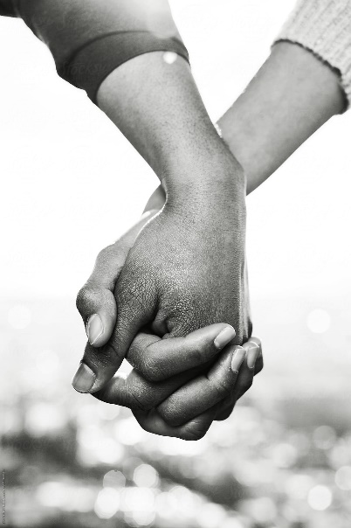
MARRIAGE COVENANT
The Power of Covenant
A promise is made powerful when the person making the promise actually does what they say they will do. Covenant is kept by conduct. The power of covenant is found in the character of the person; their word literally becomes their solemn (or sacred) promise.

Slide 5
MARRIAGE COVENANT
There is covenant in marriage
Both the husband the wife have instructions given by God to which they obligate themselves to follow.
When they do what God asks, the power of their covenant is activated.
The power of covenant keeps the husband from having sex with other women and the wife faithful to her husband and children even in hard times.

Slide 6
Covenant is an anchor to the
marriage relationship.

Slide 7
MARRIAGE COVENANT
Personal accountability
Many people have NO trouble highlighting the faults of their partner. They want to be an expert on their spouse’s responsibilities and not their own. This is not wise or productive. Each person is accountable to God for how he or she acts and responds. A person only has the power to change themselves and respond to God individually and personally.

Slide 8
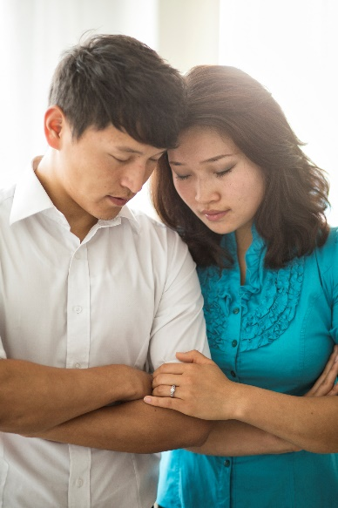
MARRIAGE COVENANT
Prayer and Responsibility
We cannot change our spouse, but we can pray for change. Prayer is the power of change because only God has the ability to change a person from the inside.
We have responsibility to work on our portion of any marriage problems that develop. We are accountable to God for our own actions and our spouse for theirs.

Slide 9
MARRIAGE COVENANT
The Protection of Covenant
Satan desires to tear apart marriage. The marriage covenant is under attack around the world. God’s heart for marriage is that the marriage covenant never be broken. Proper spiritual protection and covering is required for covenant to remain strong.

Slide 10
MARRIAGE COVENANT
When asked about divorce, Jesus said,
…For this reason, a man will leave his father and mother and be united to his wife, and the two will become one flesh? Therefore, what God has joined together, let no man separate.
Matthew 19:5-6

Slide 11
MARRIAGE COVENANT
4 Key Points
1. Spiritual Protection: The marriage is “covered”
2. The husband: head of the wife and home
3. Covenant broken: the marriage is NOT covered
4. Spiritual Protection: husband to guard and serve his family

Slide 12
MARRIAGE COVENANT
Spiritual covering like a spiritual roof
Like a roof that shelters those in the house from wind, rain, heat and cold, a spiritual roof provides protection for the relationship.

Slide 13
MARRIAGE COVENANT
This “covering” is obtained by spiritual intimacy together with Christ. Both husband and wife need to develop their individual, personal walks with Christ. The power of this intimacy keeps the enemy out of their relationship. Most attacks that Christian couples face come from their own hearts. Therefore, keeping personal intimacy with Christ as a priority is essential if their covenant with each other is to be protected.

Slide 14
MARRIAGE COVENANT
Disciplines that allow Jesus to protect your heart and home
1. Read God’s word together
2. Pray together daily

Slide 15
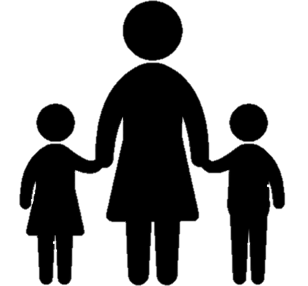
MARRIAGE COVENANT
The husband provides covering for wife and family
The Bible says the husband is to be the head of the wife and home. This means that it is his primary responsibility to cover his wife and children. Many men uncover their families by not taking this responsibility seriously.

Slide 16
MARRIAGE COVENANT
The husband provides covering for wife and family
“?…how can anyone enter a strong man’s house and carry off his possessions unless he first ties up the strong man?
Matthew 12:29

Slide 17
MARRIAGE COVENANT
The husband provides covering for wife and family
Jesus reveals the importance of husbands and fathers not allowing themselves to be bound spiritually or emotionally. Allowing this to happen forces the woman to take the leadership role and make decisions and fight battles God did not design her for.

Slide 18
MARRIAGE COVENANT
An uncovered marriage can lead to broken covenant
What does it mean when a husband is bound?
He is not free to fulfill the responsibilities God has given him.
He loses this freedom by allowing things into his life that restrict his spiritual walk and therefore make him incapable of leading.
His wife and children are now unprotected.
This can occur innocently and/or through chosen sin.

Slide 19
MARRIAGE COVENANT
An uncovered marriage can lead to broken covenant
What things can bind a husband? (a partial list)
Over-commitment of time and energy to work/ministry
Failure to deal with personal insecurities/weaknesses: anger, procrastination, laziness, fear, intimidation, rejection
Preoccupation with personal hobbies and recreational pursuits
Allowing sin to exist: drinking, gambling, pornography, immorality, drug addiction, verbal/physical abuse
Misuse of financial provision
Weak or inconsistent walk with God

Slide 20
MARRIAGE COVENANT
An uncovered marriage can lead to broken covenant
Spiritual responsibility exercised by the husband is what brings covering to the home.
Husbands and fathers should pray daily for their families. Preferably with their wife and children daily as well.
Husbands should be the obvious spiritual leaders of the home, thus bringing oneness to the couple.

Slide 21
MARRIAGE COVENANT
A comparison of two Biblical households
Job vs. Moses’ father
Job | Father of Moses
Offers sacrifices to purify family | Busy with his job
Prays for his family | Mother has to provide hiding and come up with a plan
Turns away from evil pursuits | Does not seem to be around to help protect his son

Slide 22
MARRIAGE COVENANT
The husband is to guard and serve
Many men do not realize they are the stewards of destiny. God gives them a wife and children because He wants to use them in strategic ways. It is a husband’s responsibility to guard this divine destiny for his family. Therefore, a man is to serve his family not be served by them.

Slide 23
MARRIAGE COVENANT
The family must be protected from attack
Satan is constantly fighting to break the family, starting with the marriage relationship. When both husband and wife determine to seek Christ, the enemy does not have a place to enter. The divine covenant binds them together and empowers them to stand against the evil one.

Slide 24
MARRIAGE COVENANT
A Brief Summary
Power of covenant is found in the character of the people making promises.
Both husband and wife have instructions given by God and the covenant is activated when they follow these instructions.
Satan desires to tear the marriage apart.
Personal intimacy with Christ leads to intimacy with each other and protected covenant.
Couples should read God’s word and pray daily.
Spiritual responsibility exercised by the husband is what bring covering to the home.

Slide 25
MARRIAGE COVENANT
DISCUSSION
QUESTIONS

Slide 26
MARRIAGE COVENANT
Discuss the power of covenant in marriage
Review the definition of covenant in Lesson 2.
Discuss the fact that the character of people is important to the power of covenant. Will the marriage covenant remain powerful if either the husband or wife breaks their promise?
How can the disciplines of praying and reading God’ word together strengthen their covenant to each other and God?

Slide 27
MARRIAGE COVENANT
Read Ephesians 5:23 and 1 Corinthians 11:3
Discuss how the husband is the head of the wife and the home.
Discuss how the husband is to carry out this instruction to “cover” his family.

Slide 28
MARRIAGE COVENANT
Review the list of things that can bind a husband
Discuss the kind of things that can cause a husband to be spiritually bound so he cannot fulfill his responsibilities.
Discuss how each one of these situations could change so the husband would not be bound and the home would not be “uncovered.”

Slide 29
MARRIAGE COVENANT
APPLICATION
As a husband, what changes do you need to make to assure that your wife and family are covered? Write them on a piece of paper. If you are unmarried, consider carefully the things listed that could cause you to be unable to cover your future family.
Identify the things that threaten the stability of your household. How can you stand up against these things to guard and serve your family?

Slide 30
MARRIAGE COVENANT
Contact: Info@Equippersgroup.org

