Slide 1
The foundation of MARRIAGE
Lesson- 2

Slide 2
The Foundation of MARRIAGE
OBJECTIVES OF THE LESSON
To learn God’s definition of marriage
To understand that covenant is the foundation upon which marriage is built
To know that the closer a couple is to Christ, the stronger their marriage relationship will be
DISCUSSION QUESTIONS AT END

Slide 3
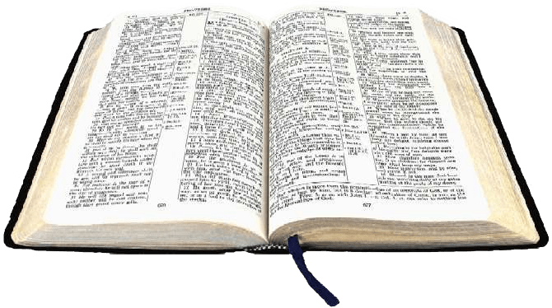
The Foundation of MARRIAGE
KEY VERSE
Therefore, everyone who hears these words of mine and puts them into practice is like a wise man who built his house on the rock. The rain came down, the streams rose, and the winds blew and beat against that house; yet it did not fall, because it had its foundation on the rock. But everyone who hears these words of mine and does not put them into practice is like a foolish man who built his house on sand. The rain came down, the streams rose, and the winds blew and beat against that house, and it fell with a great crash.
Matthew 7:24-27

Slide 4
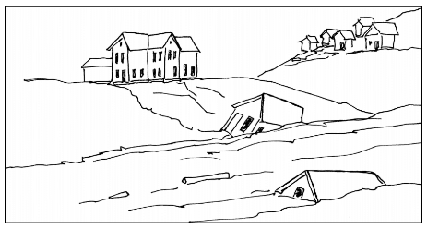
A home that is not built on biblical principles will not last. It is like a house built on sand.

Slide 5
The Foundation of MARRIAGE
The Foundation of Marriage
Foundations are intended to give stability and strength to the structures which are built upon them. In the key verse for this lesson Jesus reveals that the foundation for life, and therefore marriage, is nothing less than the Word of God.

Slide 6
The Foundation of MARRIAGE
Why is this foundation important?
Jesus says that the practice of doing what God’s word says builds a foundation that helps us withstand the storms of life.
If the family is the foundation of society and marriage is the foundation of the family, then marriage needs to be held up by the firm foundation of God’s word in order to support a successful society.
Understanding marriage as God defines it is critical for it to the kind of foundation that establishes the family as a whole.

Slide 7
The Foundation of MARRIAGE
The Definition of Marriage
Marriage is the binding covenant agreement between one man and one woman who commit themselves before God to be each other's companion for life.

Slide 8
The Foundation of MARRIAGE
What makes a relationship between a woman and man a marriage?
Marriage vs. Living Together
Marriage | Living Together
Have relationship | Have relationship
Share home, food, bed | Share home, food, bed
In a divine covenant with God and each other | NOT in covenant and can therefore leave at will

Slide 9
The Foundation of MARRIAGE
COVENANT MAKES A MARRIAGE
The thing that determines whether a man and woman ARE married can be summed up in one word: COVENANT. The word covenant means: a formal, solemn, binding agreement, or promise usually under seal between two or more parties especially for the performance of some action. Marriage is a divine covenant.

Slide 10
The Foundation of MARRIAGE
Three important aspects of marriage:
1. It is a covenant agreement
2. It is a spiritual picture of the New Covenant through Christ
3. It is also companionship

Slide 11
The Foundation of MARRIAGE
Marriage: A covenant agreement
God instituted marriage on a covenant.
In Bible times, covenants were taken very seriously and were sacred, even to the point of death.
Covenants are held together by a verbal agreement from each party to keep their promises to one another.
A break of covenant was a break of relationship.

Slide 12
The Foundation of MARRIAGE
Vows = verbal agreement = Covenant
Man and Woman make verbal promises to keep each other in marriage and fulfill certain obligations as long as they live.
These verbal commitments become the covenant that binds them in relationship to one another for life.
God expects the obligations of the marriage covenant to be upheld as long as both the husband and wife are living.

Slide 13
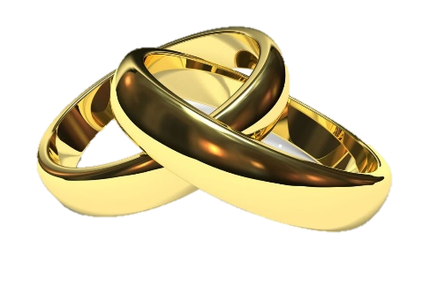
The Foundation of MARRIAGE
Outward symbols of the covenant
Many cultures us a visual symbol of marriage: rings and other jewelry, special clothing, special hairdos or adornments, and cosmetics.
Rings are most common and are a visual symbol of the unending (circle) commitment of the individuals.

Slide 14
The Foundation of MARRIAGE
God relates to humans through covenant
Noah—Genesis 9:8-17
Abraham—Genesis 17:2-14
Moses—Exodus 6:2-8
David—2 Samuel 7:8-16 and
Psalm 89: 28-29

Slide 15
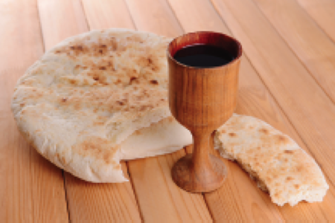
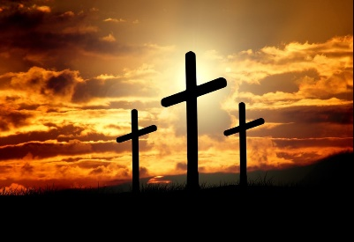
The Foundation of MARRIAGE
Marriage: A spiritual picture of the New Covenant
The greatest and “New Covenant” came through Jesus Christ, the Son of God.
The covenant was instituted during the final Passover meal with His disciples.
Jesus gave the bread and cup of Passover new meaning as a remembrance not of the sacrifice of the lamb of old, but of his impending sacrifice on the cross.
The marriage promise is a symbol of the covenant-keeping nature of God.

Slide 16
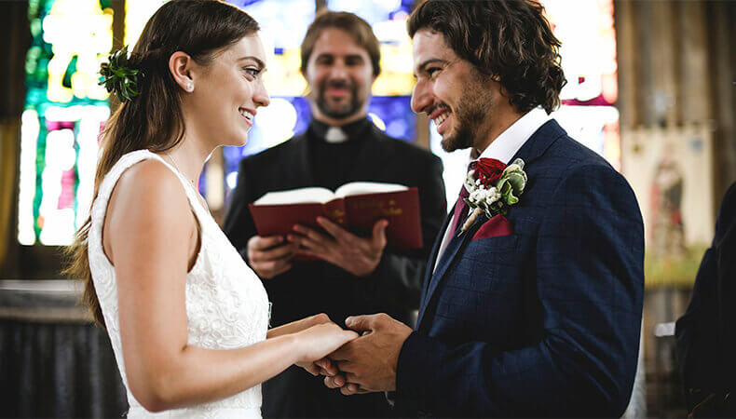
The Foundation of MARRIAGE
Marriage: A spiritual picture of the New Covenant
Every part of the Christian life rests on the fact that God does not lie and is committed to keeping His covenant. The Christian couple should reflect that part of God’s character and nature in their marriage relationship as well. Christian marriage should be a spiritual picture of the relationship Jesus has with His bride, the church.

Slide 17
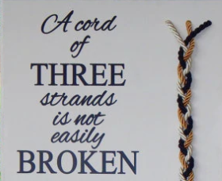
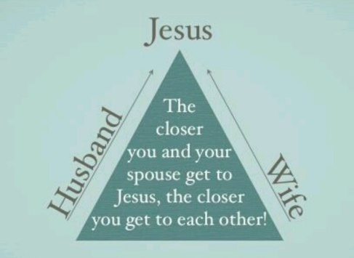
The Foundation of MARRIAGE
Marriage: Covenant and companionship
Adam and Eve—Genesis 2:20-24
Two people in companionship with each other and with God create a strong bond—Ecclesiastes 4:9-12
The Rock of Jesus supports a good marriage—Matthew 7:24-27

Slide 18
The Foundation of MARRIAGE
Divorce is NOT God’s design
Divorce breaks two covenants—between the two people and between the people and God
Divorce is often the result of not building a relationship on God’s foundation
Divorce is a forgivable sin, but should try to be avoided

Slide 19
The Foundation of MARRIAGE
A Cord of 3 Strands
Ecclesiastes 4:9-12
Solomon says that two people working together can overcome much, but that a third cord gives the added strength when life become too much for the two.
The “third strand” is Jesus holding the couple together when the pressure comes.

Slide 20
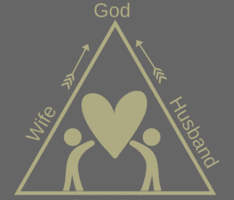
The Foundation of MARRIAGE
The marriage triangle
Christ is the one who completes the marriage relationship.
He gives the grace needed for each day.
He gives the wisdom and strength the couple needs to face problems that arise.

Slide 21
The Foundation of MARRIAGE
Jesus’ active authority in marriage provides
Grace to cover sin
Love to help forgive
Solutions to problems
Healing for pain
Hope in a foundation that does not move
A reason to stay together

Slide 22
The Foundation of MARRIAGE
SUMMARY OF PRINCIPLES
Integrity and strength of everything built in life is determined by the foundation upon which it is built.
The foundation upon which marriage is built is covenant. Without it, marriage has no strength.
The power of this covenant is found in the Christian couple doing the things God asks of them in the relationship.
Beyond that, their covenant relationship will be protected as they seek Christ first in their personal lives and allow Him to be central in their relationship with one another.

Slide 23
The Foundation of MARRIAGE
When these things are in place, God’s promise to the husband and wife is clear. No storm in life will ever have the power to destroy their relationship or their home. They will live under the blessing of God. It is then that God is pleased.

Slide 24
The Foundation of MARRIAGE
DISCUSSION
QUESTIONS

Slide 25
The Foundation of MARRIAGE
Discuss the following definition of marriage:
Marriage is the binding covenant agreement between one man and one woman who commit themselves before God to be each other's companion for life.

Slide 26
The Foundation of MARRIAGE
What part does “covenant” play in the marriage relationship between the husband and the wife?
Remember, in this lesson, “covenant” is defined as a binding agreement between two people.

Slide 27
The Foundation of MARRIAGE
Why is “commitment” important in marriage?
Who is to make this commitment – the husband or the wife, or both?

Slide 28
The Foundation of MARRIAGE
Discuss the fact that a marriage provides a companion for the husband and the wife for life.
What is a companion?
How is the companion instructed to treat their spouse?
Why is this so important?

Slide 29
The Foundation of MARRIAGE
Read Malachi 2:13-16 where God said He hates divorce.
•Discuss how a couple can avoid divorce.
•What are the consequences of a husband or wife breaking their covenant with one another?

Slide 30
The Foundation of MARRIAGE
Review the “Cord of 3 Strands” and the “Marriage Triangle.”
•Discuss the fact that a marriage will become stronger as the husband and wife grow closer to Christ.
•Who is represented in this “cord of three strands?”
•Discuss the concept that a “cord of three strands” is strong and will not unravel.

Slide 31
The Foundation of MARRIAGE
APPLICATION
Prayerfully consider your own marriage. Does your marriage line up with the definition presented in this lesson? Write your thoughts.
Discuss with your spouse how your marriage can be improved. Are you good companions? As a couple, do you reflect Christ-like character? If not, discuss how you can improve this situation.

Slide 32
The Foundation of MARRIAGE
Contact: Info@Equippersgroup.org

