Slide 1
GOD’S PURPOSE FOR MARRIAGE
Lesson- 1

Slide 2
GOD’S PURPOSE FOR MARRIAGE
OBJECTIVES OF THE LESSON
1. To learn God’s purpose for marriage
2. To understand a strong marriage is built on God’s wisdom, understanding, and knowledge
3. Learn that God created men and women different on purpose
DISCUSSION QUESTIONS AT END

Slide 3
GOD’S PURPOSE FOR MARRIAGE
KEY VERSE
The LORD God said, “It is not good for the man to be alone. I will make a helper suitable for him.” ... For this reason a man will leave his father and mother and be united to his wife, and they will become one flesh.
Genesis 2:18, 24

Slide 4
GOD’S PURPOSE FOR MARRIAGE
God is a God of PURPOSE
Everything He does has a reason.
Everything He creates has a purpose.
When humans do not understand God’s purpose for something, they begin to pervert it.

Slide 5
GOD’S PURPOSE FOR MARRIAGE
Examples of perversion (distorting or improper use) of God’s design
Clothing meant to cover the body—humans attach significance and personal worth to clothing and spend unnecessary amounts of money on clothing
Sexual intimacy as a covenant act of marriage—humans use sex for physical pleasure outside of marriage leading to disease, unwanted pregnancy, broken marriages, and orphaned children
Food intended for energy—humans use food for unhealthy cravings leading to physical disease and even death

Slide 6
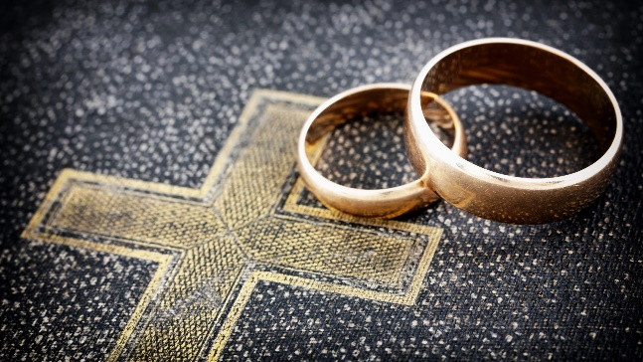
GOD’S PURPOSE FOR MARRIAGE
The significance of marriage is built on two facts:
Marriage is not just a nice cultural ritual that evolved over time from generation to generation. Rather, marriage is the basis for the healthy working of civilization itself. It was established by God at creation.
1. The marriage relationship is the foundation upon which family is built.
2. The family is the foundation upon which every society is built.

Slide 7
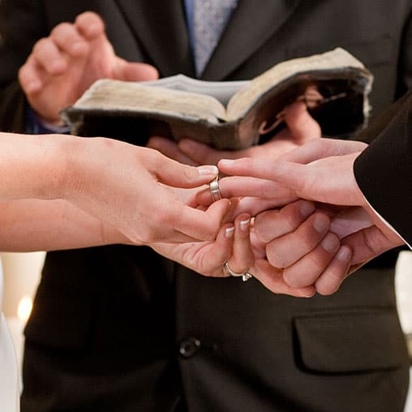
GOD’S PURPOSE FOR MARRIAGE
BUILDING A STRONG MARRIAGE
“Haven’t you read,” he replied, “that at the beginning the Creator ‘made them male and female,’ and said, ‘For this reason a man will leave his father and mother and be united to his wife, and the two will become one flesh’? So, they are no longer two, but one. Therefore, what God has joined together, let man not separate.” (Matthew 19:4-6)

Slide 8
GOD’S PURPOSE FOR MARRIAGE
Why do so many marriages struggle or fall apart?
The reason is because many husbands and wives do not know how to build their marriages according to Biblical principles.
[Proverbs 24: 3-4]

Slide 9
GOD’S PURPOSE FOR MARRIAGE
Three things involved in building a strong and lasting home
Aspects of building a strong home
Area | Aspect of Marriage | Answers the question
Wisdom | The purpose of God | What?
Understanding | The perspective of God | Why?
Knowledge | The instruction of God | How?

Slide 10
GOD’S PURPOSE FOR MARRIAGE
Wisdom: The purpose of God
Seeing life from God’s point of view
Wisdom--the accumulated knowledge of life gained through experience
A wise person wants to understand God’s purposes and reasons

Slide 11
GOD’S PURPOSE FOR MARRIAGE
Answers the question: “What?”
What is marriage?
What is God’s purpose for marriage?
What is God’s design for my marriage?

Slide 12
GOD’S PURPOSE FOR MARRIAGE
What is marriage?
God’s creation—not man’s idea
Established by God in Genesis 2:18-25
“the LORD God made a woman from the rib he had taken out of the man, and he brought her to the man.”

Slide 13
GOD’S PURPOSE FOR MARRIAGE
Understanding: The perspective of God
Couples need to know why God made both of them unique.
Understanding our differences helps establish a peaceful and successful marriage.
More understanding = a reliable, firm and stable relationship

Slide 14
GOD’S PURPOSE FOR MARRIAGE
Answers the question: “Why?”
Why did God design marriage this way?
Why did he create a male and female and place them in marriage?
Why is my husband/wife the way he/she is?

Slide 15
GOD’S PURPOSE FOR MARRIAGE
MEN
Men first relate physically, then intellectually, then emotionally, and finally spiritually.
Men are less verbal than women.
Men can face a conflict or problem and usually let it go rather quickly.
Men need honor and admiration.
Men communicate in generalities.

Slide 16
GOD’S PURPOSE FOR MARRIAGE
WOMEN
Women first relate spiritually, then emotionally, then intellectually, and finally physically.
Women are intuitive and have a keen sense of discernment.
Women are usually more sensitive than men.
Women need security.
Women communicate in specifics

Slide 17
GOD’S PURPOSE FOR MARRIAGE
So many differences
When God is in the midst of a marriage, these differences compliment instead of divide.
Each spouse must understand these differences and learn to relate to one another according to their unique needs.

Slide 18
GOD’S PURPOSE FOR MARRIAGE
Knowledge: The instruction of God
God provides instruction for a successful marriage through His word, the Bible.
The following lessons will cover these questions in more depth.

Slide 19
GOD’S PURPOSE FOR MARRIAGE
Answers the question: “How?”
How can a husband fulfill his responsibilities and love his wife like Christ loved the church?
How can a wife relate to her husband and submit in a way that pleases the Lord?
How can a couple get their marriage to a place of blessing if it is hurting?
How can a couple increase their intimacy with one another?
How can they serve the Lord together?
How can they parent together for healthy and strong children?

Slide 20
GOD’S PURPOSE FOR MARRIAGE
A Brief Summary
It is important to know that all three aspects of building a lasting marriage and family can be discovered and experienced because of God’s grace.
You can know God’s purpose for marriage because of His wisdom.
You can know God’s perspective for marriage because He provides understanding.
You can know Gods’ instructions for marriage because He gives knowledge.
As a result, the marriage and home will be filled with good things, life will be rich, and the peace of God will remain.

Slide 21
GOD’S PURPOSE FOR MARRIAGE
DISCUSSION
QUESTIONS

Slide 22
GOD’S PURPOSE FOR MARRIAGE
When these things are in place, God’s promise to the husband and wife is clear. No storm in life will ever have the power to destroy their relationship or their home. They will live under the blessing of God. It is then that God is pleased.
As more marriages in your community become successful, will your community change?
Will more successful marriages affect your nation?

Slide 23
GOD’S PURPOSE FOR MARRIAGE
Describe the main differences between men and women. Discuss the following questions:
How do these differences between men and women affect a successful marriage?
If a couple does not understand these differences, how could their marriage be adversely affected?
When a couple does understand the unique nature of their spouse, how will their marriage be positively affected?

Slide 24
GOD’S PURPOSE FOR MARRIAGE
APPLICATION
Read Proverbs 24:3-4 again. Consider how you can make your marriage stronger by adding more wisdom, understanding, and knowledge. If you are married, discuss with your spouse. Make a list of some ways you can work together to strengthen your marriage.

Slide 25
GOD’S PURPOSE FOR MARRIAGE
Contact: Info@Equippersgroup.org

