Slide 1



Church Growth Model
Facilitator’s Training Seminar
Session- 4

Slide 2
Church Growth Model
OVERVIEW
Growth in the church is accomplished through the Mission-Church Life Cycle. This cycle is a process to produce generations of disciples and believers. The life cycle of a church includes four stages: Pioneer, Parent, Partner and Participant. Each stage requires specific gifts for success and each stage has specific obstacles to overcome.
Time required to complete this session: 1 1/2 hours

Slide 3
Church Growth Model
OVERVIEW
Goals of the session:
1. Understand the “Church Life Cycle”
2.Understand the importance of generations of believers
3. Understand obstacles to growth at each stage
DISCOVERY SESSION AT END

Slide 4
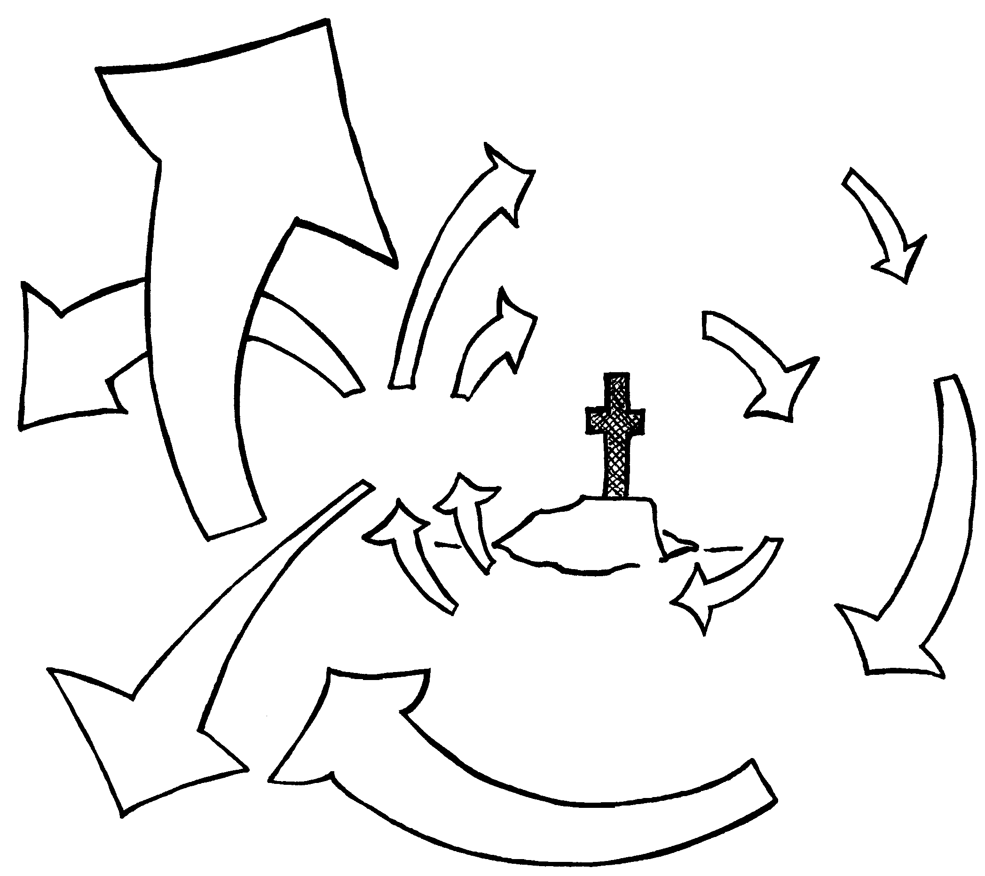
Church Growth Model
Church Planting
GROWTH
Local Church
Missions
MINISTRIES
Training
Vision For The Lost
Jesus
FRUIT
EXPANSION
New Ministries
VISION

Slide 5
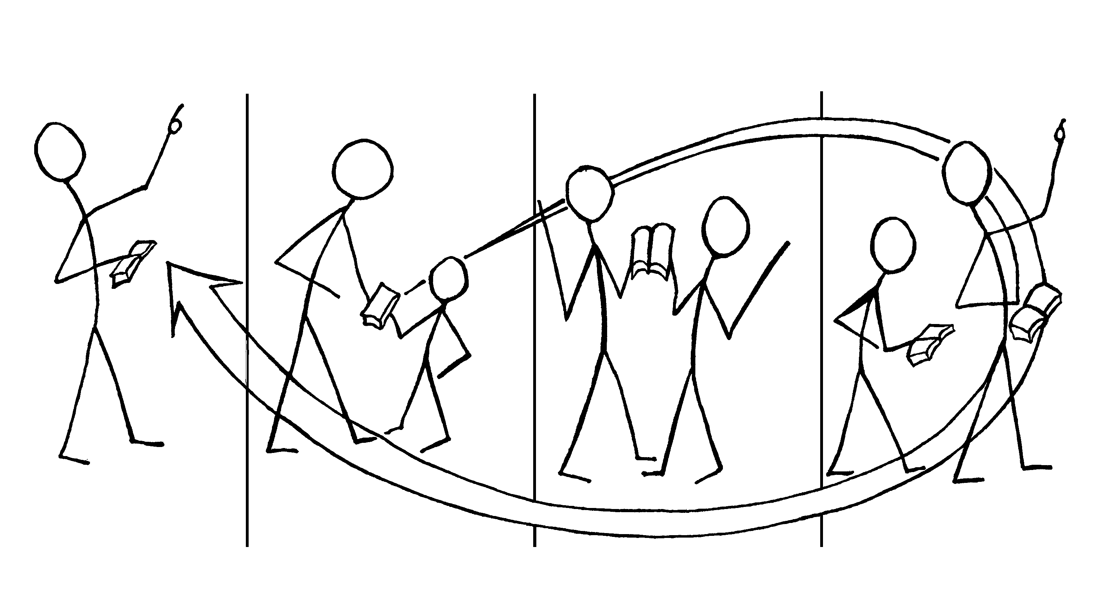
Mission-church Life Cycle
4 Stages Of Development
Stage 1
PIONEER
Stage 2
PARENT
Stage 4
PARTICIPANT
Stage 3
PARTNER

Slide 6

Mission-church Life Cycle
4 Stages Of Development
Stage 1 : PIONEER
Primary Gift : Preaching
Primary Obstacles : Pioneer tries to do everything.

Slide 7
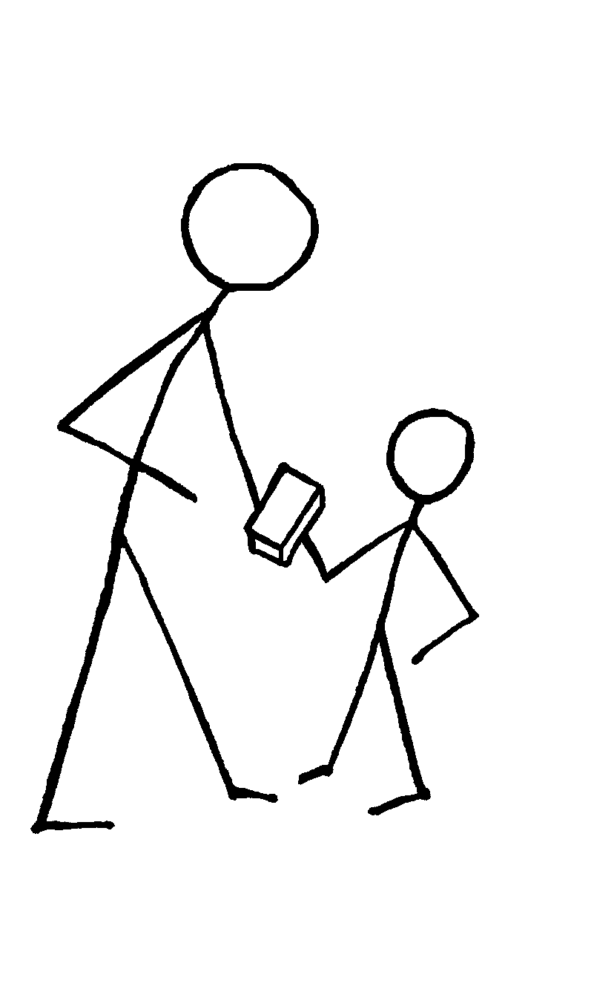
Mission-church Life Cycle
4 Stages Of Development
Stage 2 : PARENT
Primary Gift : Teaching
Primary Obstacles : Paternalism

Slide 8
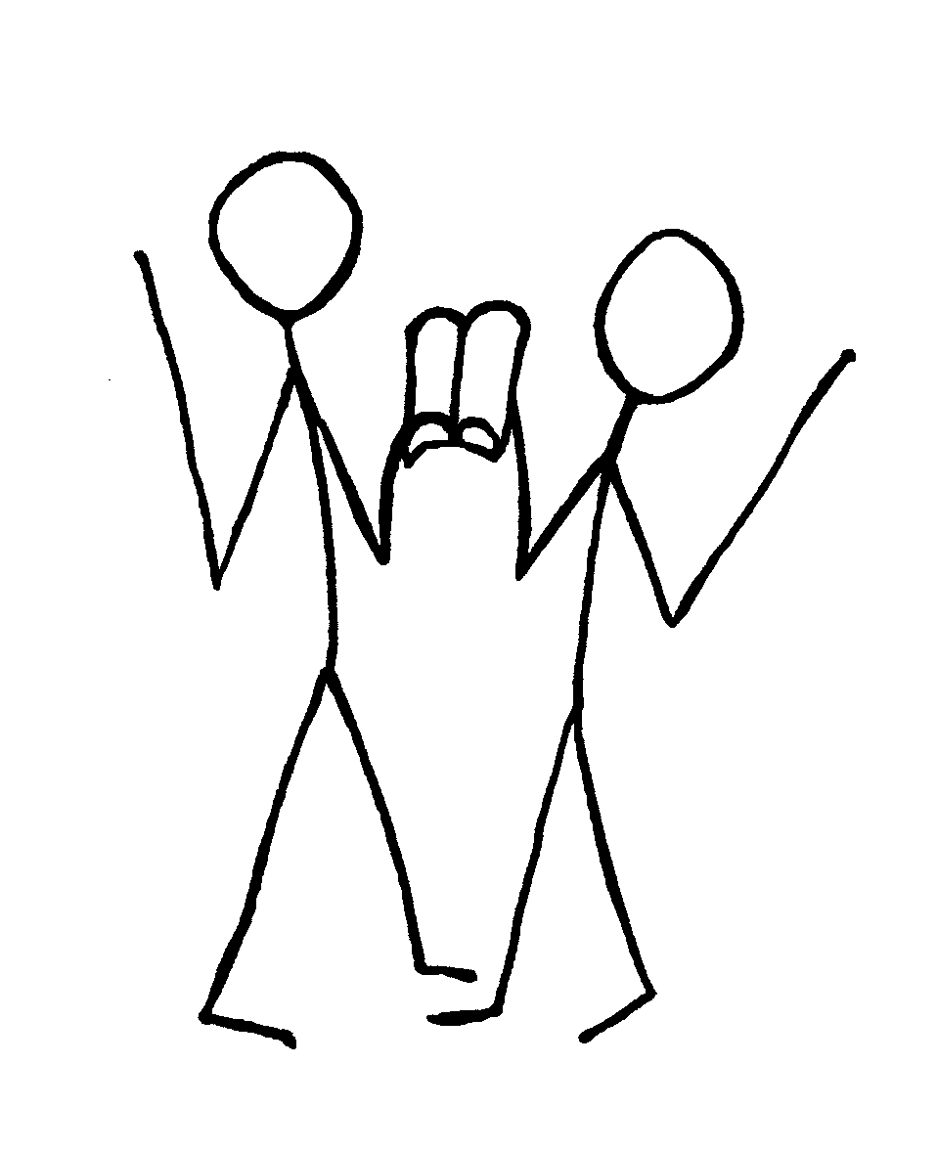
Mission-church Life Cycle
4 Stages Of Development
Stage 3: PARTNER
Primary Gift : Mentoring, Serving together
Primary Obstacles
The Partner tends to protect, dominate and control a new believer’s relationship with God
The new church resembles the attitudes and actions of an adolescent

Slide 9

Mission-church Life Cycle
4 Stages Of Development
Stage 4 : PARTICIPANT
Primary Gift : Mentoring, Leadership
Primary Obstacles
Letting go successfully

Slide 10
Church Growth
Jesus is the same yesterday, today and forever.
(Hebrews 13:8)
Jesus is the Alpha,
the Beginning
(John 1:1)
Jesus is the Omega,
the Ending
(Matthew 28:20)
A

Slide 11

Church growth model
Discovery Session

Slide 12
Discovery Session
1. Where are you as a church leader in the church growth cycle?
2. Are you able to mature and reproduce? Do you have a “new fruit” (new believers)?
3. Have you seen clearly what you need to do to receive the growth God wants to give?

Slide 13
Discovery Session
Session Conclusion:
Consider whether the Missions-Church Life Cycle (Diagram 4.2) should be posted and circulated to every believer in your church so they understand where they fit into the growth of the church.

Slide 14

Church Growth model
Contact: Info@Equippersgroup.org

