Slide 1
Vision
Facilitator’s Training Seminar
Session- 3

Slide 2
VISION
OVERVIEW
A majority of leaders want to succeed, but they do not know the process or steps that help, or hinder, them from quickly accomplishing God’s purposes. There are two parts to vision: First you must understand God’s vision for your ministry; and second is to write the vision. To effectively minister, a leader must have God’s “vision” on how to reach the destination. Where are you going? Is your vision the same as God’s vision? Can you write your vision? This session will answer these questions.
Time required to complete this session: 1 1/2 hours

Slide 3
vision
GOALS OF THE SESSION
1. Understand necessity of vision
2. Understand origin of vision
3. Understand power of vision
4. Writing your vision
DISCOVERY SESSION AT END

Slide 4
Progression Of Vision
-1-
Almighty God entrusts His vision and purposes to His servants.
Diagram 2:1

Slide 5
Progression Of Vision
-2-
Pray for direction, timing and provision.

Slide 6
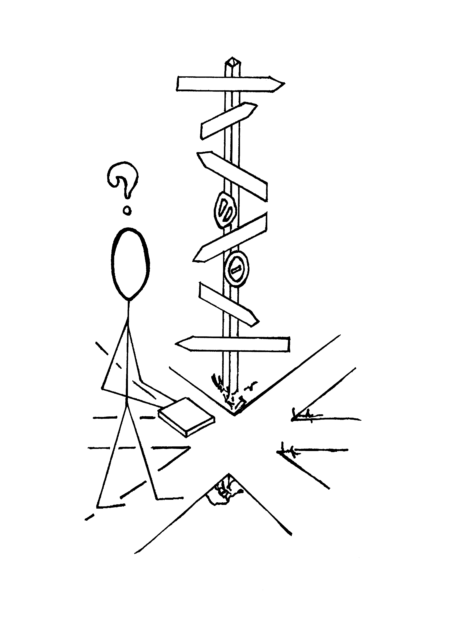
Progression Of Vision
-3-
Choose To Believe God Rather Than Your Physical Circumstances.

Slide 7
Progression Of Vision
-4-
Look Entirely To God For Wisdom, Knowledge, and Understanding.

Slide 8
Progression Of Vision
- 5 -
Pray To See The Plans, Purpose And Strategies Of God.

Slide 9
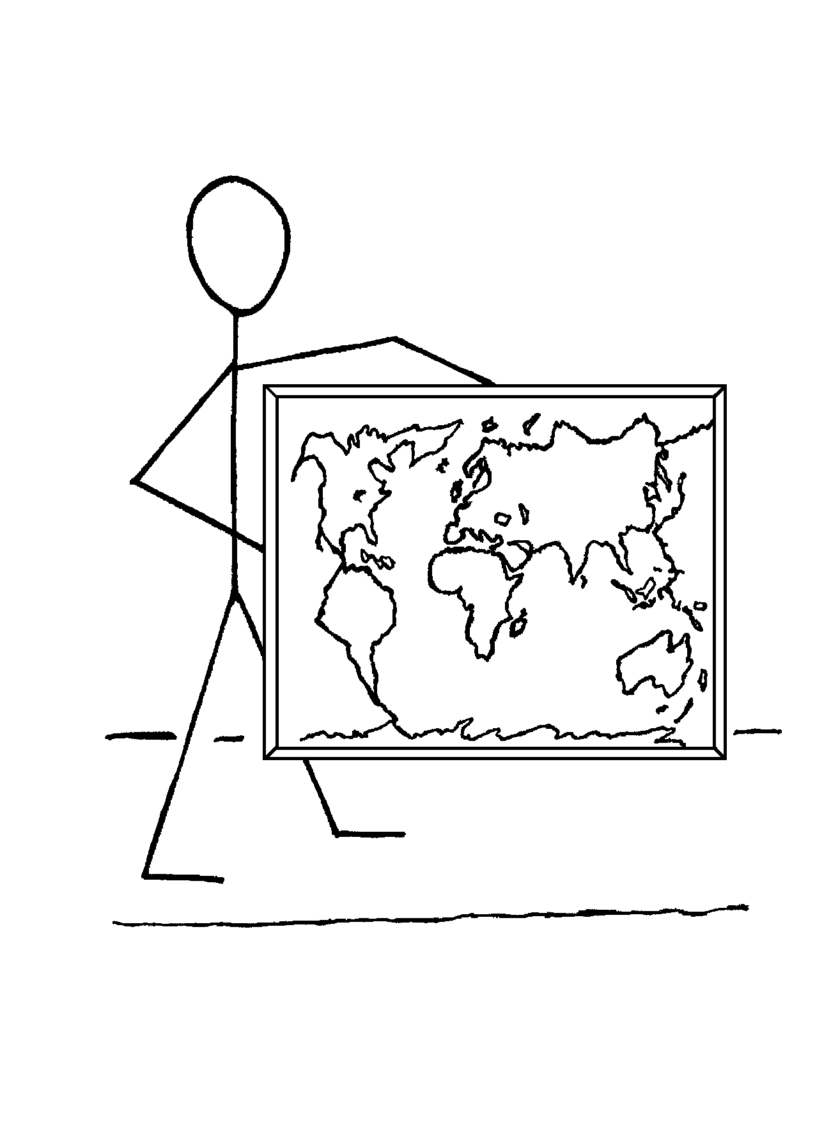
Progression Of Vision
- 6 -
Have A Clear Understanding Of The Vision. Present The Vision To The Believers In Your Church.

Slide 10
Vision
There Are 2 Major Parts To Vision
1. God - Vision
2. Writing A Vision and Implementation Plan

Slide 11
Vision
Key To Church Growth :
VISION

Slide 12
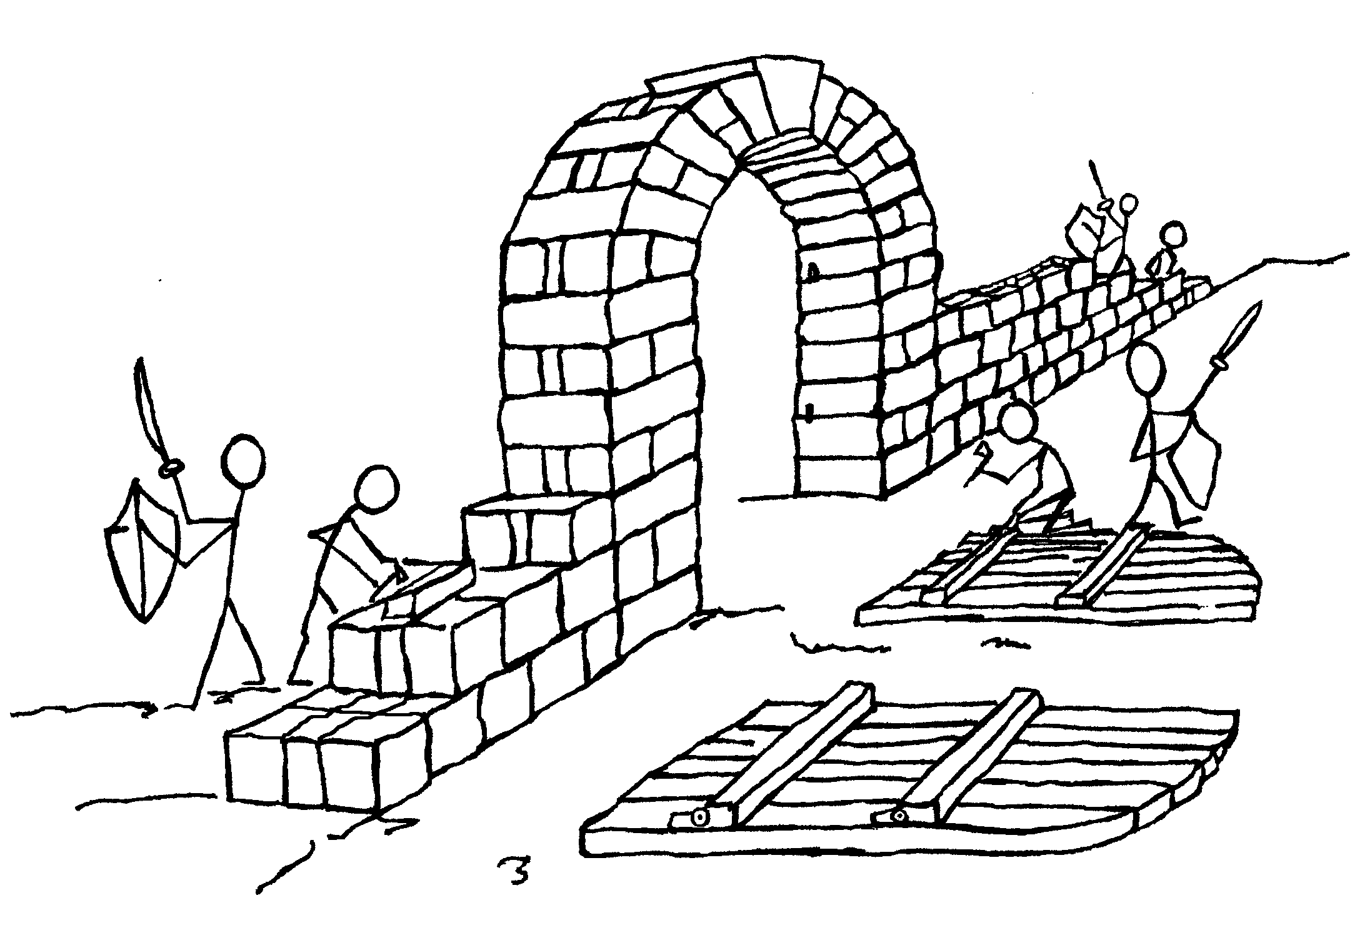
Vision
Nehemiah- A Man With Vision

Slide 13
Various Types of Vision
Four Steps Of Vision
Vision
Revision
Provision
Supervision
Nehemiah’s Strategy to complete the wall

Slide 14
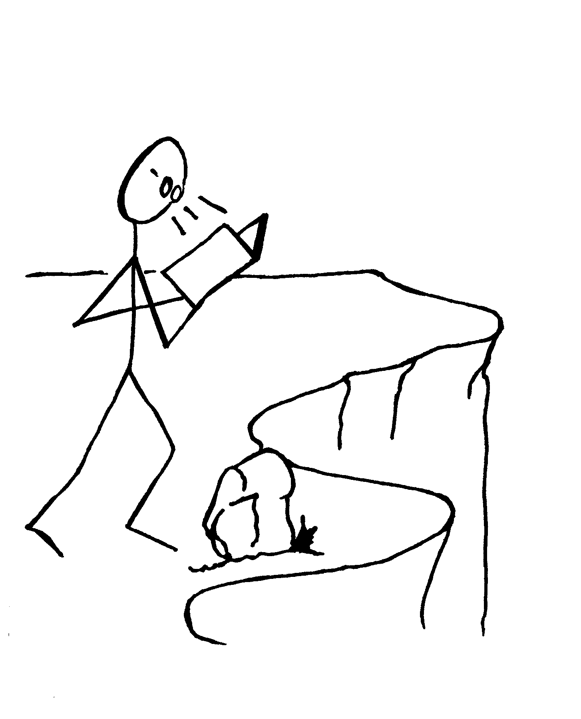
Various Types Of Vision
Myopic Vision

Slide 15
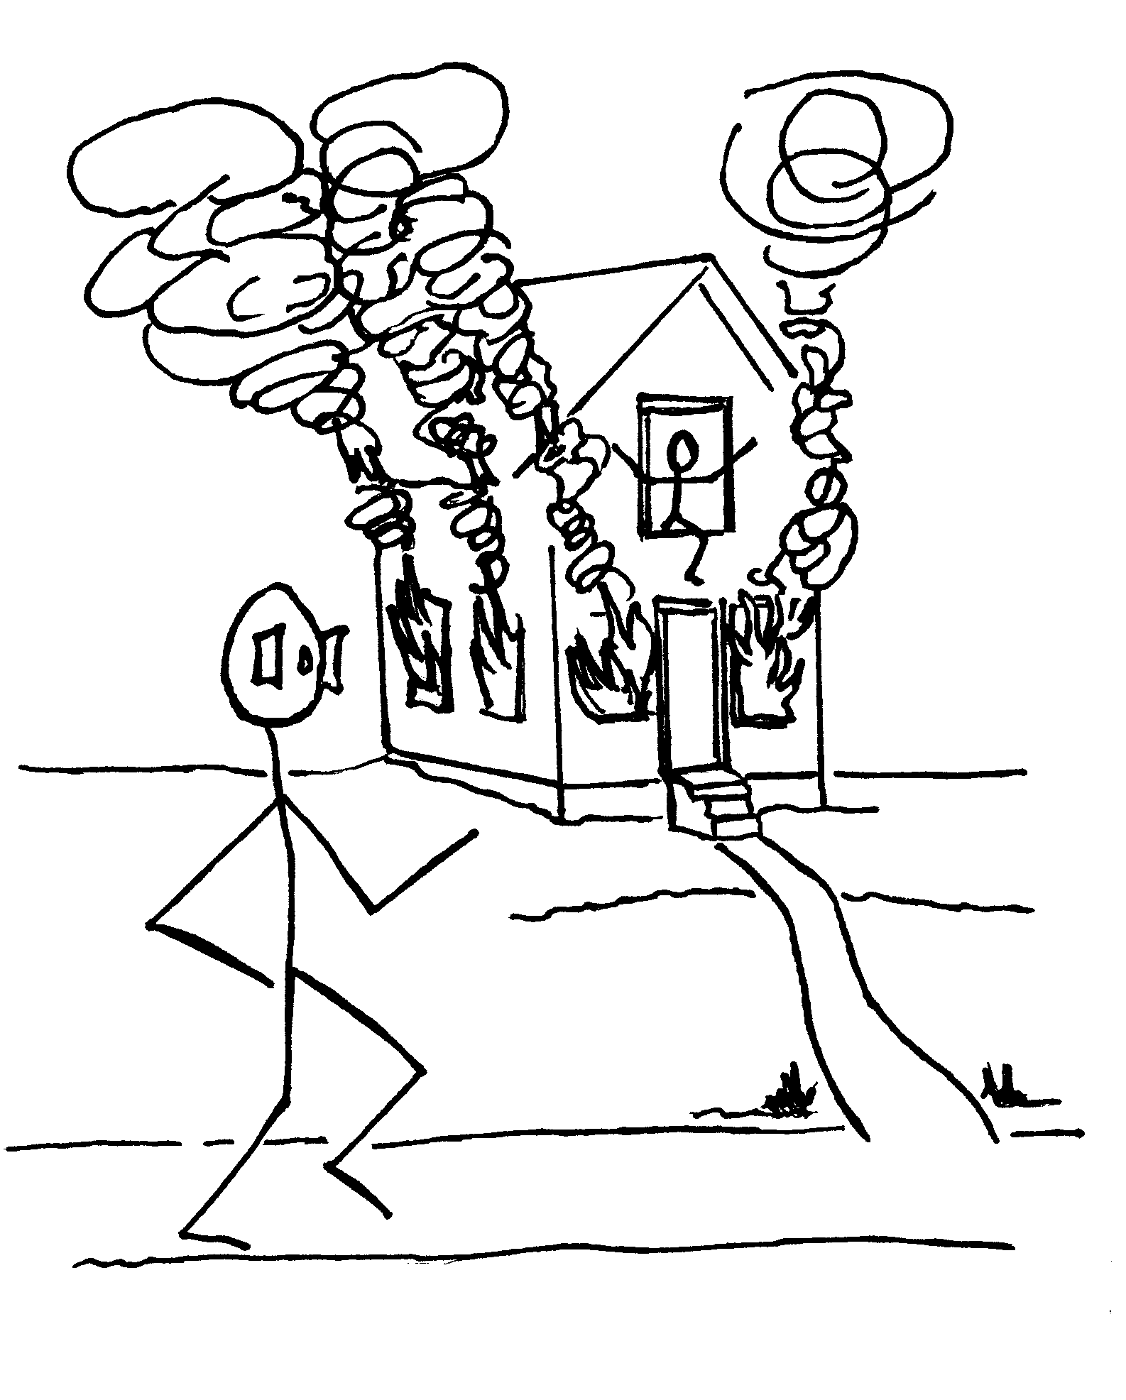
Various Types Of Vision
Peripheral Vision

Slide 16
Various Types Of Vision
Tunnel Vision

Slide 17
Various Types Of Vision
Panoramic Vision

Slide 18
Writing Your Vision
Vision Plan Includes:
Write Your Vision
What To do?
Why?
Where?
When?
With Whom?
Cost?
What will be the result?

Slide 19
Writing Your Vision
2. Master Plan- Basic Steps Required To Succeed.
Make Sure church understands vision
Recruit 2 people to help with regular activities of this ministry
With them choose a team of believers
As a team develop a plan detailing types of services and how to be administered
Create a list of resources: human, financial, location and spiritual
Create a budget showing potential costs.
Measure results every 6 months.

Slide 20
Progression Of Vision
Discovery Session

Slide 21
VISION
DISCOVERY SESSION
1.Ask each participant to write their vision on paper. Allow 15-20 minutes to accomplish this task.
1. Write about your dream or vision – You must first “see” in your mind’s eye what the finished product will look like. Write the vision in general terms with as much detail as you feel necessary. At times God gives a vision in a dream.
2. Make a master plan (or a blueprint) – This is where you develop a high level plan of the basic components.

Slide 22
VISION
DISCOVERY SESSION
2. After everyone has had time to write their vision, divide into small groups. Have each person read their vision to those in their group. This builds faith and accountability.
3. Close the session by reading several visions to the whole group.
Session Conclusion: Listen to the visions written by other participants. Prayerfully consider the vision given to you by God. You may want to write your God-given vision in your Bible.

Slide 23
vision
Contact: Info@Equippersgroup.org

