Slide 1
Purpose Of The Church
Facilitator’s Training Seminar
Session- 1

Slide 2
Purpose Of The Church
OVERVIEW
The heart of the Father, the mission of the Son, and the purpose of the church is clearly defined in this session. It points out that the church is to be God’s vehicle to all nations bringing His GOOD NEWS and freedom to His people. Specifically, this is accomplished through obedience to the Great Commission. (Matthew 28:18-20)
Time required to complete this session: 1 hour

Slide 3
Purpose Of The Church
GOALS OF THE SESSION
1. Purpose of the church is missions
2. Understand what is a “Great Commission” church
3. The church is God’s provision
Is your church a “Great Commission” church?
DISCOVERY SESSION AT END

Slide 4
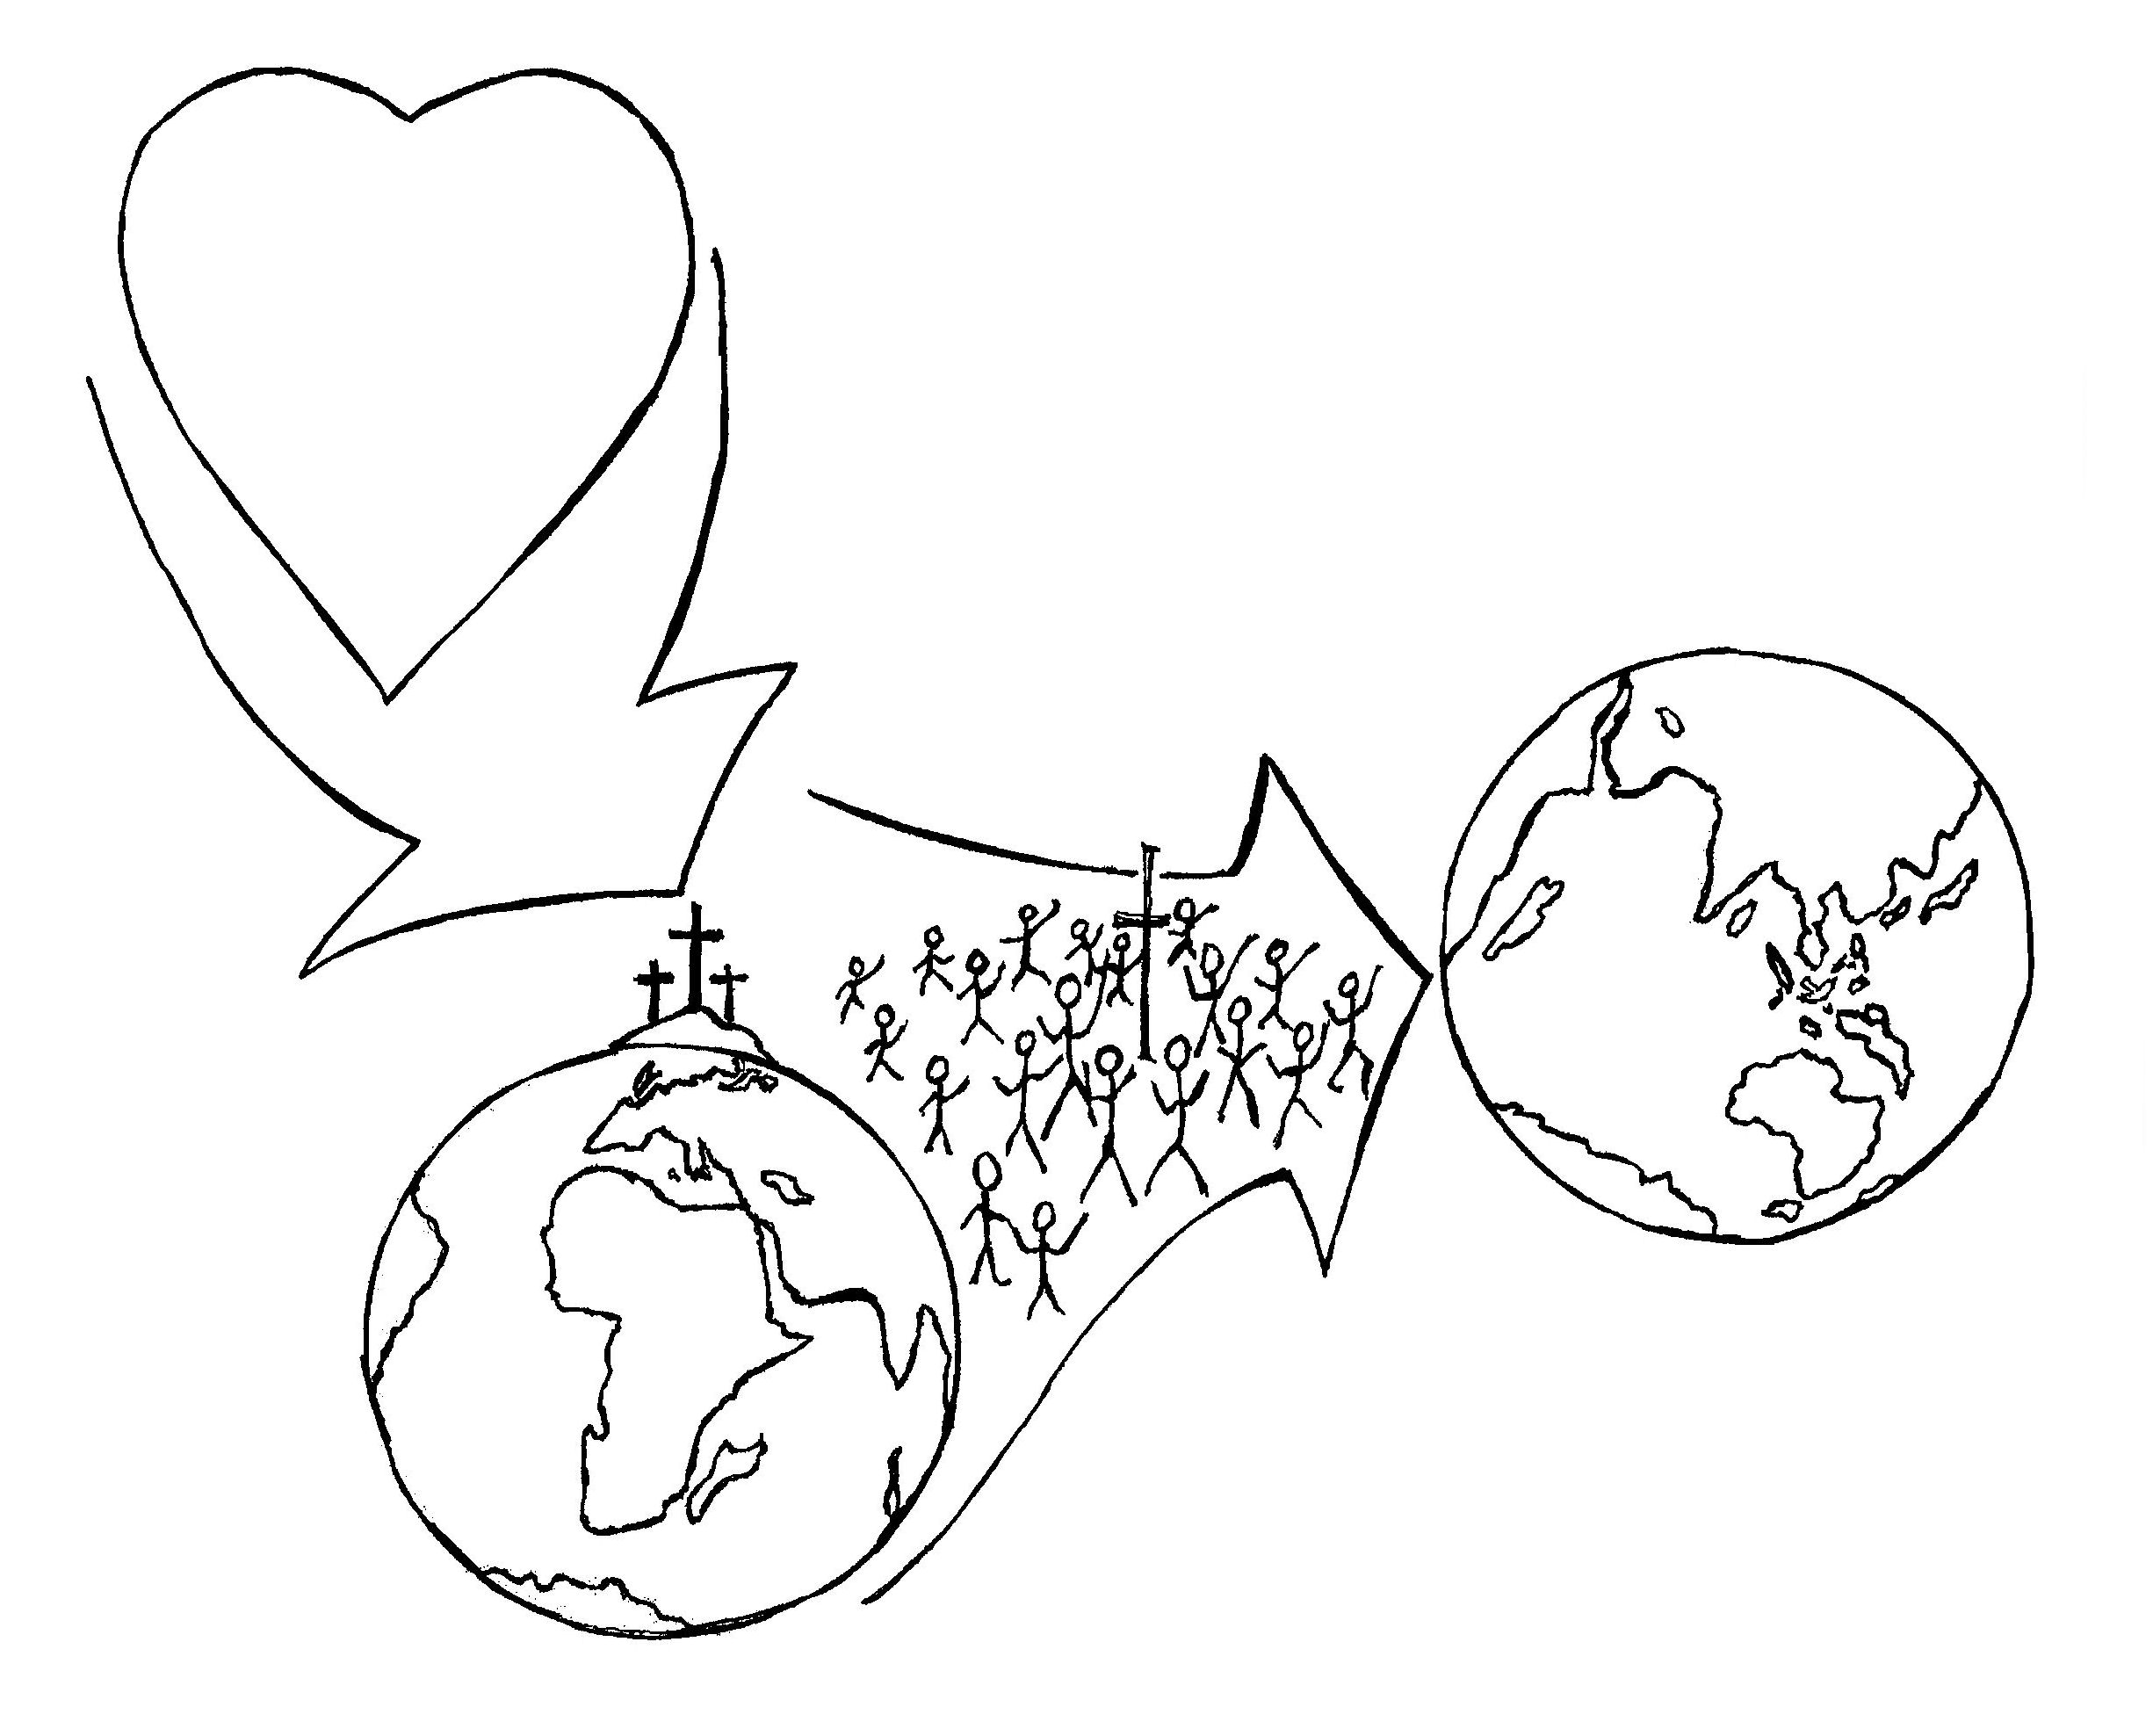
Purpose Of The Church
1. From God, the Father
(John 3:16)
From the Father
4. To the World
2. To The Son
3. Through the Church
Diagram 1:1

Slide 5
Purpose Of The Church
Purpose of the Church IS Missions
Every local church can and must become a training center regardless of size or economy.
[1 Peter 2:9-10; Matthew 28:16-20; Mark 16:15-18; 2 Corinthians 5:17-21]

Slide 6
Purpose Of The Church
God Desires The Church To Perform The Following FUNCTIONS:
The church is for the whole world. (Acts 1:8)
The church contains a separated people for His purposes and will. (Ephesians 1-2)
The Church is a royal priesthood of all believers reaching out to every person.(1 Peter 2:9)
The church is a demonstration of His love. (John 3:16)

Slide 7
Purpose Of The Church
The “Great Commission” Church
GOD WILL NOT DO IT WITHOUT YOU!
YOU CANNOT DO IT WITHOUT GOD!
GOD
YOU
Diagram 1:2

Slide 8
Purpose Of The Church
The “co-mission has Three Parts:
1. Declaration [Mt. 28:18]
2. Commandment [Mt.28:19-20]
3. Promise [Mt.28:20]
The “Great Commission”
is actually a “co-mission”
between God and You.

Slide 9
Purpose Of The Church
Yes No
□ □ Going
□ □ Preaching and Teaching
□ □ Making disciples
□ □ Baptizing
□ □ Healing the sick
The “Great Commission” Evaluation
Diagram 1:3

Slide 10
Purpose Of The Church
Your Church: What is your attitude in serving God?
Ask these Questions | What is your attitude?
1. What is your aim? | Is your goal pleasing to God? (2 Corinthians 5:9)
2. What is your vision? | Do you see the harvest? (John 4:34-38)
3. What are you praying? | Are you praying for God’s kingdom to come? Are you sending out workers into His harvest field? (Matthew 9:35-38)
4. What are you doing? | Are you committed to seeing God’s will be done?

Slide 11
Purpose Of The Church
A spiritual exercise program
Activities Of a Great Commission Church
Prayer (Matthew 6:8-13)
Study of God’s Word (2 Timothy 2:15)
Witnessing (Acts 1:8)
Winning (Romans 10:13-15 Discipling (Matthew 10:1-15)
Fellowship (Hebrews 10:25)
Interpersonal relationships (1 John 1:7, 3:23)

Slide 12
PURPOSE OF THE CHURCH
Discovery Session

Slide 13
Purpose Of The Church
DISCOVERY SESSION
Break into small groups of 5-7 people and discuss the following:
1. Read the Great Commission found in Matthew 28:18-20 and Mark 16:15-18. Discuss the significance of the Great Commission for church growth. Why did Jesus command His disciples to do the following?
> Go > Preach and teach > Baptize
> Make disciples > Heal the sick (body, soul and spirit)
2. Ask how many participants are already doing which of these commandments?

Slide 14
Purpose Of The Church
DISCOVERY SESSION
Session Conclusion: Is your church doing all five activities discussed previously? If your church is not doing them all, you must lead your church to change. Pray about whether your church should begin a “Spiritual Exercise” program.

Slide 15
PURPOSE Of the CHURCH
Contact: Info@Equippersgroup.org

