Slide 1




pioneer: biblical perspective
Lesson- 4

Slide 2
Pioneer: biblical perspective
OBJECTIVES OF THE LESSON
Understand that Christ is an example of a “pioneer”
Understand the importance of a Pioneer having vision
Understand Jesus’ sending of the disciples
Learn Christ’s message
Learn to become imitators of His Message
Activity Assignments at the end

Slide 3
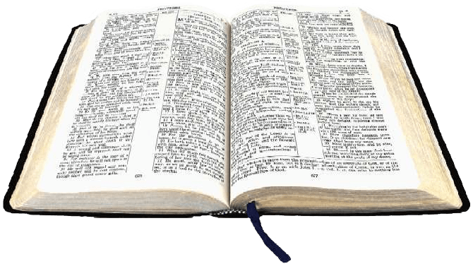

Pioneer: biblical perspective
KEY VERSE
Then Jesus came to them and said, “All authority in heaven and on earth has been given to me. Therefore go and make disciples of all nations, baptizing them in the name of the Father and of the Son and of the Holy Spirit, and teaching them to obey everything I have commanded you. And surely I am with you always, to the very end of the age.”
Matthew 28:18-20

Slide 4

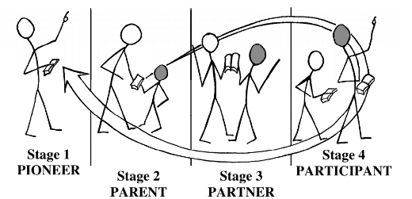
Pioneer: biblical perspective
As discussed in Lesson 2, the Great Commission explains the mission of the church. It is to go, make disciples of al nations, baptize them and teach them to obey God’s Word. The result is a new way of life. Remember, the church is a group of like-minded believers. Each believer, as a part of the church, has a role in this mission.
The Mission-Church Life Cycle explains how to accomplish the mission of the church through service by believers.

Slide 5
Pioneer: biblical perspective
Stage 1: Pioneer
The Pioneer Stage is the beginning of the Missions-Church Life Cycle. The Pioneer in one who tells others about Jesus, God and God’s Word. The definition of a pioneer is a person who “leads the way,” who “starts new growth,” and who “prepares.”
The primary person active in this stage is the Pioneer who acts as an evangelist, preaching and explaining God’s Word. Before a person can become a believer and be born again, they must first hear God’s Word. The Hoy Spirit will then work in their hearts so they can understand their need for the Savior, Jesus Christ. The Pioneer is sent out from a local church to an area that needs to hear about Christ. This person goes and begins to preach to non-believers. As new believers come to Christ, the Pioneer gathers them together to start teaching and discipling them. Together, they form a new church.

Slide 6
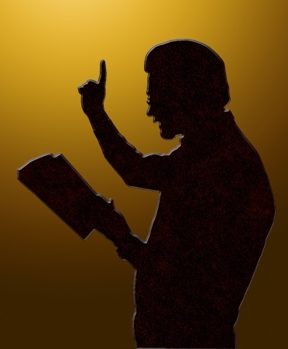
Pioneer: biblical perspective
Stage 1: Pioneer
The Pioneer Stage is the beginning efforts of planting a new church. Like a seed must be planted for a new plant to grow, the Pioneer must “plant the seed of God’s Word” for a new church to start to grow. The following ideas will be taught in this lesson.
A. Vision
B. Being Sent
C. Jesus’ mission and the church’s message
D. Method of preaching

Slide 7

Pioneer: biblical perspective
Stage 1: Pioneer (Vision)
Vision is critical to becoming an effective Pioneer. Just as an artist has a vision of how the painting will look even before it is begun, the Pioneer has a God-given vision to see new believers and plant a new church. Without vision, there is no goal for which to work.
What is vision?
Vision is the ability to anticipate possible future events and developments. God give vision to believers to help them accomplish the work He has for them to do (Joel 2:28, Acts 2:17). The Bible gives many examples of God speaking to a person through a vision or a dream. Some of these examples are:
Joseph (Gen. 37-41)
Ezekiel (Eze. 37:1-15)
Cornelius & Peter (Acts 10)
Jacob (Gen 46:1-4)
Ananias (Acts 9:10-16
Paul (Acts 16:6-10)

Slide 8

Pioneer: biblical perspective
Stage 1: Pioneer (Vision)
Testing a vision
When the Pioneer receives a vision from God for their life or church, they must first test the vision to make sure it fits with Scripture. The Bible is the baseline for Christian life. A God-given vision will not go against Biblical principles. If the vision you received from God is unclear, pray and ask the Holy Spirit for guidance in better understanding what God wants you to do. Search the Bible for examples of people who had a vision similar to the one God gave to you. Study how they implemented their vision and its outcome.

Slide 9


Pioneer: biblical perspective
Stage 1: Pioneer (Vision)
Four Steps of Vision
1. Vision
An effective leader seeks God’s vision, not their own. A Christian leader’s vision comes:
From God
From God’s Word
From a seen or heard need
2. Revision
Identifying the necessary tasks and making an action plan will sometimes change the original vision. When this happens, it becomes a “re-vision.” This revision might be a major change or a small change. Be open to God as He refines your vision over time.

Slide 10

Pioneer: biblical perspective
Stage 1: Pioneer (Vision)
Four Steps of Vision
3. Provision
God’s will and grace never leads a believer beyond His provision, care and sight (Phil. 4:13, 19). Provision has two parts: faith and focus.
Faith—the first part of provision is released when a believer begins to move in obedience to what God wants for them. Several examples of faith follow. See Hebrews 11 to learn more about other heroes of the faith.
Noah acted in faith when he built the ark
Abraham walked in faith. He chose to believe God, not his physical circumstances
God provided manna for the Israelites to each while in the wilderness
Focus—Focus your love and worship clearly on God, the provider, who is the giver of all good things. Look to God and not to people. Do not manipulate people to meet your needs. Trust God to meet your needs.

Slide 11

Pioneer: biblical perspective
Stage 1: Pioneer (Vision)
Four Steps of Vision
3. Supervision
“Super-vision” is the most critical stage of vision. It is harnessing resources to fulfill the God-given vision and bring it to completion. It is also the place where the greatest spiritual warfare takes place. Satan, the enemy of God, is in great opposition to God’s people working together in unity by the power of the Holy Spirit. Supervision used the power of God Almighty to do supernatural works. Effective supervision includes:
Communication of the vision—it is the leader’s job to communicate the vision effectively. To effectively accomplish the vision, each member of the team must become a vision partner, not just a worker. The team must accept ownership and responsibility for the results. There must be a high level of commitment to overcome problems and not be overcome by them.
Motivation—a vision partner’s motivation must come from a pure heart toward God. This prevents the enemy from coming in and robbing the reward of faithfulness and successful completion of the vision. Motivations will be tested along the journey.
Recruitment of fellow laborers—recruitment of vision team members begins with prayer. Jesus said to pray that the “Lord of the Harvest” would send forth laborers (Matt. 9:38). It is very important to build a team that has a united spirit to submit to God Almighty, the vision and to one another.
Commitment and submission to leadership—it is critical that each vision partner commit and submit to leadership. When this happens, there is great joy in completion of God’s task by His people. Without commitment and submission, nothing will be accomplished for the Kingdom of God.
Action—servants of God submit to Him and one another with a hear of a servant knowing that in God’s kingdom there are no lesser or greater persons. Your attitude is far more important to God than your actions. Your abilities come from Him anyway. He sees the motives of your heart.

Slide 12
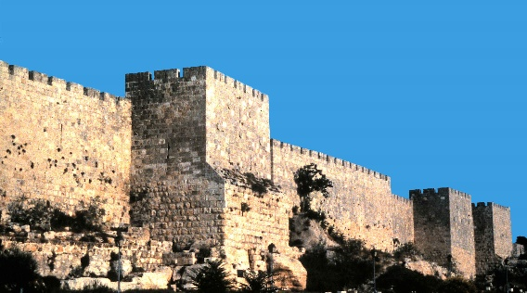
Pioneer: biblical perspective
Stage 1: Pioneer (Vision)
Example: Nehemiah—a man with a vision
Nehemiah is a good example of a man with a vision from God. Nehemiah demonstrates excellent leadership. He was spiritually ready to answer Gods’ call. He used careful planning, teamwork, problem solving and courage to ger the work done. He joined other workers and worked very hard. As you have time, read the book of Nehemiah. As you read this book, make a list of the leadership and organizational actions used by Nehemiah.
God gave Nehemiah a vision and burden not only to rebuild the walls, but also to rebuild the faith of the people. He accepted the vision given to him by God. However, he knew that he could accomplish this task only with God’ help. Nehemiah continued to pray and ask for God’s help during the entire time he was working in Jerusalem. He actually traveled to Jerusalem to oversee this geat task. Nehemiah risked his job and his life to accomplish the vision God gave him.
He communicated the vision to the volunteers who would be working with him before asking them to sacrifice their time and energy. He appealed to their sense of dignity, identity and responsibility in committing to accomplish the vision God gave them.
He organized the people into groups and assigned each group a particular section of the wall to repair. After encountering enemies who threatened them, Nehemiah divided the workers into two parts: one half was armed to protect the other half while they worked. He put in place a strategy among the people which included prayer, guard duty, hard work and encouragement for everyone. The wall were successfully rebuilt and completed in just 52 days.

Slide 13
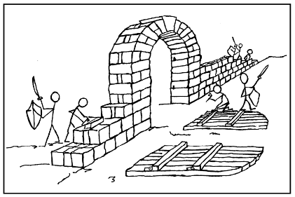
Pioneer: biblical perspective
Stage 1: Pioneer (Vision)
Diagram 4.1
Diagram 4.1 is about the wall—it is not about the workmen or the guards! The wall represents the vision given by God. Each person had a focused task to perform so that the vision could be accomplished. Each one concentrated on their own duty. The result was that, as a team, they quickly completed the wall.

Slide 14
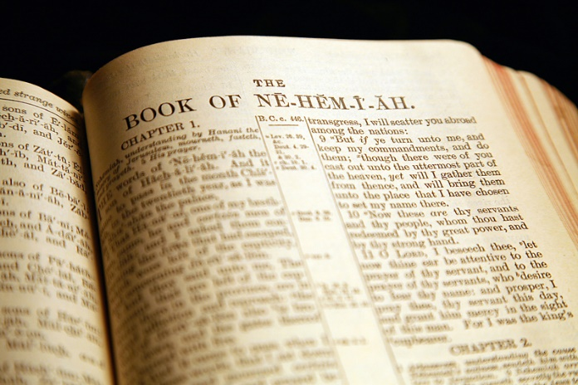
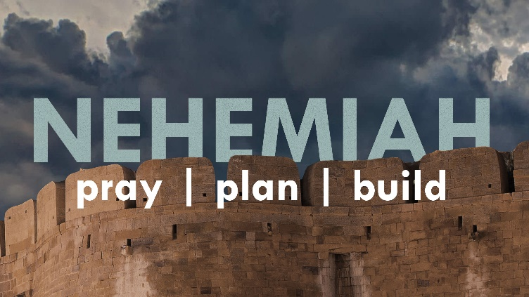
Pioneer: biblical perspective
Stage 1: Pioneer (Vision)
After rebuilding the walls, Nehemiah continued to organize the people. The vision required a change of heart—both of him and the workers. It also required commitment to complete the vision.
Change of heart—Nehemiah experienced a change of heart when he heard the sad news about the condition of Jerusalem. God gave Nehemiah a vision that would change the situation and the hearts of many people. God’s vision to accomplish His will and purpose will change your heart’s desire too. As you seek to obediently follow Him, He will change your desires.
Commitment to complete the vision—the rebuilding of the wall was only the beginning. The Israelites’ love of God was renewed by the reading of God’s Word. Likewise, God’s people today are renewed through study and reading of the Bible, God’s Word.
The result was a revival of God’s people. Because of Nehemiah’s organizational skills, they were able to serve God faithfully and obediently (Neh. 6:15-16). Table 4.1 shows some of the results of a successful completion of Nehemiah’s vision.

Slide 15
Pioneer: biblical perspective
Stage 1: Pioneer (Vision)
Table 4.1 Results of Nehemiah’s vision
1 | The work to accomplish the vision cost Nehemiah temporary time from his responsible and wealthy position with the king of Persia. (Neh. 2:1-9) Result: The Israelites rallied as a nation and began to rebuild the walls of Jerusalem (Neh. 2:18-3:32) | 5 | Nehemiah, Ezra and all the people confessed their sins. (Neh. 9-10) Result: They sought God’s forgiveness Their commitment to God was renewed
2 | This work brought intense opposition from powerful men. Result: They overcame threatened attacks by taking wise defense measures (Neh. 4) They overcame disunity among the Israelites by facing the problem and setting a good example (Neh. 5) They overcame false accusations by insight and courage (Neh. 6:1-14) | 6 | The city of Jerusalem was once again inhabited by the Israelites. (Neh. 11-12) Result: They organized and committed to regular worship The walls and gates were dedicated
3 | The walls rebuilt and the gates repaired in 52 days. The city was fully inhabited by the Israelites. (Neh. 6:15-16, 7:73) | 7 | Nehemiah continued to provide spiritual guidance for the people for many years. He provided fresh leadership to new opposition. (Neh. 13)
4 | Nehemiah arranged for Ezra, a prophet of God and scribe of Israel, to read the Law so the people could mold their lives by it. (Neh. 8:8-9)

Slide 16
Discipleship process
Stage 1: Pioneer (Being Sent)
Once a Pioneer receives God’s vision, they must then be sent out from a local church to accomplish and complete the God-given vision.
1. Christ is sent by the Father
For I have come down form heaven not to do my will but to do the will of him who sent me. (John 6:38)
There are many places in the Bible, especially in the book of John, that relate the fact that Jesus was sent by the Father. As time permits, look up the following verses in John 3:17, 4:34, :30, 7:16-18 and 8:29.

Slide 17
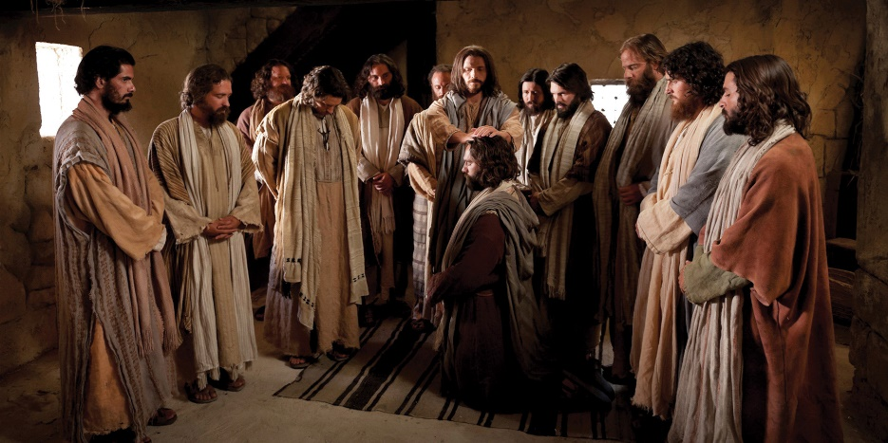
Discipleship process
Stage 1: Pioneer (Being Sent)
2. Disciples are sent
a. Sent by Jesus
Just as Jesus was sent by the Father, Jesus send His disciples today. Disciples are commanded to go to all nations, make disciples, baptize and teach as stated in Matthew 28:18-20.

Slide 18
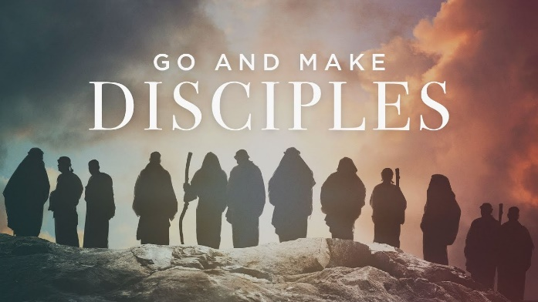
Discipleship process
Stage 1: Pioneer (Being Sent)
2. Disciples are sent
b. Sent by early churches
The early church leaders witnessed Jesus’ example of sending His disciples to tell about God. They followed His example. They commissioned mature believers and sent them to tell others about Jesus. These believers were sent to perform the following tasks:
Proclaim the Word of God—in obedience to the Holy Spirit they were sent to proclaim the Word in other cities and nations. (Acts 13:2-5)
To work an “assigned field”—Jesus extended the call of God to all mankind. Paul wrote about being “assigned to a field.” Paul’s field was the Gentile people. (2 Cor. 10:13) Other apostles were sent to the “field” of the Jewish people.
Apostle & Teacher—Paul said he was appointed to be a herald, an apostle and a teacher. (1 Tim. 2:7) A herald is “one who makes formal public announcements in the name of a king.” Paul was heralding the good news of his king, Jesus.
Witness to the whole world—believers in the early church received power of the Holy Spirit to use in witnessing. (Acts 1:8) After the Holy Spirit came to them, they were able to effectively witness to the whole world about Jesus.

Slide 19
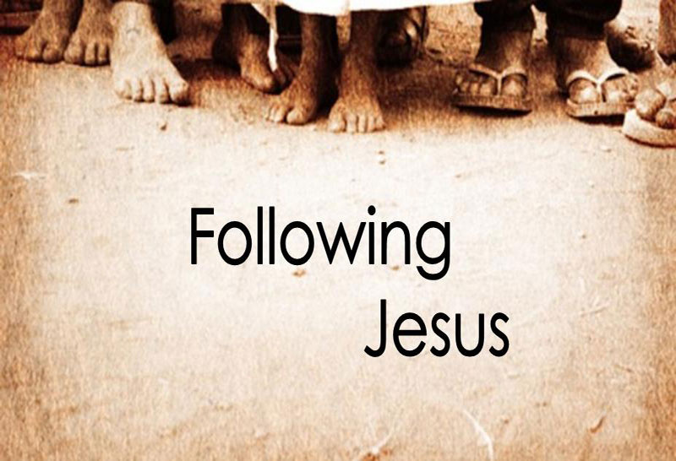
Discipleship process
Stage 1: Pioneer (Jesus’ mission and the church’s message)
1. Jesus’ mission
For the Son of Man came to seek and to save what was lost. (Luke 19:10)
Sin separates people from God. Jesus came to restore the relationship between God and mankind. His mission was to make it possible to mankind to return to God the Father by having their sin cleansed and forgiven. The following list shows aspects of Jesus’ mission.
Example and pattern for life (1 John 2:6, Rom. 8:29, 2 Cor. 3:18, 1 Pet. 2:21)
Light for people in darkness (John 12:46-47)
Call sinners to repentance (Luke 5:32, Matt. 9:13, 4:17, Mark 2:17)
Seek and save lost (Luke 19:10, 1 Tim. 1:15)
Fulfill law and prophets (Matt. 5:17)
Serve and give His life as ransom (Matt. 20:28, Mark 10:45, 1 Pet. 2:24)
Preach the good news (Luke 4:43)
Give new birth/eternal life (John 10:10, 3:16, 10:28, 17:2, 1 John 5:11-12)
Savior of the world (John 3:17, 1 Tim. 1:15)
Mediator between God and man (1 Tim. 2:5, John 17:20-21, Heb. 7:25)
Reconcile people to fellowship with God (Eph. 2:14-18, 1 John 1:3)
Destroy the power of death (Heb. 2:14-15 and John 11:38-45)

Slide 20
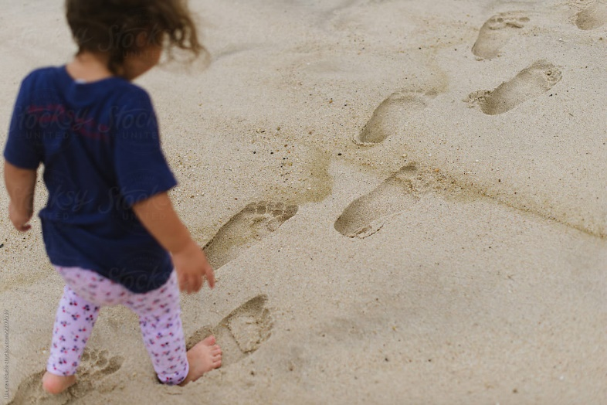
Discipleship process
Stage 1: Pioneer (Jesus’ mission and the church’s message)
2. Disciples Mission
Jesus taught His disciples what to do and what to say. Then, it was their task to do what He showed them and taught them. A disciple today must also follow the pattern and example of Jesus because He still works through His disciples. It is the same for His disciples today as it was for His disciples 2,000 years ago.

Slide 21
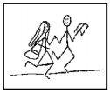
Discipleship process
Stage 1: Pioneer (Jesus’ mission and the church’s message)
3. Jesus Christ is the message
A Pioneer who commissioned and sent out by a local church must proclaim the message taught by Christ. Jesus came to call mankind back to God. Jesus said that he was the way, the truth and the life. The only way to know the Father is through Jesus, the Son. (John 14:6)
Always remember that Jesus calls His disciples to Himself. The work of the believers in the church is to call others to Jesus, not to themselves, a denomination of a church group.

Slide 22
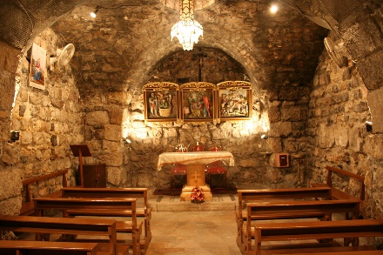
Discipleship process
Stage 1: Pioneer (Jesus’ mission and the church’s message)
4. The early church’s mission and message
Disciples in the early church followed Jesus’ example and command. They went first to Judea, then to Samaria, then to the entire world proclaiming the Good News about Jesus. (Acts 1:8) The gospel they proclaimed included the death, burial and resurrection of Jesus, the Messiah and Lord. People were urged to repent, believe in Christ and be baptized.
Peter replied, “Repent and be baptized, every one of you, in the name
of Jesus Christ for the forgiveness of your sins. And you will receive the
gift of the Holy Spirit. The promise is for you and your children and for all
who are far off—for all whom the Lord our God will call.” (Acts 2:38-39)

Slide 23
Pioneer: biblical perspective
Stage 1: Pioneer (Method: teach and preach about Jesus)
Table 4.2 Early Church preached to everyone
To large groups—the first and second gospel messages were delivered by Peter. The results were that 5,000 believers were added. (Acts 2:14-41 and 3:11-4:4)
To households—Peter preached to Cornelius and his household. All believed. They were some of the first Gentiles to believe. (Acts 10)
During persecution—Peter and John preached to the Jewish leaders. Because of this, they were put in jail and persecuted. (Acts 4:1-22)
One-on-one—Philip was instructed by an angel of the Lord to travel to Gaza on a certain road. He met an Ethopian who was seeking to know God. Philip told him about Jesus. The Ethiopian believed. (Acts 8: 26-39)
Everywhere they went—the apostles and disciples preached about Jesus wherever they found themselves. (Acts 8: 4-8, 11:19-21)
To everyone—the Gospel is to be preached to everyone. (Rom. 1:14-15)
Where Christ has never been preached—Paul, an apostle, preached Christ to those who had not heard. (Rom. 15:20)
Become all things to all men—Paul said this so that by all possible means he might take the opportunity to preach about Jesus so that people would believe. (1 Cor. 9:19-23)
With zeal and boldness—the apostles and believers continued to preach the gospel even when it became dangerous and illegal. (Acts 5:17-42)

Slide 24
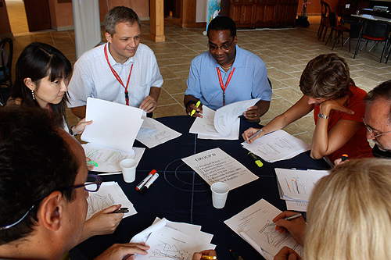
Pioneer: biblical perspective
Activity
Assignments

Slide 25
Pioneer: biblical perspective
CLASS ACTIVITY
Read about Barnabas and Saul (later known as Paul) in Acts 13. Discuss the following question:
Whom did the church at Antioch send out to preach?
What did Barnabas and Saul preach?
To whom did they preach?
What was the “sending out” process given in Acts 13:1-3?
Is this process taking place in your church?
Why is it important that the Pioneer, who is going out to preach, demonstrate the character and person of Christ? What did Jesus do when He saw the multitude.

Slide 26

Pioneer: biblical perspective
PERSONAL ACTIVITY
Read Romans in preparation for Lesson 5

Slide 27
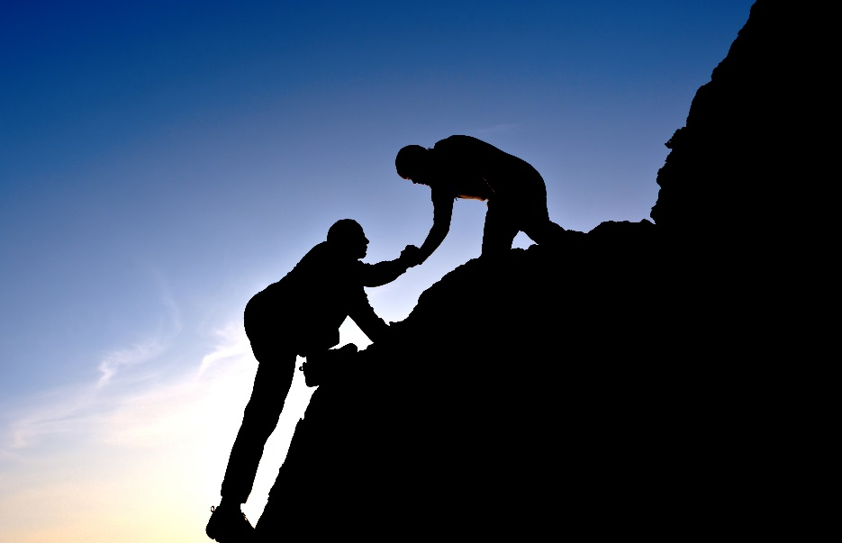
Pioneer: biblical perspective
DISCIPLESHIP ACTIVITY
Who discipled you?
Who is your disciple?

Slide 28

Pioneer: biblical perspective
Contact: Info@Equippersgroup.org

