Slide 1




The Church: The New Covenant with god
Lesson- 2

Slide 2
The church: The New covenant with god
OBJECTIVES OF THE LESSON
1. Learn about the church
2. Understand all believers have a role in the church
Learn the importance of mobilizing the church
Understand the role of leaders and the role of believers
Learn about the Great Commission
Activity Assignments at the end

Slide 3
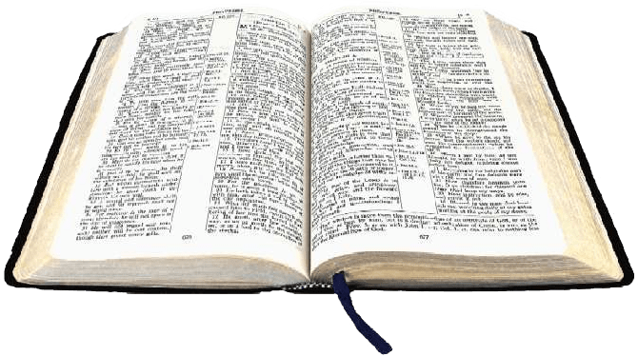

The church: The New covenant with god
KEY VERSE
And God placed all things under his feet and appointed him to be head over everything for the church, which is his body, the fullness of him who fills everything in every way.
Ephesians 1:22-23

Slide 4
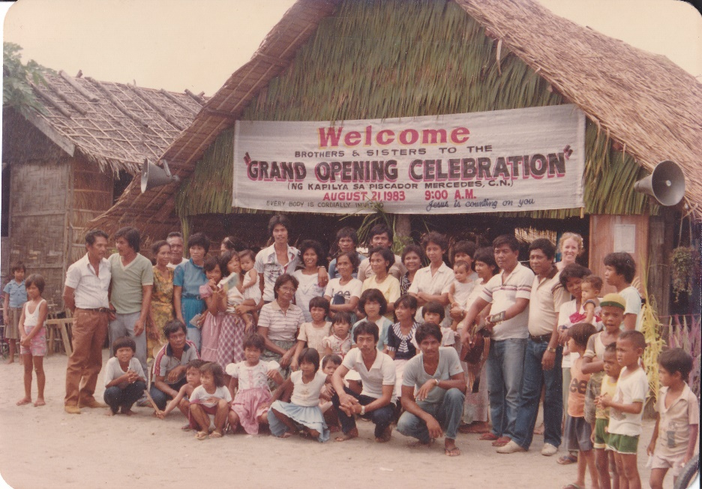
The church: The New covenant with god
What is the church?
Church—ones who are called out or separated from
The “church” is the community of believers in Jesus who are joined together into one body by the Holy Spirit. This is like an invisible living body composed of all believers from all nations, cultures and generations. The church is not a building…it is the people (Ephesians 2:19-21).

Slide 5
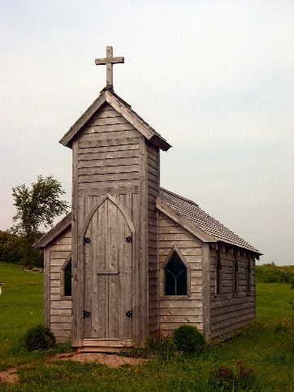
The church: The New covenant with god
What is the church?
This lesson will teach about the whole (universal) church, designated “church,” and the local church, designated “local church.”
The Bible uses several names* for the “church.”
The church of God (1 Cor. 1:2, 2 Cor. 1:1)
The church of the living God (1 Tim. 3:15)
The church of the firstborn (Heb. 12:23)
The churches of Christ (Rom. 16:16)
*These are general terms not references to specific names of local churches, although some may use these names.

Slide 6
The church: The New covenant with god
Relationship of the church to Jesus
The Bible uses illustrations (word pictures) to describe the church and its relationship with Jesus.
Table 2.1 Illustration of the church in relation to Jesus
Church | Jesus
A flock | Good Shepherd—watches over the sheep (believers) and is known by them. They follow Him. He gave His life for the sheep. (John 10:1-18)
Branches | True Vine—the Father is the gardener who trim the branches that grow fruit because of the vine (Jesus). (John 15:1-8)
A bride | Bridegroom—Jesus loves the church like a husband loves his wife. He gave Himself to make her clean, holy and blameless—a radiant bride. (Eph. 5:25-30, Rev. 19:7)
A building | Chief Cornerstone—Jesus is the main building block upon which the church (believers) are being built. (Eph. 2:19-22, 1 Pet. 2:4-8)
A living body | Head of the body—Jesus leads the church and designates roles of ministry (apostles, prophets, evangelists, pastors, and teachers) to believers so they can perform works of service to God and mankind. (1 Cor. 12:12-31, Eph. 1:22-23, 4:11-16, Col. 1:18, 2:19)

Slide 7
The church: The New covenant with god
Becoming part of the church
Each believer becomes a member of the church from the moment of belief and commitment of their life to Jesus. Believers are given many names in the Bible.
Saints (2 Cor. 13:13, Phil. 1:1, 4:21-22)
Brothers/Sisters (Rom. 10:1, Jam. 1:2, 2 Pet. 1:10)
Christians (Acts 11:26, 26:28, 1 Pet. 4:16)
Believers (1 Tim. 4:12)
Disciples (Matt. 10:42)
Chosen People (1 Pet. 2:9, Rev. 17:14)
Royal Priesthood (1 Pet. 2:5, 9)
Holy Nation (1 Pet. 2:9)
Ambassadors (2 Cor. 5:20)
Workmen (Matt. 9:37-38, 2 Tim. 2:15)

Slide 8
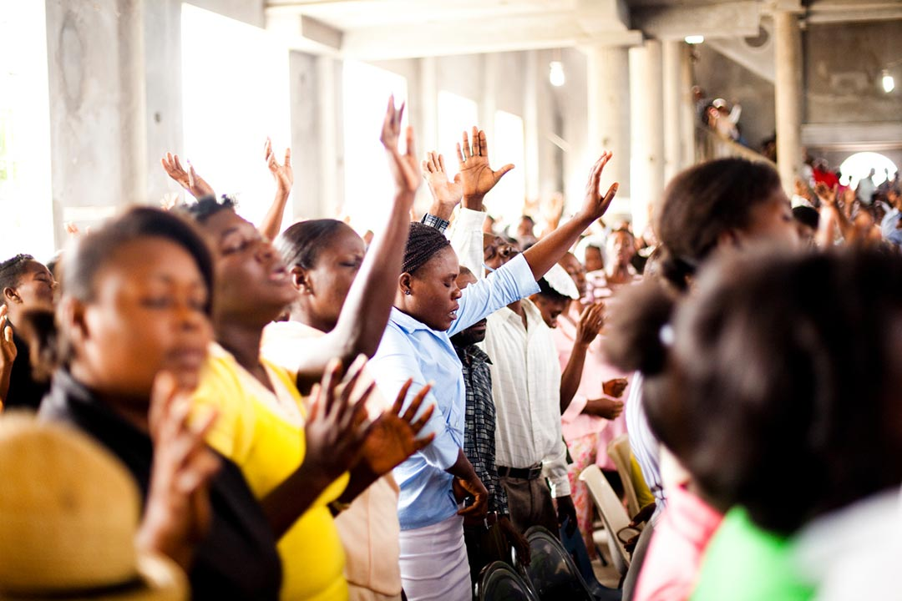
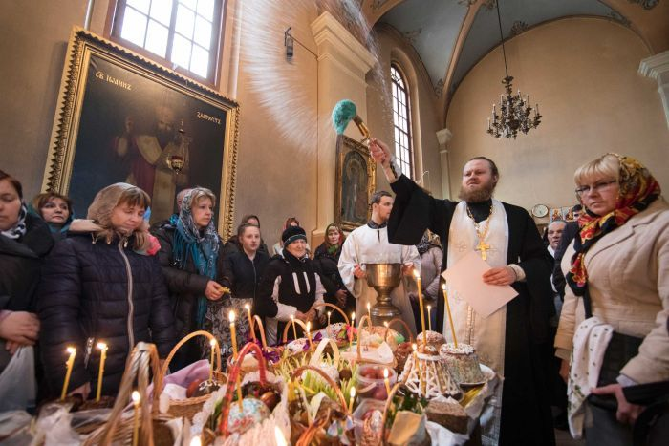
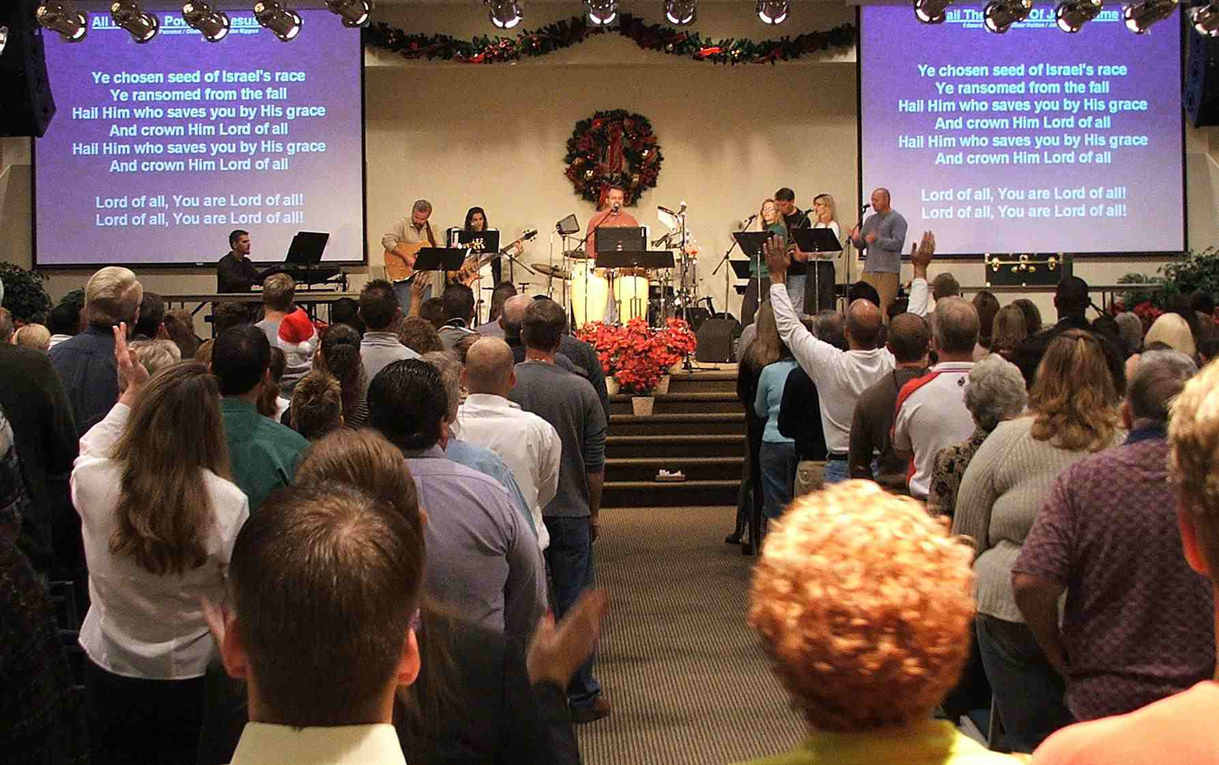
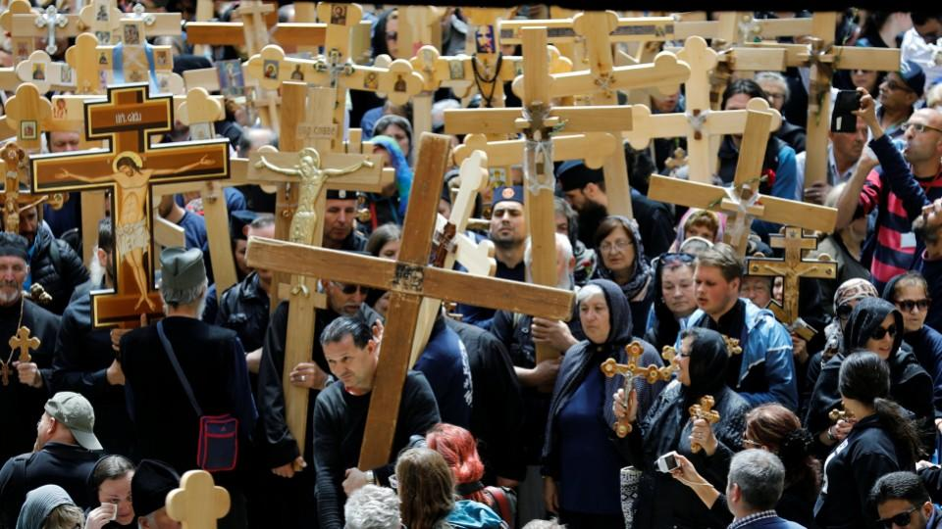
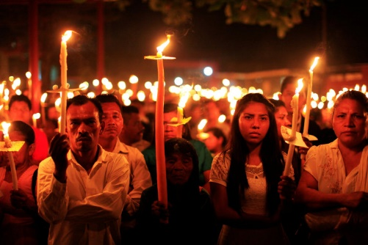
The church: The New covenant with god
The church: universal
God’s people—whether they looked forward to the cross and trusted in the Messiah of looked back to the cross and trusted in Jesus Christ as Savior—are all part of the universal church.

Slide 9
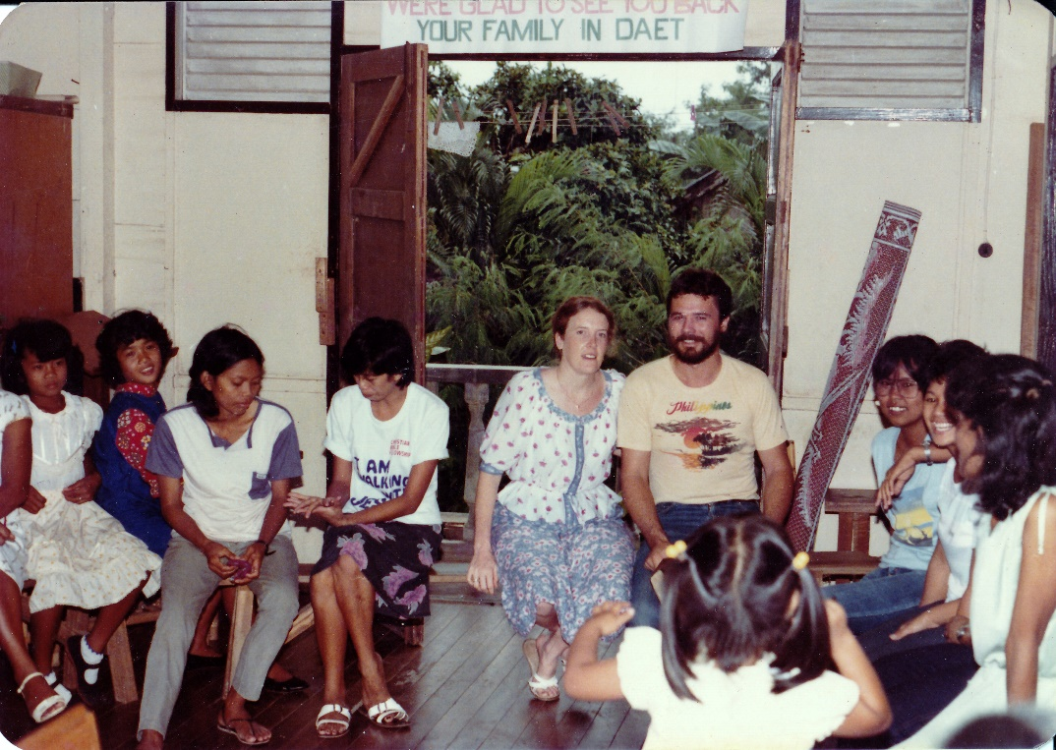
The church: The New covenant with god
The church: local
The local church is a group of believers that meet together regularly in a community with local leadership.

Slide 10
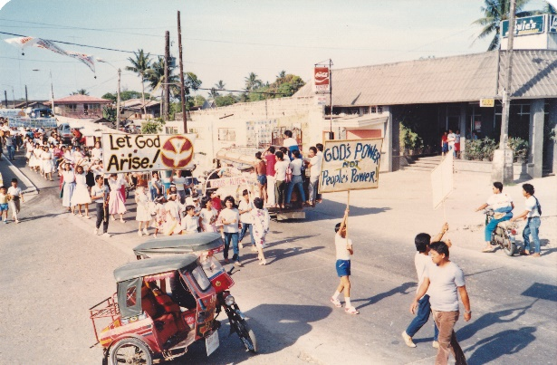
The church: The New covenant with god
The church: missions
The purpose of the local church is to accomplish God’s mission by distributing the truth of God’s Word to all people in the world—believers and non-believers. “Mission” refers to fulfilling God’s World to mankind so that His message of salvation goes out to all people in all nations. This is accomplished when believers make themselves available to be used in God’s plan to minister to the spiritual condition of all people.
Read Eph. 3:10, Acts 20:20-21, 1 Tim. 3:14-15, 2 Tim. 4:1-14

Slide 11

The church: The New covenant with god
The church: missions
The purpose and mission of the church is extensive: It covers all relationships which include ministry to God, ministry to other believers and ministry to people of the world.
“Missions” is not just a committee.
“Missions” is not just a program.
“MISSIONS” IS THE PURPOSE OF THE CHURCH.

Slide 12
The church: The New covenant with god
The church: mobilization of the church
The local church operates like a human body. Each member does their part—just as each part of the human body has a specific task—to make the whole complete. The church is to be self-governing, self-reproducing and self-financing.
Read Ephesians 4 and 1 Corinthians 12
Roles of Service
Ephesians 4:11-16
Diagram 2.1
Mobilization of the Church
For Works of Service
Romans 12:6-8
--Apostles
--Prophets
--Evangelists
--Pastors
--Teachers
To Prepare God’s People
Note: Additional works of service are given in 1 Corinthians 12:1-11

Slide 13
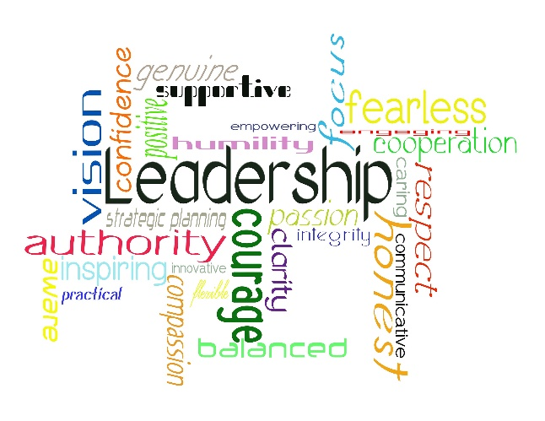
The church: The New covenant with god
The church: mobilization of the church
There are five roles of service for leadership in the church; apostles, prophets, evangelists, pastors and teachers. These leaders are responsible to prepare God’s people so they can do works of service for God (Rom. 12:6-8). Effective preparation produces the following results:
God’s people are prepared (equipped) to do works of service for one another and the world
Believers reach unity in their faith and knowledge of God and His son, Jesus
The church (body of Christ) is built up
Believers mature in their faith and Christian walk

Slide 14
The church: The New covenant with god
The church: reasons local churches fail to grow
To find the keys and solutions to growth, one must first identify the obstacles. Use this list as a caution in your work of leadership in the church.
Read James 4:1-10 to see how the Holy Spirit helps leaders in the church
Lack of prayer
Immaturity
Poor leadership
Lack of delegation
No ministry
No vision
Not equipped to understand the church’s purpose
Faith without works
Disunity
Lack of obedience to Christ and His word
Procrastination
Poor personal testimony of leadership
Inappropriate giving and tithing
Busy building individual personal kingdoms with no time to build God’s kingdom

Slide 15

The church: The New covenant with god
Leadership in the local church
Role of a leader
Ephesians 4:11-16 explains that the role of leaders in the local church is to prepare and equip God’s people to do works of service—for other believers and the community. Believers are mobilized to serve God in the way they are uniquely called to do, and this is how the church grows and matures. The church is guided by its leaders to fulfill the purpose and will of God.
For a church to function properly both believers and leaders must understand their roles and work together. One person, or even a few, cannot do everything. Each person must find their role and perform it for the church to be successful.

Slide 16
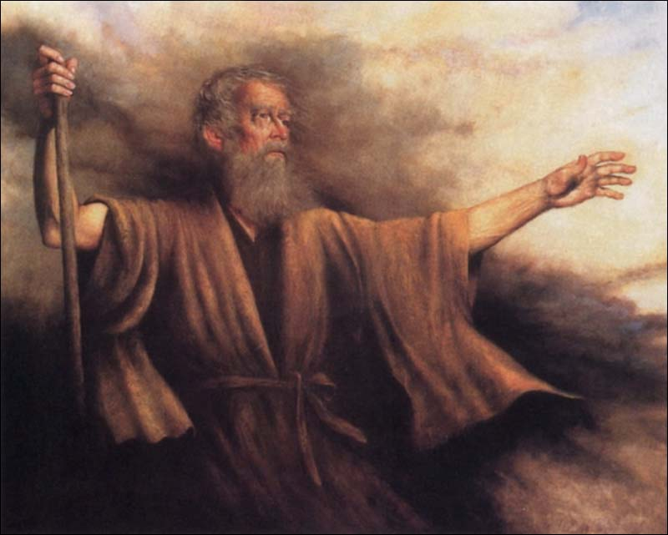
The church: The New covenant with god
Leadership in the local church
Leadership example: Moses
Moses is an example of a leader chosen by God who initially failed to provide effective leadership for God’s people. By trying to do everything himself, Moses quickly became frustrated, tired and ineffective. He was faced with the following problems:
The responsibility for the people of God was too great
His leadership style was not getting the job done
The people were discouraged and complained
The leaders of the tribes were complaining
God was angry
Moses was wearing out himself and the people
God used Jethro, Moses’ father-in-law, to bring a solution to this leadership crisis. Moses followed his advice and chose qualified men from each tribe to judge minor disputes while he continued to judge major issues. These leaders helped him bear the load. The result was meeting the needs of the people.
Read Exodus 18:13-26

Slide 17
The church: The New covenant with god
Leadership in the local church
Danger Signs
Some danger sign (problems) are seen in local churches which result from lack of effective leadership or rebellious and disobedient attitudes of believers. Leadership is responsible to correct these problems. Here is a list of possible danger signs.
Table 2.2 Danger sign of ineffective leadership
Believers’ attitude | Cause of the problem
Do not like where they are or how they got there | Leaders may have failed to effectively share or communicate their vision
 | Believers may not have been faithful to attend meetings or listen and seek God regarding their role
Are apathetic, uncommitted, undecided | Leaders may have failed to teach God’s Word effectively
 | Believers may not be reading God’s Word or seeking to follow His direction
Do not know what to do, how to do it, or why it should be done | Leaders failed to communicate/teach effectively
 | Believers may not be listening to the Holy Spirit or their leaders
Do not like criticism—even constructive criticism | Leaders may have failed to teach about teamwork and unity
 | Believers may be prideful and not open to God’s discipline
Do not accept responsibility for tasks that need to be done | Leaders may have failed to teach about the local church, its parts and their functions
 | Believers may not be obedient to the leading of the Holy Spirit or their leaders
Blame others for all of the problems/difficulties | Leaders may have failed to teach about responsibility and the trials of life
 | Believers may have failed to trust God to handle difficulties

Slide 18

The church: The New covenant with god
Leadership in the local church
Role of Believers
What is the role of believers in the local church?
Believers are God’s instruments who minister to one another and to God
Believers are to tell people in their community about Jesus
Believers are commissioned to tell all people on earth about God’s plan for mankind since the beginning of creation
Believers are to be a blessing to all people on earth
Believers are to work with local church leadership to accomplish the purposes and will of God

Slide 19
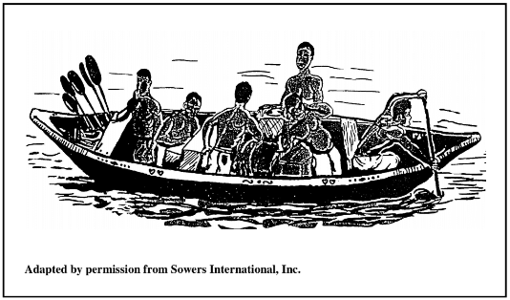
The church: The New covenant with god
Leadership in the local church
Role of Believers
A local church is successful when operating as a team. Study the following picture. The people in the boat represent a church. Does this picture represent a successful church or an ineffective church?
Diagram 2.2

Slide 20
The church: The New covenant with god
Leadership in the local church
Role of Believers
Consider the following questions.
Diagram 2.2
Who is doing ALL of the work?
Why are most of the oars not being used?
Are the people in the church working or playing?
Are the purposes of God being fulfilled in this church?
Do you think this church is making much progress?

Slide 21
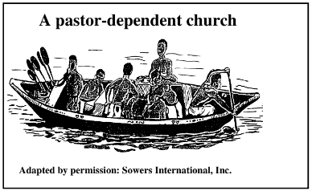
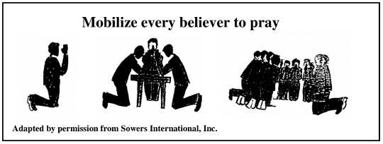
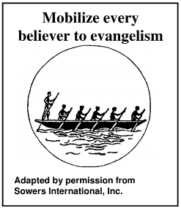
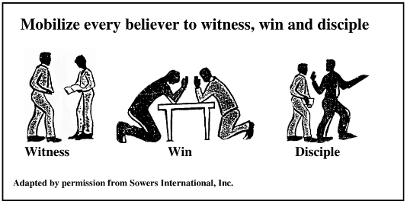
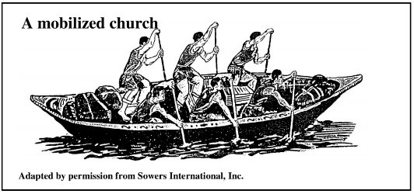
The church: The New covenant with god
Mobilizing the church
The previous diagram shows a common problem in local churches today—lack of effective leadership. The following diagrams will illustrate the way to overcome this problem through prayer, discipleship, evangelism, training and equipping to mobilize the church.

Slide 22
The church: The New covenant with god
Mobilizing the church
Diagram 2.3
THE PROBLEM: A pastor dependent church IS NOT an effective model of leadership.
It makes little progress because leadership is afraid to, or will not, delegate responsibility. There is not enough training to teach believers how to do “good works” of service. In this scenario the paster is most likely the only one with the oar.
The greatest strength and resource of a church is its people. If people are not trained and equipped properly the result can be frustration, laziness, judgement, complaint and criticism. This is not healthy. Prayer is one of the first things required for change.

Slide 23
The church: The New covenant with god
Mobilizing the church
Diagram 2.4
A good leader will mobilize every believer to pray.
Prayer changes the heart of the person praying.
Individual believers should pray. Prayer helps the individual believer to have a stronger relationship with God. It improves their understanding of who God is and who they are.
Believers should pray in small groups.
Believers should pray as a collective body.
Once believers are mobilized to pray, the Holy Spirit begins to enable supernatural results through His power. God wants His people to have unity in mind and purpose so they can demonstrate His purpose, power and will.

Slide 24
The church: The New covenant with god
Mobilizing the church
Diagram 2.5
Mobilize every believer to witness, win and disciple.
Church growth begins by equipping and training believers whom God has currently entrusted to you. Once believers are trained to witness, win and disciple others, the church will grow. Through discipleship, believers help maintain and keep the church growing.

Slide 25
The church: The New covenant with god
Mobilizing the church
Diagram 2.6
Evangelism is the task of the whole church.
Evangelism is the responsibility of every believer, not just the responsibility of an evangelist. “Evangelism” means to have a great enthusiasm and zeal to share about Jesus and His church. Each believer is to talk with others about Jesus. Each believer is told to be God’s witness (Acts 1:8, 2 Timothy 1:8). Jesus continually declared the Good News to everyone wherever He went. So did his disciples. Therefore believers, His disciples today, are to do the same-proclaim the Good News of Jesus.
When every believer contributes their talents and services to accomplish the vision God has given the leadership of their church, all parts of the church (leaders and believers) have fulfillment and satisfaction.

Slide 26
The church: The New covenant with god
Mobilizing the church
Diagram 2.7
A mobilized church is everyone working together—each one doing their part.
Each part can rejoice with what God is doing in their church. Leadership is still setting the direction. They arrive at their destination quickly and with great rejoicing because everyone under their authority is trained and equipped.
A mobilized church makes rapid progress because everyone has a function and a role within the church.

Slide 27
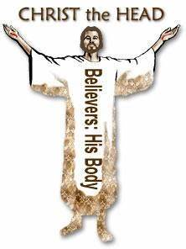
The church: The New covenant with god
Jesus—builder of His church
Jesus Christ is the head of the church. He is the foundation, the master planner and
the master builder of the church. He is the Alpha (beginning) and Omega (end).
The universal church, worldwide body of believers, have all been called out of sin and darkness and into His light. His way includes everyone who receives Jesus.
Each member has a purpose. There are differing responsibilities, but everyone is significant and vital to the whole.
Under the old covenant, only the nation of Israel was God’s select people. Under the new covenant, all people can enter and become God’s people. Believers are a royal priesthood and a holy nation.
The church is Almighty God’s plan and purpose. The church is to become a great nation, just like Abraham, by encouraging worship, obedience and service to God.
There is no wiser leader or greater builder than Jesus, the Creator of heaven and earth. Jesus has given commands, examples of leadership and qualifications for leaders in His holy church. God’s people are to be a demonstration of his love to the world.

Slide 28
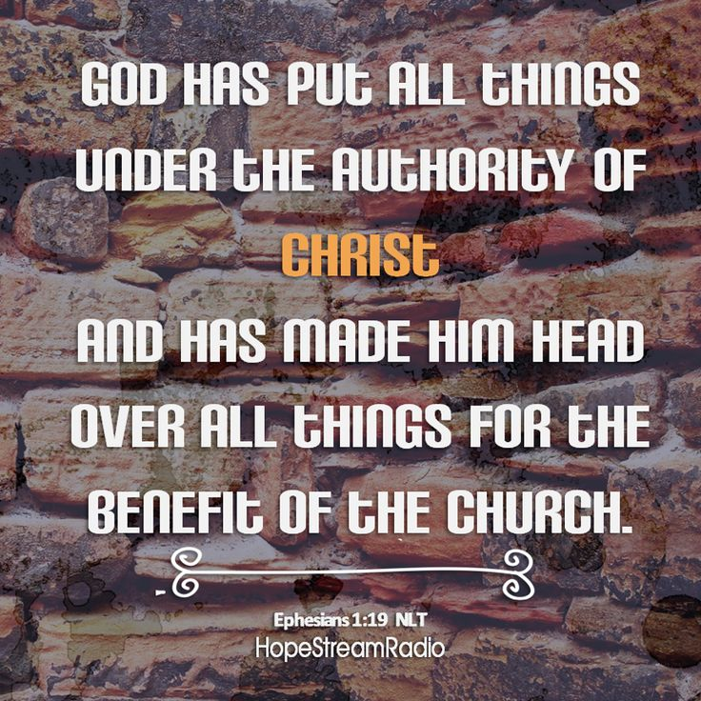
The church: The New covenant with god
Jesus—builder of His church
Table 2.3 Jesus—leader and builder of His church
1. The builder of the church | Matthew 16:16
2. Add to the church | Acts 2:47
3. Grows the church | 1 Corinthians 3:7-8
4. People vs. the building | 1 Peter 2:4-12
5. Membership/spiritual birth | 1 Peter 1:22-25
6. Living stones/chosen people | 1 Peter 2:1-10
7. Order/submission | 1 Peter 2:13-15
8. Leadership | 1 Peter 5:1-4
9. Guides church into truth | John 16:13
10. Empowers the church | Acts 1:8

Slide 29





The church: The New covenant with god
Jesus—builder of His church
Diagram 2.8
EVANGELISM
1. From God, the Father
John 3:16
4. To the World
2. To the Son
3. Through the church

Slide 30
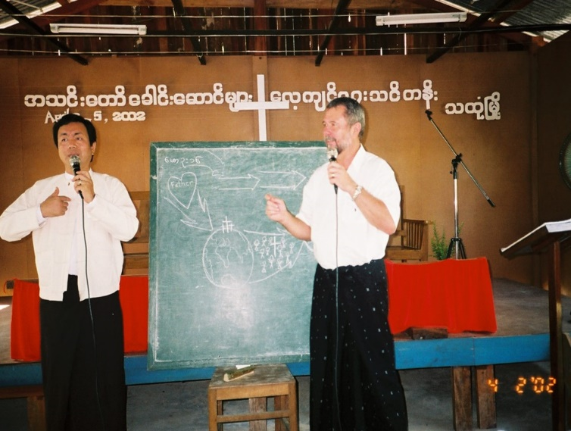
The church: The New covenant with god
Jesus—builder of His church
From God, the Father—the heart of God has not changed throughout the ages. God’s mission has always been to restore mankind’s relationship to Him and use believers to establish the Kingdom of God. John 3:16
To the Son (Jesus)—the mission of Jesus is to redeem mankind and form a kingdom of priests (the church) that demonstrates and proclaims His Good News. Luke 1:67-79
Through the church (God’s people)—the church is God’s vehicle to reach out to a world that does not know Him. All believers are priests who are called to worship in spirit and truth and to obey what Jesus said: Go, and make disciples. 1 Peter 2:9-10, John 4:24, Matt. 28:18-20, Mark 16: 15-18
To the world—the church’s mission is to make disciples and equip them for God’s service. They are to reach out to the world telling people about God and His way to
salvation. 2 Peter 3:9, 1 Timothy 2:3-6, 2 Corinthians 5:17, John 20:21,
Acts 1:8, 1 Corinthians 9:16-18

Slide 31
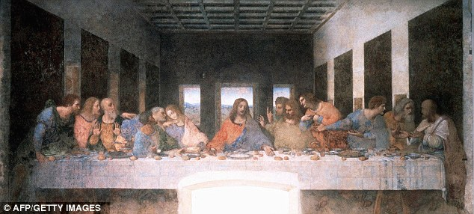
The church: The New covenant with god
The Great Commission
The final words someone says to a loved one before their departure are very important. Jesus’ last words to His followers are the commands called the “Great Commission.” It is recorded in Scripture two times: Matt. 28:18-20 and Mark 16:15-18. Remember, when something is repeated in the Bible, it indicates that it is very important.

Slide 32
The church: The New covenant with god
The Great Commission
Matthew 28: 18-20
Then Jesus came to them and said, “All authority in heaven and on earth has been given to me. Therefore go and make disciples of all nations, baptizing them in the name of the Father and of the Son and of the Holy Spirit, and teaching them to obey everything I have commanded you. And surely I am with you always, to the very end of the age.”
Mark 16: 15-18
He said to them, “Go into all the world and preach the good news to all creation. Whoever believes and is baptized will be saved, but whoever does not believe will be condemned. And these signs will accompany those who believe: In my name they will drive out demons; they will speak in new tongues; they will pick up snakes with their hands; and when they drink deadly poison, it will not hurt them at all; they will place their hands on sick people, and they will get well.”

Slide 33
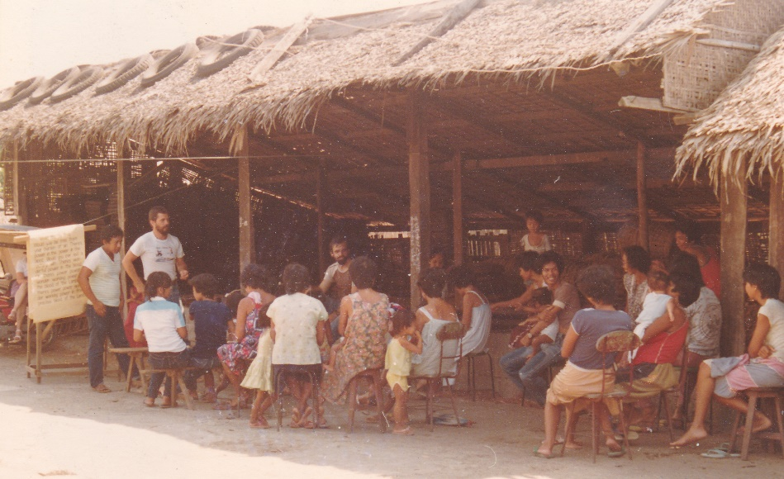
The church: The New covenant with god
The Great Commission
Jesus gave this “commission” to His believers. A commission is an authorization or command to act in a prescribed manner. It includes authority to act for, on behalf of, or in place of another.
This “commission” to all believers is the basis for church planting. The process of telling others about Jesus and then teaching new believers through a discipleship process results in the formation of new churches.
This manual teaches the Mission-Church Life Cycle, a process of witnessing, winning and discipling new believers to maturity in their faith. Discipleship is the key to church growth.

Slide 34
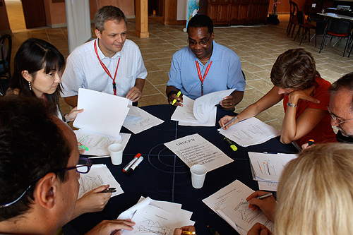
The church: The New covenant with god
Activity
Assignments

Slide 35
The church: The New covenant with god
CLASS ACTIVITY
What is the church?
What is the difference between the local church and the universal church?
What is the purpose and mission of the church? Why is the mission of the church important?
Read and discuss Matthew 28: 18-20 and Mark 16:15-18, the Great Commission.
  List the commands given by Jesus to the church.
  What did Jesus command in the Great Commission?
  What did he promise?
  Write these down and meditate on them at home.

Slide 36
The church: The New covenant with god
PERSONAL ACTIVITY
Read Hebrews.
Review Diagrams 2.2 and 2.7. Consider your part in the church. Are you a member of a “pastor-dependent church” or are you an active part of a “mobilized church”?
Review Table 2.2, Danger signs of ineffective leadership. Prayerfully consider each attitude, the cause of the problem and how to resolve it.

Slide 37

The church: The New covenant with god
Contact: Info@Equippersgroup.org

