Slide 1
water baptism
Lesson- 9

Slide 2
water baptism
OBJECTIVES OF THE LESSON
To understand the meaning of water baptism
To know the importance of water baptism
Be baptized
DISCUSSION QUESTIONS AT END

Slide 3
water baptism
KEY VERSES
Or don’t you know that all of us who were baptized into Christ Jesus were baptized into his death? We were therefore buried with him through baptism into death in order that, just as Christ was raised from the dead through the glory of the Father, we too may live a new life.
Romans 6:3-4

Slide 4
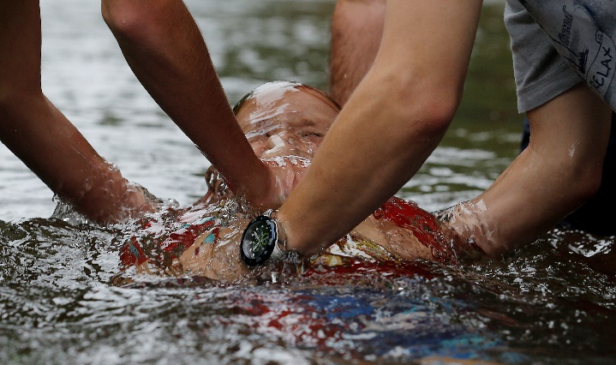
water baptism
What is baptism?
Baptism (Greek baptisma)—to dip, plunge, submerge or immerse
Believers in Jesus are baptized to signify they are set apart to a new life. Baptism follows repentance. Baptism is an ordinance (ceremony or ritual) in which a person is taken to water, put under it and brought up again to signify new life. This is usually done before witnesses.

Slide 5
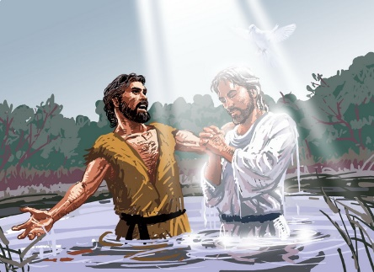
water baptism
What is baptism?
Why would Jesus command that His believers do such a strange thing?
By being baptized the believer is publicly identifying himself with Christ’s death, burial, and resurrection. Scripture shows the importance of baptism to Jesus. He commanded his disciples be baptized and then go make new disciples and baptize them also.
Peter replied, “Repent and be baptized, every one of you, in the name of Jesus Christ for the forgiveness of your sins. And you will receive the gift of the Holy Spirit.” (Acts 2:38)
Although Jesus commanded believers to be baptized, it is not a requirement for salvation. Water baptism is an act of obedience. There is one significant example where a baptism was not possible—the thief on the cross next to Jesus. He proclaimed his belief and Jesus said He would see him in paradise.
(See Luke 23:39-43)

Slide 6
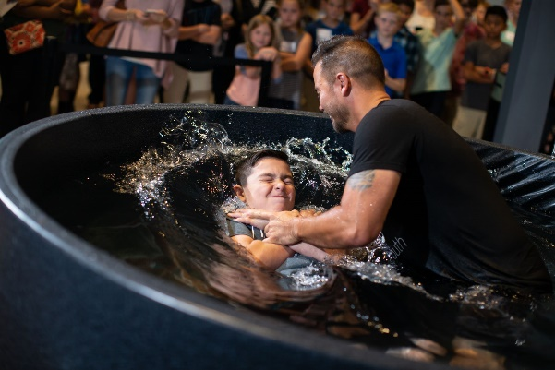
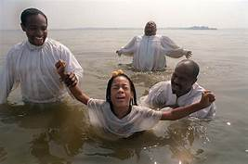
water baptism
What is baptism?
While not mandatory for salvation, it is clear that baptism is important.
See Matt. 28:19, Mk. 16:16, Jn. 3:5, Acts 10:48 and 22:16
Note: The Bible indicates that Jesus and His disciples were baptized by immersion. There are a variety of ways people practice baptism: immersion, sprinkling and infant baptism. The important point is that the believer recognizes his need for salvation and is obedient to the command of baptism to the extent possible.

Slide 7
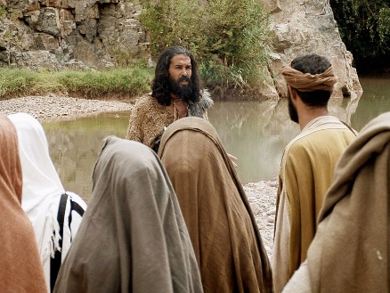
water baptism
Water baptism in the New Testament
Baptism of John
John the Baptist was a prophet sent by God to preach repentance and to point the way to Jesus, the Messiah. “John’s baptism” is mentioned several times in the NT.
People went out to his from Jerusalem and all Judea…Confessing their sins, they were baptized by him in the Jordan River. I baptize you with water for repentance…But after me will come one who is more powerful than I…He will baptize you with the Holy Spirit and with fire. (Matt. 3:5-6, 11)
See also Jn. 1:26, 3:23, and Acts 19:4

Slide 8
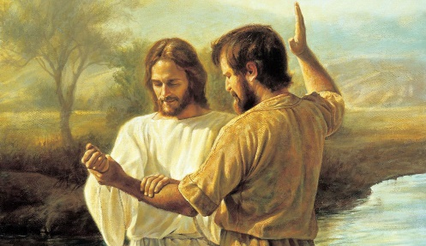
water baptism
Water baptism in the New Testament
Baptism of Jesus
Jesus was baptized by John the Baptist to fulfill the prophecy of His righteousness.
Jesus replied, “Let it be so now; it is proper for us to do this to fulfill all righteousness.” (Matt. 3:15)
After His baptism, Jesus began His public ministry. He taught about baptism by example. He commanded his followers, including us, to disciple others and baptize them.
Go therefore and make disciples of all the nations baptizing them in the name of the Father and the Son and Holy Spirit. (Matt. 28:19)

Slide 9
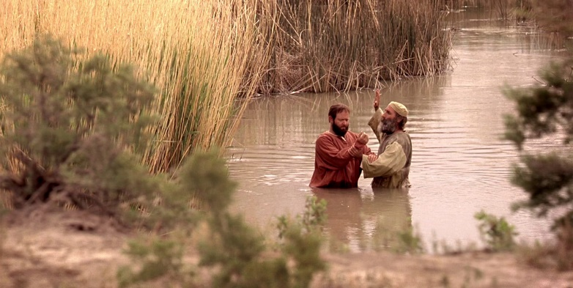
water baptism
Water baptism in the New Testament
Baptism in the early church
There were many examples of water baptism observed by the early church.
Believers at Pentacost—Acts 2:38-41
Converts in Samaria—Acts 8:12-13
Ethiopian Eunuch—Acts 8:36-39
Saul of Tarsus (Paul)—Acts 9:18, 22:16
Peter at Cornelius’ house—Acts 10:34-48
Lydia of Thyatira—Acts 16:15
Philippian prison jailer and his household—Acts 16:33
Believers in Corinth—Acts 18:8
Ephesian disciples—Acts 19:5

Slide 10
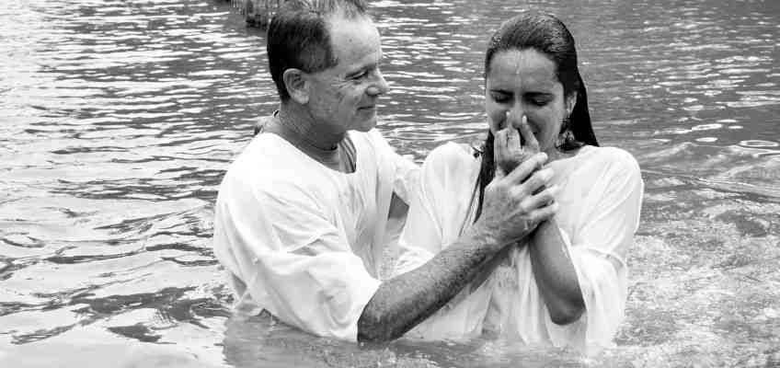
water baptism
Significance of baptism
Baptism is for those who have repented of their sins and believe that Jesus Christ is the Son of God. It is an outward expression of an inward change. It is an event the believer can look back on and remember. It is a picture of who the believer is in Christ. Many times this happens immediately, or very soon, after the person believes.
Shows identification with Jesus’ death and resurrection—Romans 6:3-4
Shows we belong to the body of Christ (church)—1 Corinthians 12:13
Shows that we are Christians (like Jesus)—Galatians 3:27
Shows the believer has been cleansed and purified—Acts 22:16

Slide 11
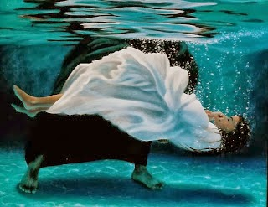
water baptism
Symbolism of baptism in the believer
And this water symbolizes baptism that now saves you also—not the removal of dirt from the body but the pledge of a good conscience toward God. It saves you by the resurrection of Jesus Christ. (1 Peter 3:21)
Understanding water baptism is the key to a victorious and liberated Christian life. The act of going under the water and rising up from it again is a picture demonstrating what has happened to the Christian believer.
Read Romans 6:1-11 and Colossians 2:11-12

Slide 12
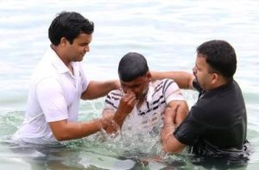
water baptism
Symbolism of baptism in the believer
Understanding water baptism
He died—I died with Him. The new believer’s old sinful nature is put to death by confessing Jesus as Savior
For we know that our old self was crucified with him so that the body of sin might be rendered powerless, that we should no longer be slaves to sin—because anyone who has died has been freed from sin. (Romans 6:6-7)
Acts 22:16, 2 Cor. 5:17, Col. 1:13
He was buried—I was buried with Him. Just as a person is buried after death, the new Christian must “bury” the sinful person he was before he accepted Jesus—represented by going under the water.
Or don’t you know that all of us who were baptized into Christ Jesus were baptized into his death? We were therefore buried with him through baptism into death…(Romans 6:3-4)
1 Cor. 15:22, Eph. 4:22-23
He was raised—I have a new life in Him. The new believer is now alive for eternity in Jesus Christ. This is represented when he is raised up from under the water.
Having been buried with him in baptism and raised with him through your faith in the power of God, who raised him from the dead. (Colossians 2:12)
Rom. 6:4-5, 8-11, Eph. 2:6, Col. 3:1

Slide 13
water baptism
DISCUSSION
QUESTIONS

Slide 14
water baptism
Why must we be water baptized?
What stages of Jesus’ life are pictured in water baptism?
What do we declare to the world through water baptism?
What does it mean, in a practical sense, to live “a new life?”

Slide 15
Jesus’ Resurrection
APPLICATION
Memorize Romans 6:3-4
Write a short description of your baptism. Be willing to discuss your baptism with the class.

Slide 16
water baptism
Contact: Info@Equippersgroup.org

