Slide 1
Jesus’ Resurrection
Lesson- 8

Slide 2
Jesus’ Resurrection
OBJECTIVES OF THE LESSON
To know what the resurrection makes available to believers
To understand Jesus’ resurrection
To understand that the resurrection is important for salvation
Respond to Jesus’ resurrection by obeying the Scriptures
DISCUSSION QUESTIONS AT END

Slide 3
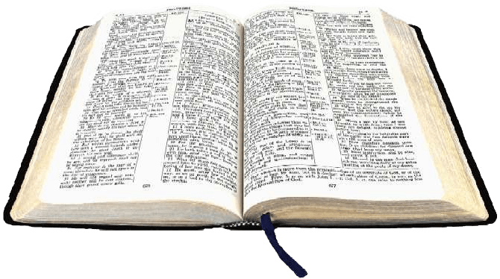
Jesus’ Resurrection
KEY VERSES
Praise be to the God and Father or our Lord Jesus Christ! In his great mercy he has given us new birth into ta living hope through the resurrection of Jesus Christ form the dead.
1 Peter 1:3

Slide 4
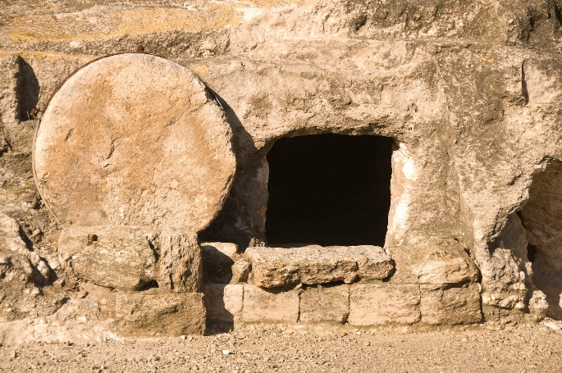
Jesus’ Resurrection
What is “the resurrection?”
Resurrection—a person who was dead becomes alive again, or to raise up
Examples of people resurrected in the Bible:
Widow of Zarephath’s son—1 Kings 17:17-24*
Shunammite woman’s son—2 Kings 4:18-37*
Various saints at Jesus’ death—Matthew 27:50-53*
Jairus’ daughter—Mark 5:22-43*
Jesus—Mark 16:1-8
Widow of Nain’s son—Luke 7:11-17*
Lazarus—John 11:17-44*
Eutychus—Acts 20:7-12*
Tabitha—Acts 9:36-43*
*These resurrections were followed by a second physical death, whereas Jesus was resurrected and ascended to heaven to never die again.

Slide 5
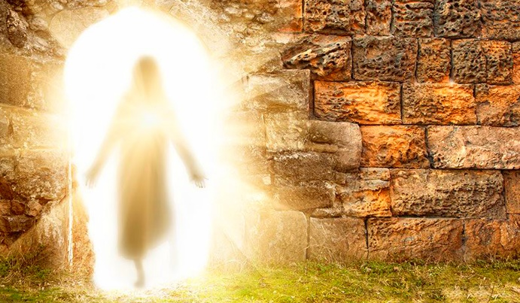
Jesus’ Resurrection
What is “the resurrection?”
Jesus’ resurrection was different—he became the “firstfruits” of a new kind of human life. After He rose, he had a physical body that could be touched, He ate, He walked and talked. His new body was perfect, no longer subject to weakness, aging or death. His new body was different—He was not just a spirit. His new body was eternal.
Look at my hands and my feet. It is I myself! Touch me and see, a ghost does not have flesh and bones, as you see I have. (Luke 24: 39)
See also Matt. 28:9, Lk. 24:15-18, 28-30, Jn. 20:20, 21:12-13

Slide 6
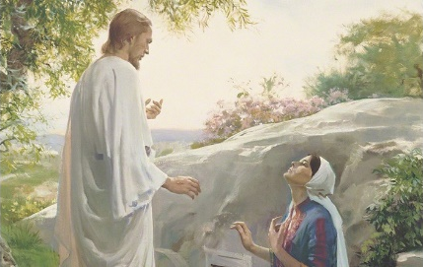
Jesus’ Resurrection
What is “the resurrection?”
The principle (or teaching) of the resurrection of Jesus is the foundation of our faith. His resurrection was prophesied in the Old Testament (Job 19:25-27) and Jesus talked about the resurrection of the saints (Christians) during His ministry on earth (Matt. 24:31, 27:52).
The resurrection sets the Christian faith apart from all other religions. Three days after Jesus was placed in the tomb God raised Him from the dead! This is why Christians celebrate Easter. (Rom. 1:4)
Important evidence of Jesus’ resurrection is recorded in the Scriptures relating to people who saw Him after His death—over 500 people. He also met with the disciples.
Read the following passages about the resurrection: Matt. 26-28, Mk. 14-16, Lk. 22-24, Jn. 20-21, and 1 Cor. 15:3-6

Slide 7
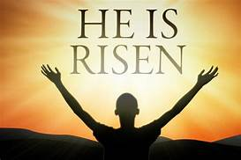
Jesus’ Resurrection
The resurrection and salvation
We learned earlier that Jesus provided redemption (to buy back), justification (substitution of Himself for sin), and atonement (reconciliation with God) through His blood. After Jesus died on the cross and was resurrected, the way for man’s salvation was complete! It is only through the grace of God and the death of and resurrection of Jesus that we can be saved from our sin.
That if you confess with your mouth, “Jesus is Lord,” and believe in your heart that God raised him from the dead, you will be saved. For it is with your heart that you believe and are justified, and it is with your mouth that you confess and are saved. (Rom. 10:9-10)
Salvation is found in no one else, for there is no other name under heaven given to men by which we must be saved. (Acts 4:12)

Slide 8
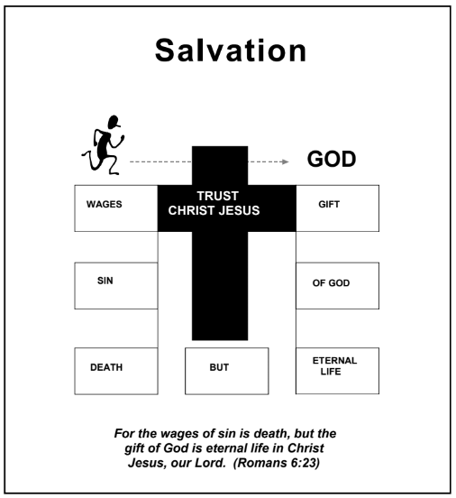
Jesus’ Resurrection
The resurrection and salvation
Salvation has two requirements for a man to be saved: confess that Jesus is Lord and believe in your heart that God raised Jesus from the dead. After this, the Holy Spirit comes to live in the new Christian to lead him in living a life that is pleasing to God.
Jesus said to her, “I am the resurrection and the life. He who believes in me will live, even though he dies; and whoever lives and believes in me will never die. Do you believe this?”
(John 11:25-26)

Slide 9
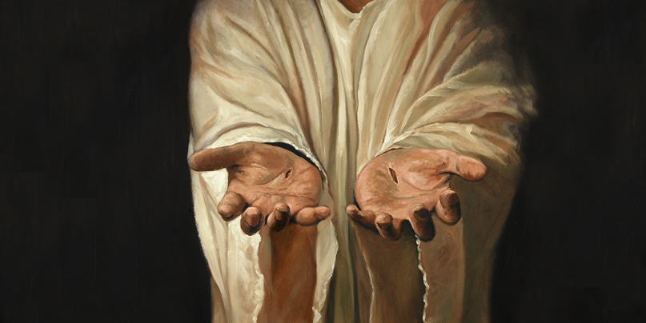
Jesus’ Resurrection
Significance of the resurrection of Jesus
The resurrection of Jesus is said to be the most important proof for His deity. The fulfillment of the prophesied resurrection is the fulfillment of God’s Word.
And if Christ has not been raised, your faith is futile; you are still in your sins. (1 Cor. 15:17)
Significance of the resurrection in the Christian life:
Cornerstone of our faith—1 Cor. 15:14, Eph. 2:18-20, 2 Pet. 2:6-7
Salvation is dependent on the resurrection—Rom. 6:4, 10:9
Proves Jesus is God—Rom. 1:4, 1 Tim. 3:16
The end goal of Christian life—1 Cor. 15:19-20, Phil. 3:10-12

Slide 10
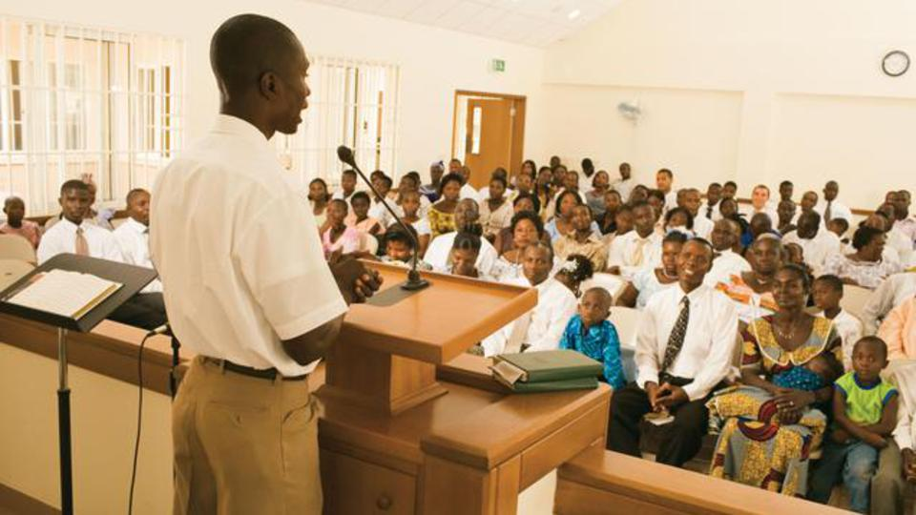
Jesus’ Resurrection
Significance of the resurrection of Jesus
In the OT Israelites were commanded to observe the Sabbath (7th day or Saturday) to remember and worship God. This day was chosen because it was the day God rested during creation. Most Christians now honor the resurrection by observing a Sabbath on Sunday—the day he arose.
On the first day of the week we came together to break bread… (Acts. 20:7)
See also Ex. 20:8-11, 31: 12-18, Mk. 16:9, Jn. 20:19

Slide 11
Jesus’ Resurrection
Significance of the resurrection of Jesus
Reasons for the resurrection of Jesus
Jesus arose because of who He is | But God raised him from the dead, freeing him from the agony of death, because it was impossible for death to keep its hold on him. (Acts 2:24) | To become head of the church | And God placed all things under his feet and appointed him to be head over everything for the church, which is his body, and the fullness of him who fills everything in every way. (Eph. 1:22-23)
 |  |  | Eph. 1:19-23
To fulfill the covenant God made with David | You will be with child and give birth to a son, and you are to give him the name Jesus. He will be great and will be called the Son of the Most High. The Lord God will give him the throne of his father David, and he will reign over the house of Jacob forever; his kingdom will never end. (Luke 1:31-33) | To be the firstfruits of the resurrection | But Christ has indeed been raised from the dead, the firstfruits of those who have fallen asleep. For since death came through a man, the resurrection of the dead comes also through a man. (1 Cor. 15:20-21)
 | Ps. 89:20-37, Isa. 9:6-7, Acts 2:25-31 |  | Col. 1:18
To be the giver of resurrection life | Since, then, you have been raised with Christ, set your hearts on things above, where Christ is seated at the right hand of God. Set your minds on things above, not on earthly things. For you died, and your life is now hidden with Christ in God. When Christ, who is your life, appears, then you also will appear with him in glory. (Col. 3:1-4)
 | Jn. 11:25, Eph. 2:6

Slide 12
Jesus’ Resurrection
Significance of the resurrection of Jesus
Reasons for the resurrection of Jesus
To become the source of resurrection power | I pray also that the eyes of your heart may be enlightened in order that you may know the hope to which he has called you, the riches of his glorious inheritance in the saints, and his incomparably great power for us who believe. That power is like the working of his mighty strength, which he exerted in Christ when he raised him from the dead and seated him at his right hand in the heavenly realm (Eph. 1:18-20) | To seat us in heavenly places | As for you, you were dead in your transgression and sins, in which you used to live when you followed the ways of this world and of the ruler of the kingdom the air,…But because of his great love for us, God who is rich in mercy, made us alive with Christ even when we were dead in transgressions—it is by grace you have been saved. And God raised us up with Christ and seated us with him in the heavenly realms in Christ Jesus. (Eph. 2:1-2, 4-6)
 | Matt. 28:18, Eph. 1:19-21, Phil. 4:13 |  | Col. 3:1-3
So our justification would be accomplished | He was delivered over to death for our sins and was raised to life for our justification. (Rom. 4:25) | To give us new birth | Praise be to the God and Father of our Lord Jesus Christ! In his great mercy he has given us new birth into a living hope through the resurrection of Jesus Christ from the dead. (1 Pet. 1:3)

Slide 13
Jesus’ Resurrection
Response to the resurrection of Jesus
Believe It | Think About It
That if you confess with your mouth, “Jesus is Lord,” and believe in your heart that God raised him from the dead, you will be saved. (Rom. 10:9) | Since, then, you have been raised with Christ, set your hearts on things above where Christ is seated at the right hand of God. Set your minds on things above, not on earthly things. For you died and your life is now hidden with Christ in God. (Col. 3:1-3)
Live It | Preach It
But whatever was to my profit I now consider loss for the sake of Christ. What is more, I consider everything a loss compared to the surpassing greatness of knowing Christ Jesus my Lord, for whose sake I have lost all things. I consider them rubbish that I may gain Christ and be found in him, not having a righteousness of my own that comes from the law, but that which is through faith in Christ—the righteousness that comes from God and is by faith. I was to know Christ and the power of his resurrection and the fellowship of sharing in his sufferings, becoming like him in his death, and so, somehow, to attain to the resurrection from the dead. (Phil. 3:7-11) | With great power the apostles continued to testify to the resurrection of the Lord Jesus and much grace was upon then all. (Acts 4:33) We are witnesses of everything he did in the country of the Jews and in Jerusalem. They killed him by hanging him on a tree, but God raised him from the dead on the third day and caused him to be seen. He was not seen by all the people, but by witnesses whom God had already chosen—by us who ate and drank with him after he rose from the dead. He commanded us to preach to the people and the testify that he is the one whom God appointed as judge of the living and the dead. All the prophets testify about him that everyone who believes in him receives forgiveness of sins through his name. (Acts 10:39-43)

Slide 14
Jesus’ Resurrection
DISCUSSION
QUESTIONS

Slide 15
Jesus’ Resurrection
Why did Jesus appear to man after His resurrection?
Discuss the reasons why Jesus arose from the dead.
How does one become saved?
What benefits do we realize from Jesus’ resurrection?

Slide 16
Jesus’ Resurrection
APPLICATION
Memorize 1 Peter 1-3
Read 1 Corinthians 15 to understand just how important Jesus’ resurrection is to His believers.
Pray about what your response to the resurrection should be and make it a point to obey these commands.

Slide 17
Jesus’ Resurrection
Contact: Info@Equippersgroup.org

