Slide 1
Blood of Jesus
Lesson- 7

Slide 2
Blood of Jesus
OBJECTIVES OF THE LESSON
To understand the meaning of sacrifice and shed blood
To understand what the shed blood of Jesus does for man
To understand the purpose of the cross
Appropriate benefits you received through the blood of Jesus
DISCUSSION QUESTIONS AT END

Slide 3
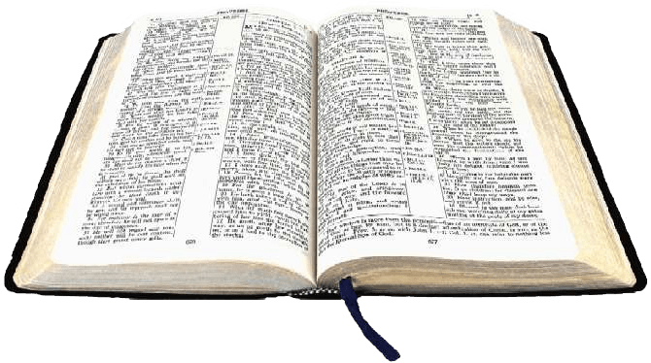
Blood of Jesus
KEY VERSES
In him we have redemption through his blood, the forgiveness of sins, in accordance with the riches of God’s grace.
Ephesians 1:7
In fact, the law requires that nearly everything be cleansed with blood, without the shedding of blood there is no forgiveness.
Hebrews 9:22

Slide 4
Blood of Jesus
A brief review
The following truths were established in previous lessons and are a foundation for this lesson. Those truths are:
All mankind has a sin nature that resulted from the fall in Genesis
People discovered that knowing what is right does not make you do what is right and without Jesus we will always be slaves to sin
There are terrible consequences of sin. Sin demands death—physically, spiritually and eternally
God could no longer be close to mankind because His holiness cannot dwell with sin
Although sin separates mankind from God, He had a plan of restoration through the life, death and resurrection of His son

Slide 5
Blood of Jesus
Significance of the blood of Jesus
In the following pages we will look at three ways that Jesus’ sacrifice was necessary
Blood sacrifice in the Bible
Blood and Covenants
Mankind’s sin problem solved through the blood

Slide 6
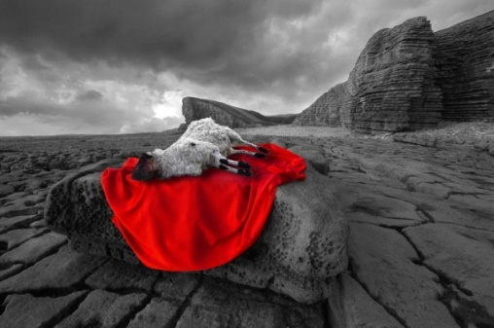
Blood of Jesus
Blood sacrifice in the Bible
Most people today are uncomfortable with the idea of blood sacrifice. Killing a living creature is not a pleasant activity. The ugliness of pain, blood and death reveals the ugliness of our sin.
The first blood sacrifice was made by God to provide a covering for Adam and eve after they sinned.
The LORD God made garments of skin for Adam and his wife and clothed them.
(Gen. 3:21)
Three things we learn from this verse:
We cannot create our own covering for sin. Nothing we can do will fix sin. Only God can provide.
The penalty for sin is death. The innocent animal dies for the guilty human.
Blood was shed when the animal was killed. Blood is necessary to cover man’s sin.

Slide 7
Blood of Jesus
Blood sacrifice in the Bible
God commanded His people to practice blood sacrifice in the Old Testament. An animal was killed as a substitute for the one(s) who sinned. This practice demonstrated how serious the offense of sin really is. There is life in blood.
For the life of a creature is in the blood, and I have given it to you to ake atonement for yourselves on the altar; it is the blood that makes atonement for one’s life. (Leviticus 17:11)
Atonement means to cancel out, clean, or reconcile. Atonement finds a way to get rid of the problem between two parties and bring forgiveness.
In fact the law requires that nearly everything be cleansed with blood, and without the shedding of blood there is no forgiveness. (Hebrews 9:22)

Slide 8
Blood of Jesus
Blood sacrifice in the Bible
Old Testament sacrifice was a picture of what was to come—Jesus, the ultimate sacrifice.
Jesus was born of a woman but had perfect blood because His Father was God (Lk. 1:26-38). Jesus died on the cross and gave His blood for our sin. He was the perfect and final sacrifice for mankind’s sin. Jesus is called the Lamb of God because of this. The blood of animals was never enough to completely restore our relationship with God.
For if the blood of goats and bulls and the ashes of a heifer sprinkled on those who are ceremonially unclean sanctify them so that they are outwardly clean. How much more, then, will the blood of Christ, who through the eternal Spirit offered himself unblemished to God, cleanse our consciences from acts that lead to death, so that we may serve the living God! (Heb. 9:13-14)

Slide 9
Blood of Jesus
Blood sacrifice in the Bible
The blood of Jesus is the currency that buys mankind back from the slavery of sin, Satan and separation from God.
For you know that it was not with perishable things such as silver of gold that you were redeemed from the empty was of life handed down to you from your forefathers, but with the precious blood of Christ, a lamb without blemish or defect. (1 Pet. 1:18-19)
From Genesis to Revelation, we see accounts of lambs sacrificed for sin.
A lamb killed for Noah’s family (Gen. 8:20)
A lamb killed for the Israelites at Passover (Ex. 12:1-21)
A Lamb killed for the world (1 Pet. 1:18-19)
In Revelation, there is a prophecy picturing the Lamb of God being worshipped by all tribes, languages and people. (Rev. 5:6, 9-10)

Slide 10
Blood of Jesus
Blood and covenants
A covenant is a pact of an agreement between two or more parties. The Hebrew word for covenant is “berith” which literally means to cut a compact (made by passing through pieces of flesh). Blood is an important part of covenant.
God’s covenants have three main characteristics.
Words and promises
Sacrifice and blood indicating a covenant is needed for life and death reasons
A seal of sign as a reminder of the covenant

Slide 11
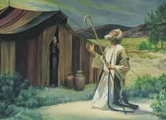
Blood of Jesus
Blood and covenants
Characteristics as seen in God’s covenant with Abraham.
Words and promises: God says he will make a great nation through Abraham (Gen. 15:1-6, 17:1-14)
Sacrifice and blood: Abraham is told to cut certain animals in half and was between (Gen. 15:7-21)
A seal and sign: God requires circumcision of Abraham and his descendants (Gen. 17:11)

Slide 12
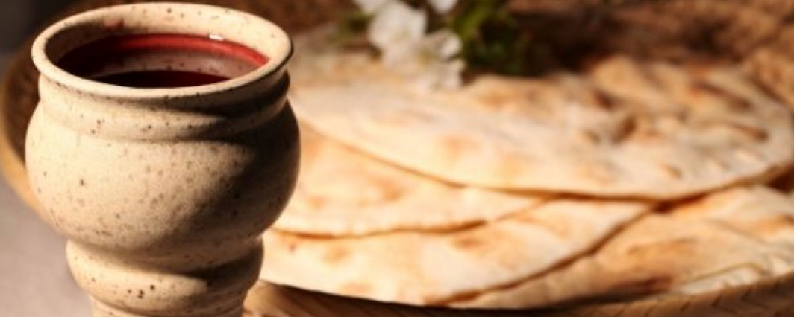
Blood of Jesus
Blood and covenants
There are several covenants recorded in the Bible between God and individuals, nations, and mankind. The final covenant (New Covenant) was through Jesus.
Words and promises: There are many promises associated some are listed in Hebrews chapter 8 (Heb. 10:15-22)
Sacrifice and blood: Jesus says his blood is the new covenant at the Passover meal (Matt. 26:27-28)
A seal and sign: The Holy Spirit is given to believers and Communion is established (Eph. 1:13-14 and 1 Cor. 11:23-33)

Slide 13
Blood of Jesus
Mankind’s sin problem solved through the blood
The blood of Jesus provides justification, redemption, atonement and reconciliation.
For all have sinned and fall short of the glory of God and are justified freely by his grace through the redemption that came by Christ Jesus. God presented him as a sacrifice of atonement, through faith in his blood. (Rom. 2:23-25)
Since we have now been justified by his blood, how much more shall we be saved from God’s wrath through him! For if, when we were God’s enemies, we were reconciled to him through the death of his Song, how much more, having been reconciled, shall we be saved through his life! (Rom. 5:9-10)
These words are at the heart of the gospel and are truly “good news” to the believer. Each word carries the solution to sin. Let’s explore the meaning of each of these words.

Slide 14
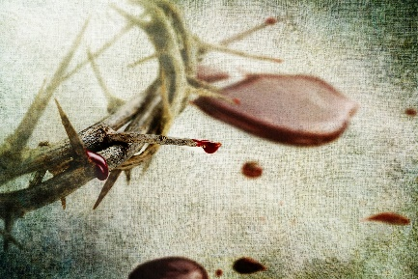
Blood of Jesus
Mankind’s sin problem solved through the blood
Justification—the act of announcing a law breaker legally “not guilty.” Our sin makes us law breakers. Without Jesus we stand guilty before the Judge (God) and are sentenced to death. With Jesus he takes our sentence on himself and we are cleared of all charges—God declares us “not guilty.” (Rom. 3:28, 4:2, 5:1-9, Gal. 2:16-17, Tit. 3:7)
Redemption—to buy back captured goods or prisoners. As a result of Adam’s fall people became prisoners of sin and Satan. Jesus’ blood is the payment provided to buy us back. (Eph. 1:7, 14, Col 1:14, Heb. 9:12, Gal. 4:5, Tit. 2:14, 1 Pet. 1:18-19)
Reconciliation—act of changing from being an enemy to a friend. Jesus restores the relationship between God and man. (2 Cor. 5:18-20, Gal. 4:5)
Atonement—to cancel out, clean or reconcile. The word gets most of its meaning from the OT book of Leviticus. In the NT we usually see it used as reconciliation. Jesus was THE sacrifice by which God can show mercy to sinners. (Heb. 2:17, 9:5)

Slide 15
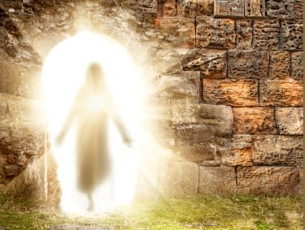
Blood of Jesus
Mankind’s sin problem solved through the blood
The sin problem and God’s solution
Because of man’s fall (sin), mankind becomes a slave to Satan and sin | Redemption (buy back out of slavery)
 | In him we have redemption through his blood, the forgiveness of sins, in accordance with the riches of God’s grace that he lavished on us with all wisdom and understanding. (Eph. 1:7-8)
Man is sinful, declared guilty, sentenced to death. Mankind has no way to get right on his own. | Justification (declared “not guilty”)
 | Know that a man is not justified by observing the law, but by faith in Jesus Christ. So we, too, have put our faith in Christ Jesus that we may be justified by faith in Christ and not by observing the law, because by observing the law no one will be justified. (Gal. 2:16)
Man is separated and hostile to God and no longer communicates with Him. | Reconciliation (enemies made friends)
 | All this is from God, who reconciled us to himself through Christ and gave us the ministry of reconciliation: that God was reconciling men’s sins against them. And he has committed to us the message of reconciliation. We are therefore Christ’s ambassadors, as though God were making his appeal through us. We implore you on Christ’s behalf: Be reconciled to God. (2 Cor. 5:18-21)

Slide 16
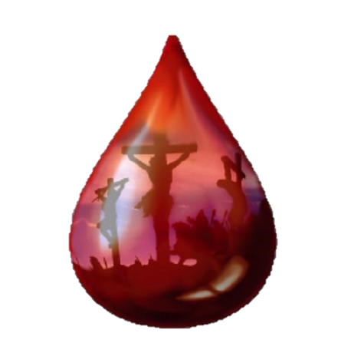
Blood of Jesus
Benefits of the blood of Jesus
Jesus provided justification for man’s sin just as if man never sinned. He paid the sacrificial price (redemption) for sin and provided atonement (reconciliation) to God for all who believe in him. His blood satisfied the requirement of God.
Did away with sin & provided forgiveness
But if we walk in the light, as he is in the light, we have fellowship with one another, and the blood of Jesus, his Son, purifies us from all sin,…If we confess our sins, he is faithful and just and will forgive us our sins and purify us from all unrighteousness.
(1 Jn. 1:7, 9)
(Eph. 1:7, Heb. 9:26-28)
Provided an eternal inheritance
For this reason Christ is the mediator of a new covenant, that those who are called may receive the promised eternal inheritance—how that he has died as a ransom to set them free from the sins committed under the first covenant.
(Heb. 9:15)
Provided eternal redemption
He did not enter by means of the blood of goats and calves; but he entered the Most Holy Place once for all by his own blood, having obtained eternal redemption.
(Heb. 9:12)

Slide 17
Blood of Jesus
Benefits of the blood of Jesus
Sanctified (set apart) the believer
And by that will, we have been made holy through the sacrifice of the body of Jesus Christ once for all.
(Heb. 10:10)
(Heb. 13:12)
Gave entrance to God’s presence (Most Holy Place)
Therefore, brothers, since we have confidence to enter the Most Holy Place, by the blood of Jesus, by a new and living way opened for us through the curtain, that is, his body.
(Heb. 10:19-20)
(Jn. 1:12, Eph. 2:11-16, Heb. 2:11-12)
Purchased the church of God
Keep watch over yourselves and all the flock of which the Holy Spirit has made you overseers. Be shepherds of the church of God, which he bought with his own blood
(Acts 20:28)
(Eph. 1:22)
Justified the believer
God made him who had no sin to be sin for us, so that in him we might become the righteousness of God.
(2 Cor. 5:21)
(Rom. 5:8-9, Heb. 9:14, 10:21-22)

Slide 18
Blood of Jesus
Freedom through the blood of Jesus
Jesus’ death on the cross won a great victory—atonement for mankind! This means that misery and suffering as a result of sin were cancelled. The blood of Jesus gained new freedoms for man as shown below.
Through Jesus’ death, we have freedom from:
Satan | And having disarmed the powers and authorities, he made a public spectacle of them. Triumphing over them by the Cross. (Col. 2:15) | The curse (the Law) | Christ redeemed us from the curse of the law by becoming a curse for us, for it is written, “Cursed is everyone who is hung on a tree.” (Gal. 3:13)
 | Col. 1:13 |  | Deut. 28:15-68
Sickness | He himself bore our sins in his body on the tree, so that we might die to sins and live for righteousness; by his wounds you have been healed. (1 Pet. 2:24) | Everlasting death | But it has now been revealed trhoguh the appearing of our Savior, Christ Jesus, who has destroyed death and has brought life and immortality to light through the gospel. (2 Tim. 1:10)
 | Matt. 8:17 |  | Jn. 5:24, Rom 6:23

Slide 19
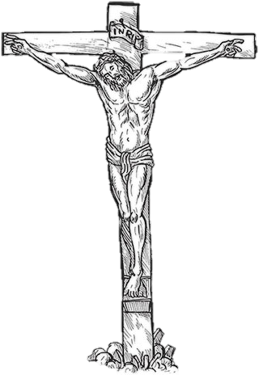
Blood of Jesus
The Cross—God’s plan
Jesus was crucified, put to death by being nailed to a wooden cross. The wicked men who did this thought they were executing a man who was disturbing their lives. Little did they know God had planned this all along.
The cross is where God’s love and His judgement meet. Judgement demanded death; His love met His own demands.
But God demonstrates his own love for us in this; While we were still sinners, Christ died for us. Since we have now been justified by his blood, how much more shall we be saved from God’s wrath through him! For if, when we were God’s enemies, we were reconciled to him through the death of his Son, how much more, having been reconciled, shall we be saved through his life! Now only this, but we also rejoice in God through our Lord Jesus Christ, through whom we have now received reconciliation. (Rom. 5:8-11)

Slide 20
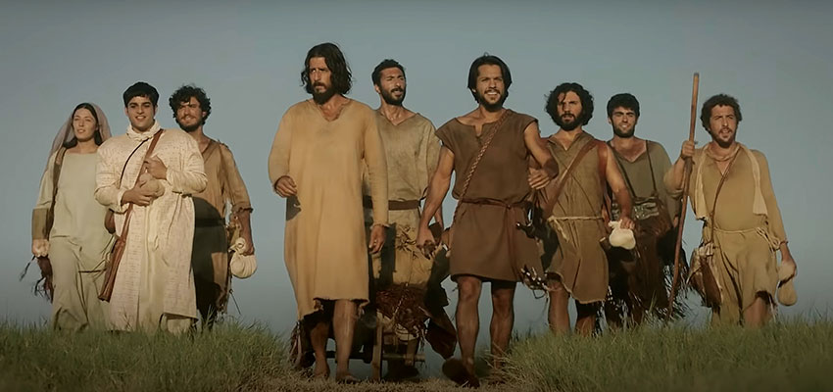
Blood of Jesus
Mankind’s response to Jesus’ death
So, truly the work of redemption, justification, and atonement is done completely by God through the blood of Jesus. Our part is to accept these gifts through faith and follow Jesus.
Jesus referred to His death many times during His life and commanded the believer to take us his cross and follow Him. This means, in part, to be careful how you live in light of the great price Jesus paid for your salvation.
Then Jesus said to his disciples, “If anyone would come after me, he must deny himself and take up his cross and follow me. For whoever wants to save his life will lose it, but whoever loses his life for me will find it.” (Matt. 16:24-25)

Slide 21
Blood of Jesus
DISCUSSION
QUESTIONS

Slide 22
Blood of Jesus
What was accomplished by Jesus’ death on the cross?
What is the meaning of redemption, justification and atonement?
How does the cross demonstrate God’s love for us?
What is the connection between shed blood and forgiveness?

Slide 23
Blood of Jesus
APPLICATION
Memorize Ephesians 1:7 and Hebrews 9:22
Read the following chapters—Hebrews 8-10
Have you made the commitment to take up your cross and follow Jesus? Be prepared to share what this means to you.

Slide 24
Blood of Jesus
Contact: Info@Equippersgroup.org

