Slide 1




Nature of mankind
Lesson- 5

Slide 2
Nature of mankind
OBJECTIVES OF THE LESSON
To show that mankind was created by God
2. To see mankind from God’s perspective
To understand mankind’s value and position in Jesus
Praise God for your position in Christ
DISCUSSION QUESTIONS AT END

Slide 3
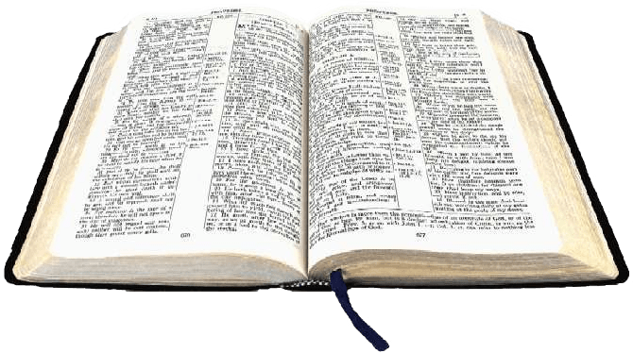

Nature of mankind
KEY VERSES
This is good, and pleases God our Savior, who wants all men to be saved and to come to a knowledge of the truth.
1 Timothy 2:3-4

Slide 4

Nature of mankind
Mankind
God, the Creator, is the best source for understanding mankind (human beings, people). God’s instruction manual for His creation is the Bible. The whole Bible is an explanation of God’s relationship with people—who they are and what He requires of them.
The term “man” means mankind, human race, or the whole species of human beings. In the New Testament the Greek word for “man” is anthropos, not to be confused with the term for male gender which is aner. In this study, the term “man” is meant to include both male and female. Although men and women are physically different and are assigned different roles to perform, God treats both the same—as mankind.
For God does not show favoritism. (Rom. 2:11)

Slide 5
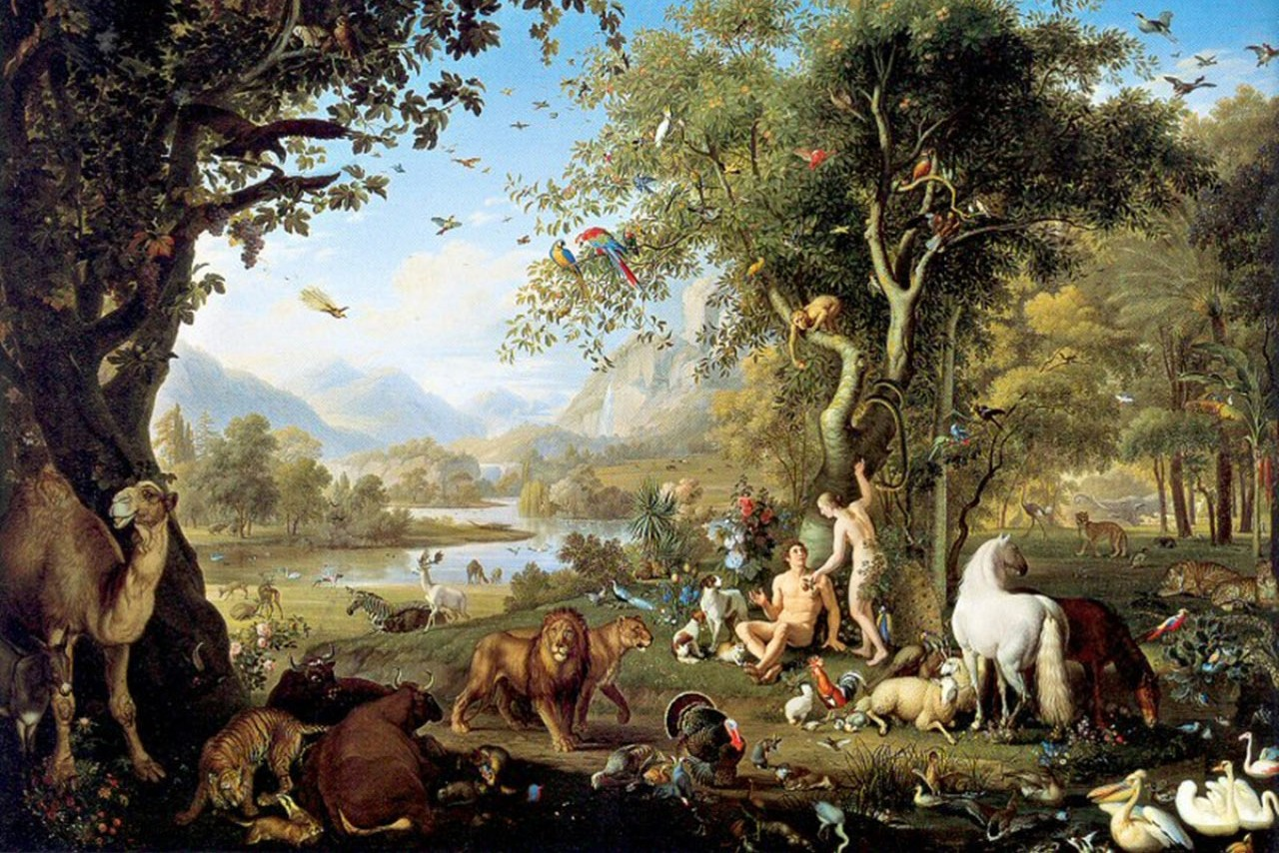
Nature of mankind
Mankind: beginning
Then God said, “Let us make man in our image.” (Gen. 1:26)
The first four chapters of Genesis describe mankind’s beginning. In the verse quoted above, the pronouns “us” and “our” show that there is more than one doing the creating. Mankind exists because all three parts of the Godhead created him—the Father, the Son and the Holy Spirit. The first man and woman were created perfect, without sin, sickness or death. They lived in perfect harmony with God and His perfect creation.
Read Genesis chapters 1-4 for the whole story of mankind’s beginning

Slide 6
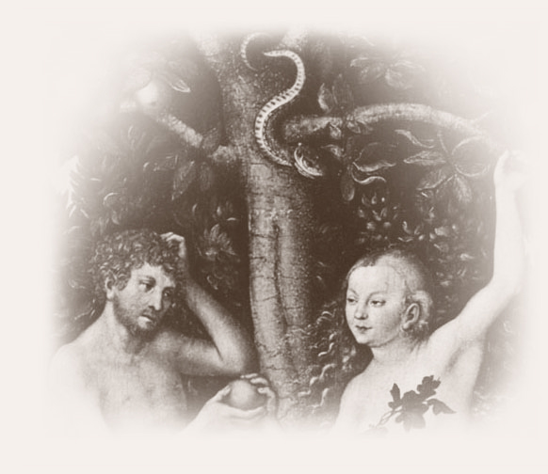
Nature of mankind
Mankind: choice—obey God or sin?
The creation of man and woman in God’s image is a mystery. However, there are some things we know:
People have a conscience (unlike animals) to know right from wrong
People have freedom to choose to obey God or not—free will
Adam and Eve chose not to obey God’s instruction and ate from the tree of the knowledge of good and evil. They sinned against God using their free will and thus brought sin into the world. Satan (the serpent) also played a part by lying to them.
Satan is an angel created by God who had already rebelled against Him. Satan constantly wages war against God for the soul of every person.

Slide 7
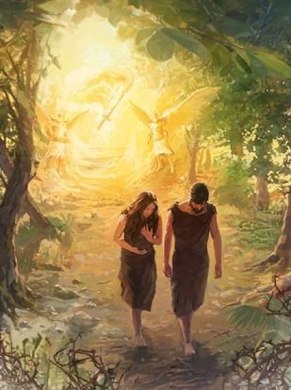
Nature of mankind
Mankind: the result of sin
Sin—any failure to conform to the moral law of God in act, attitude or nature
Consequences of the first sin:
Separation from God—Adam and Eve hide (Gen. 3:10, Isa. 59:2)
Cast out of Eden—no longer allowed to walk with God (Gen. 3:23-24)
Fear (Gen. 3:10)
All mankind became sinners (Rom 5:12-21, 7: 18-24)
Curses (Gen. 3:14-18)
Death (Gen. 2:17, Rom. 5:12-14, 17-19)
The remainder of the Bible is the story of restoring the relationship between God and man that was lost in the garden.

Slide 8
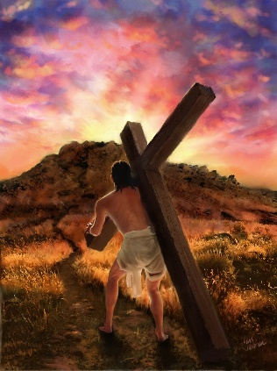
Nature of mankind
Mankind: hope of salvation
God did not give up on mankind because of sin.
He provided the first blood sacrifice to give animal skins to cover Adam and Eve (Gen. 3:21). He promised Satan would be crushed and a promise of a coming Savior (Gen. 3:15).
God loves man despite his sinful nature. In a person’s lifespan (birth, life, death, judgement by God) he is incapable of pleasing God through his own strength. So, God provided a way through faith in Jesus Christ.
For just as through the disobedience of one man [Adam] the many were made sinners, so also through the obedience of the one man [Christ] the many will be made righteous.
(Rom. 5:19)

Slide 9
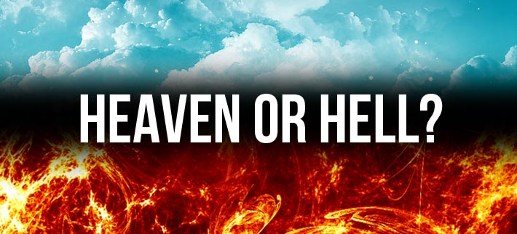
Nature of mankind
Mankind: resurrection
Sooner or later, everyone dies, but Jesus taught that death is not the end. After death, each person is resurrected. If you chose not to believe in Jesus, this will be a terrible experience—God must judge everyone for their sin because He is perfectly holy. God does not allow sin in His presence, so those who did not accept His son will be banished forever to a place called hell. (See Acts 24:15-16)
If you did choose Jesus, your resurrection will be wonderful (John. 1:12). You will be given a perfect body and live with God forever in a beautiful home called heaven that is beyond human imagination.

Slide 10
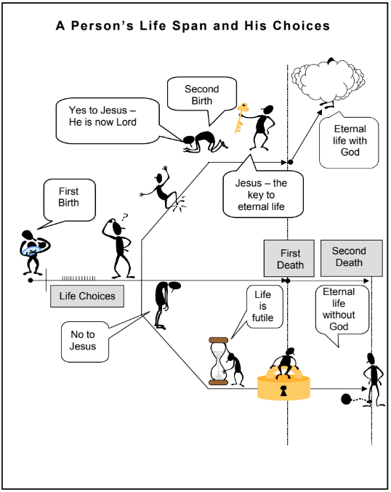
Nature of mankind
Mankind: resurrection
A Person’s Lifespan and His Choices

Slide 11
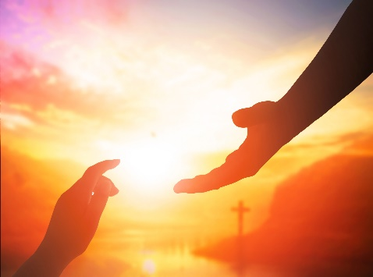
Nature of mankind
God’s view of mankind
God’s view of mankind
All people sin | For all have sinned and fall short of the glory of God. (Rom. 3:23) | All people will give an account to God (judgement) | For we must all appear before the judgement seat of Christ, that each one may receive what is due him for the things done while in the body, whether good or bad. (2 Cor. 5:10)
 | Ps. 51:5, Isa. 64: 6, Rom. 1:21-32 |  | Rom. 14:10, Heb 9:27, Rev 20: 12-15
All people die once | Just as man was destined to die once, and after that to face judgement, so Christ was sacrificed once to take away the sins of many people; and he will appear a second time, not to bear sin, but to bring salvation to those who waiting for him. (Heb. 9:27-28) | All people are treated equally by God | For there is no difference between Jew and Gentile—the same Lord is Lord of all and richly blesses all who call on him for “Everyone who calls on the name of the Lord will be saved.” (Rom. 10:12-13)
 |  |  | Acts 10:28, Gal. 3:28, Jas. 2:5
 | Ecc. 3:2, 1 Cor. 15:22
Mankind was created in the image of God | This is the written account of Adam’s line. When God created man, he made him in the likeness of God. He created them male and female and blessed them. And when they were created, he called them “man.” (Gen. 5:1-2)
 | Gen. 1:27, Jas. 3:9

Slide 12

Nature of mankind
God’s view of mankind
God’s view of mankind
People are spiritual beings | And the dust returns to the ground it came from, and the spirit returns to God who gave it. (Ecc. 12:7) | Every person will confess Jesus as Christ | That at the name of Jesus every knee should bow, in heaven and on earth and under the earth, and every tongue confess that Jesus Christ is Lord, to the glory of God the Father. (Phil. 2:10-11)
 | Job 32:8, Acts 7:59, 1 Cor. 2:11-12, Jas. 2:26 |  | Rom. 14:10, Heb 9:27, Rev 20: 12-15
Each person is of great value to God | For God so loved the world that he gave his one and only Son, that whoever believes in him shall not perish but have eternal life. (Jn. 3:16) | God wants each person to be saved | For the grace of God that brings salvation has appeared to all men. (Tit. 2:11)
 |  |  | Lk. 3:6, Jn. 3:17, Acts. 2:21, Rom. 5:18, 10:13, 1 Tim. 2:3-4, 4:10, 2 Pet. 3:9
 | 1 Cor. 6:20
Each person is known by God before he is born | For you created my inmost being; you knit me together in my mother’s womb. I praise you because I am fearfully and wonderfully made; your works are wonderful, I know that full well. My frame was not hidden from you when I was made in the secret place. When I was woven together in the depths of the earth, your eyes saw my unformed body. All the days ordained for me were written in your book before one of them came to be. (Ps. 139: 13-16)
 | Rom. 14:10, Heb 9:27, Rev 20: 12-15

Slide 13
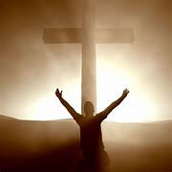
Nature of mankind
Mankind’s position in Jesus Christ
Justified (declared “not guilty” of sin)
And are justified freely by his grace through the redemption that came by Christ Jesus. (Rom. 3:24)
Sanctified and made acceptable in Christ Jesus
To the church in Corinth, to those sanctified in Christ Jesus and called to be holy, together with all those everywhere who call on the name of our Lord Jesus Christ—their Lord and ours. (1 Cor. 1:2)
No condemnation
Therefore, there is no condemnation for those who are in Christ Jesus. (Rom. 8:1)
Righteous and holy in Christ Jesus
It is because of him that you are in Christ Jesus who has become for us wisdom from God—that is, our righteousness, holiness and redemption. (1 Cor. 1:30)
Set free from the law of sin and death
Because through Christ Jesus the law of the Spirit of life set me free from the law of sin and death. (Rom. 8:2)
Made alive at the resurrection of Christ
For as in Adam all die, so in Christ all will be made alive. (1 Cor. 15:22)

Slide 14
Nature of mankind
Mankind’s position in Jesus Christ
A new creation
Therefore, if anyone is in Christ, he is a new creation; the old has gone, the new has come! (2 Cor. 5:17)
Declared righteous
God made him who had no sin to be sin for us, so that in him we might become the righteousness of God. (2 Cor. 5:21)
One in Christ Jesus will all other believers
There is neither Jew nor Greek, salve nor free, male nor female, for you are all one in Christ Jesus. (Gal. 3:28)
Holy and blameless
For he chose us in him before the creation of the world to be holy and blameless in his sight. (Eph. 1:4)
Adopted as God’s children
In love he predestined us to be adopted as his sons through Jesus Christ, in accordance with his pleasure and will. (Eph. 1:5)
Blessed with every spiritual blessing
Praise be to the God and Father of our Lord Jesus Christ, who has blessed us in the heavenly realms with every spiritual blessing in Christ. (Eph. 1:3)

Slide 15
Nature of mankind
Mankind’s position in Jesus Christ
Forgiven and redeemed
In him we have redemption through his blood, the forgiveness
Brought near to God
But now in Christ Jesus you who once were far away have been brought near through the blood of Christ. (Eph. 2:13)
God’ work of art
For we are God’s workmanship, created in Christ Jesus to do good works, which God prepared in advance for us to do. (Eph. 2:10)
Seated with Christ Jesus
And God raised us up with Christ and seated us with him in the heavenly realms in Christ Jesus. (Eph. 2:6)
Chosen and brought under Christ’s leadership
To be put into effect when the times will have reached their fulfillment—to bring all things in heaven and on earth together under one head, even Christ. In him we were also chosen, having been predestined according to the plan of him who works out everything in conformity with the purpose of his will. (Eph. 1:10-11)

Slide 16
Nature of mankind
Mankind’s position in Jesus Christ
Members of Christ’s body—the church
After all, no one ever hated his own body, but he feeds and cares for it, just as Christ does the church—for we are members of his body. (Eph. 3:6)
Owned by God (God’s possession)
Who [the Holy Spirit] is a deposit guaranteeing our inheritance until the redemption of those who are God’s possession—to the praise of his glory. (Eph. 1:14)
See also Mal. 3:17 and 1 Cor. 6:19-20)
Fullness of Christ
And you have been given fullness in Christ, who is the head over every power and authority. (Col. 2:10)
Set free from sinful nature
In him you were also circumcised, in the putting off o the sinful nature, not with a circumcision done by the hands of men but with the circumcision done by Christ. (Col.. 2:11)
Share in the promise in Christ Jesus
This mystery is that through the gospel the Gentiles are heirs together with Israel, members together of one body, and sharers together in the promise in Christ Jesus. (Eph. 3:6)

Slide 17

Nature of mankind
DISCUSSION
QUESTIONS

Slide 18
Nature of mankind
Why does God value man?
What is your understanding of sin?
What are some characteristics of a believer’s position with Jesus?
Which of “God’s instructions” did you not know?

Slide 19
Nature of mankind
APPLICATION
Memorize 1 Timothy 2:3-4
Read about the fall of mankind in Genesis, chapters 1-4.
Study the “Lifespan of Man” illustration. Prayerfully consider your personal position with God because of Jesus’ sacrifice.

Slide 20

Nature of mankind
Contact: Info@Equippersgroup.org

