Slide 1




god the Holy spirit
Lesson- 4

Slide 2
god the holy spirit
OBJECTIVES OF THE LESSON
To understand the Holy Spirit is a person (part) of the Trinity
2. To understand the purpose of the Holy Spirit
To know how the Holy Spirit works in a believer’s life
Listen for the voice of the Holy Spirit and obey Him
DISCUSSION QUESTIONS AT END

Slide 3
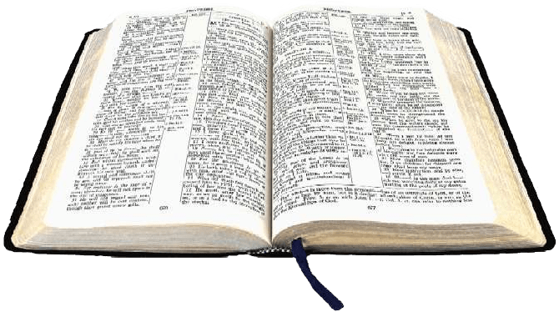

god the holy spirit
KEY VERSES
I will ask the Father, and he will give you another Counselor to be with you forever. (John 14:16)
I tell you the truth: It is for your good that I am going away. Unless I go away, the Counselor will not come to you; but if I go, I will send him to you. (John 16:7)

Slide 4
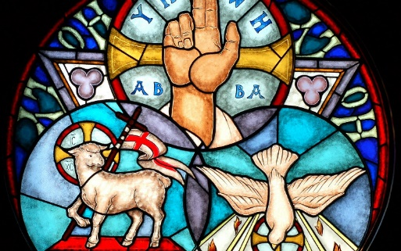
god the holy spirit
Who is the Holy Spirit?
The Holy Spirit is the Spirit of God—the third person of the Trinity. HE IS GOD. He is a gift to people and dwells within the believer. (see John 7: 37-39 and Acts 5:3-4)
Peter replied, “Repent and be baptized, every one of you, in the name of Jesus Christ
for the forgiveness of your sins. And you will receive the gift of the Holy Spirit.”
(Acts 2:38-39)
He is the primary manifestation of the Trinity on earth today. His main task is to work withing and upon believers to complete the work of God in their character and works. (Read Romans 8:1-17) This lesson focuses on the deity and work of the Holy Spirit. Other lessons will cover the gifts of the Holy Spirit.

Slide 5
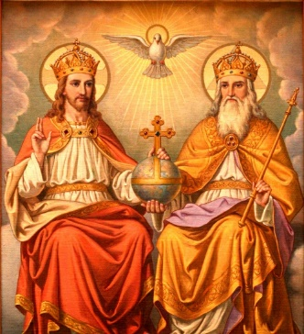
god the holy spirit
Holy Spirit: Co-equal with Father and Son
He is called God (2 Cor. 3:18 and Heb. 10:15-17)
  Then Peter said, “Ananias, how is it that Satan has so filled your heart that you have lied to the Holy Spirit…You have not lied to men but to God.” (Acts 5:3, 4)
He has the attributes of God (Gen. 1:2 and Heb. 9:14)
  …The Spirit searches all things, even the deep things of God. For who among men knows the thoughts of a man except the man’s spirit within him. In the same way, no one knows the thoughts of God except the Spirit of God. (1 Cor. 2:10-11)
He is a person of the Trinity (1 Peter 1:2)
  May the grace of the Lord Jesus Christ, and the love of God, and the fellowship of the Holy Spirit be with you all. (2 Cor. 13:14)

Slide 6

god the holy spirit
Holy Spirit: His names
Spirit of
God
Spirit
Spirit of
Truth
Holy Spirit
Counselor
Comforter
Spirit of
Christ

Slide 7

god the holy spirit
Holy Spirit: His attributes
Attributes of God reflected in the Holy Spirit
Eternal and Infinite | How much more, then, will the blood of Christ, who through the eternal Spirit offered himself unblemished to God, cleanse our consciences from acts that lead to death, so that we may serve the living God! (Heb. 9:14) | Holy | But you will receive power when the Holy Spirit comes on you; and you will be my witnesses in Jerusalem and in all Judea and Samaria, and to the ends of the earth. (Acts 1:8)
All knowing (omniscient) | For who among men knows the thought of a man except the man’s spirit within him? In the same way no one knows the thoughts of God except the Spirit of God. (1 Cor. 2:11) | Creator | The Spirit of God has made me; the breath of the Almighty give me life. (Job 33:4)
Always present (omnipresent) | Where can I go from your Spirit? Where can I flee from your presence? (Psalm 139:7) | Truth | This is the one who came by water and blood—Jesus Christ. He did not come by water only, but by water and blood. And it is the Spirit who testifies, because the Spirit is the truth. (1 John 5:6)
All Powerful (omnipotent) | Be the power of signs and miracles, through the power of the Spirit. So from Jerusalem all the way around to Illyricum, I have fully proclaimed the gospel of Christ. (Rom. 15:19)

Slide 8
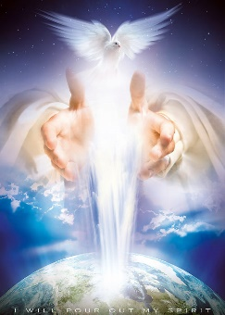
god the holy spirit
Holy Spirit: His Work
The work of the Holy Spirit is to make the presence of God known—both in the world and in the believers. He indwells the believer. He also gives the believer gifts which enable him to:
  Be like Jesus through fruit of the Spirit (Gal. 5:22-23)
  Do Jesus’ works through gifts of the Spirit (1 Cor. 12:8-11)

Slide 9
god the holy spirit
Holy Spirit: His Work
Fruit of the Spirit and Gifts of the Spirit
Fruit of the Spirit (Galatians 5:22:23) | Gifts of the Spirit (1 Cor. 12:8-11)
But the fruit of the Spirit is: | To one there is given through the Spirit the:
Love | Message of wisdom
Joy | Message of knowledge
Peace | Faith
Patience | Gifts of healing
Kindness | Miraculous powers
Goodness | Prophecy
Faithfulness | Distinguishing of spirits
Gentleness | Speaking in different kinds of tongues
Self-Control | Interpretation of tongues
Against these things there is no law. | All these are the work of one and the same Spirit, and he gives them to each one, just as he determines.

Slide 10
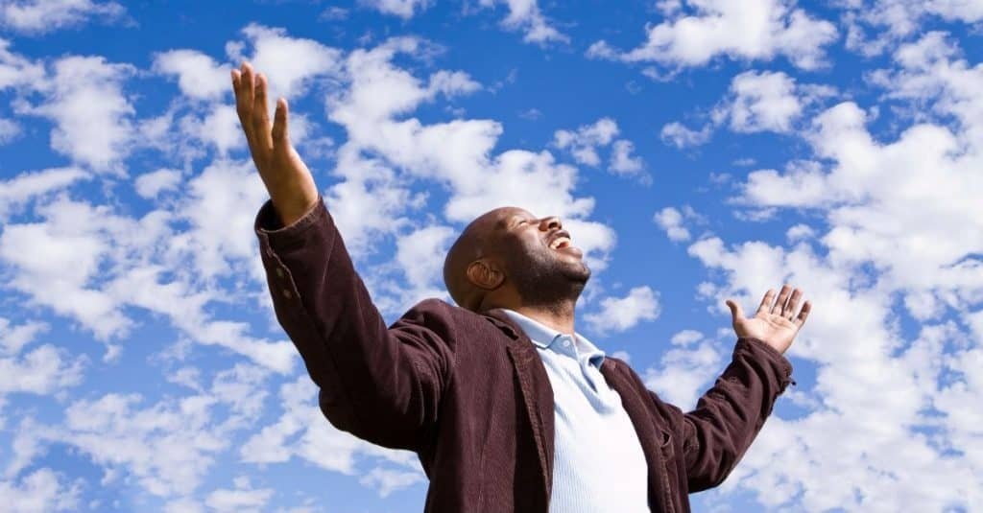
god the holy spirit
Holy Spirit: His Work
The Holy Spirit is a person. He can be grieved (saddened) just as any other person. (Read Isa. 63:10 and Eph. 4:30) If the leading of the Holy Spirit or His gifts are ignored, His influence can be quenched (extinguished or put out). (Read 1 Thes. 5:19)
The following table illustrates how the Holy Spirit interacts with mankind.

Slide 11

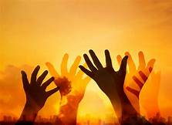
god the holy spirit
Holy Spirit: His Work
Attributes of God reflected in Jesus
He convicts the world | When he comes, he will convict the world of guilt in regard to sin and righteousness and judgement. (John 16:8) | He speaks and lead God’s people | Because those who are led by the Spirit of God are sons of God. (Rom. 8:14)
 |  |  | Acts 8:29, 10:19-20, 13:2, 16:6-7, 20:23, Gal. 5:18
He teaches | But when he, the Spirit of truth, comes, he will guide you into all truth. He will not speak on his own; he will speak only what he hears, and he will tell you what is yet to come. (John 16:13) | He appoints men to specific service | While they were worshipping the Lord and fasting, the Holy Spirit said, “Set apart for me Barnabas and Saul for the work to which I have called them.” (Acts 13:2)
 | Neh. 9:20, 1 Cor. 2:10-12, 1 John 2:27 |  | Acts 20:28
He intercedes and helps believers pray | In the same way, the Spirit helps us in our weakness. We do not know what we ought to pray for, but the Spirit himself intercedes for us with groans that words cannot express. (Rom. 8:26) | He testifies of Christ | When the Counselor comes, whom I will send to you from the Father, the Spirit of truth who goes out from the Father, he will testify about me. (John 15:26)
 | Jude 20 |  | John 16:14, 1 John 4:2

Slide 12
god the holy spirit
Holy Spirit: His Work
Attributes of God reflected in Jesus
He ministers new birth | Flesh gives birth to flesh, but the Spirit gives birth to the spirit. (John 3:6) | He indwells (lives in and fills) the believer | Do you not know that your body is a temple of the Holy Spirit, who is in you, whom you have received from God? You are not your own. (1 Cor. 6:19)
 | Titus 3:5-6
 |  |  | Eze. 44:4, John 14:17, Rom. 5:5, 8:9, 1 Cor 3:16, Eph. 5:18, 1 John 3:24
He brings unity | Make every effort to keep the unity of the Spirit through the bond of peace. (Eph. 4:3) | He gives life | And if the Spirit of him who raised Jesus from the dead is living in you, he who raised Chrst from the dead will also give life to your mortal bodies through his Spirit, who live in you. (Rom. 8:11)
 | Rom. 15:5, Eph. 4:11-13, Phil. 2:1-2 |  | 2 Cor. 3:6, 1 Pet. 3:18
He gives us assurance of salvation | The Spirit himself testifies with our spirit that we are God’s children. (Rom. 8:16) | He empowers believers to be witnesses | But you will receive power when the Holy Spirit come on you, and you will be my witnesses in Jerusalem, and in all Judea and Samaria, and to the end of the earth. (Acts 1:8)
 | 1 John 3:24, 4:13-14 |  | Eze. 36:27, Eph. 3:16

Slide 13
god the holy spirit
Holy Spirit: His Work
Attributes of God reflected in Jesus
He sets apart (seals) every believer into the Body of Christ | Now it is God who makes both us and you stand firm in Christ. He anointed us, set his seal of ownership on us, and put his Spirit in our hears as a deposit, guaranteeing what is to come. (2 Cor. 1:21-22) | He changes new believers to be like Jesus | But the fruit of the Spirit is love, joy, peace, patience, kindness, goodness, faithfulness, gentleness and self-control. Against such things there is not law. Those who belong to Christ Jesus have crucified the sinful nature with its passions and desires. Since we live by the Spirit let us keep in step with the Spirit. (Gal. 55:22-26)
 | 2 Cor. 5:5, Eph. 1:13
 |  |  | Eze. 36:27, Rom. 5:3-5, 8:2-4, Tit. 3:5
He baptizes every believer into the Body of Christ | For we were all baptized by one Spirit into one body—whether Jew or Greek, slave or free—and we were all given the one Spirit to drink. (1 Cor. 12:13) | He gives spiritual gifts to the believer | God also testified to it by signs, wonders and various miracles, and gifts of the Holy Spirit distributed according to his will. (Heb. 2:4)
 |  |  | 1 Cor. 12:1-11
He makes us holy (sanctified) | Who have been chosen according to the foreknowledge of God the Father, through the sanctifying work of the Spirit, for obedience to Jesus Christ and sprinkling by his blood. (1 Pet. 1:2) | He brings freedom to the believer | Now the Lord is the Spirit, and where the Spirit of the Lord is, there is freedom. (2 Cor. 3:17)

Slide 14
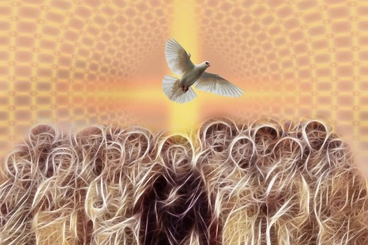
god the holy spirit
Holy Spirit: Works in all generations
Presence in the Old Testament
Before Jesus came as a man, the Holy Spirit was present and working in selected individuals. Examples include:
Joseph (Gen. 41:38)
Bezalel-the craftsman (Ex. 31:2-3, 35: 30-31)
Joshua (Num. 27:18)
Job (Job 33:4)
David (Ps. 139:7)
In the New Testament Church
The book of Acts has sometimes been called “Acts of the Apostles,” but also “Acts of the Holy Spirit.” The word Holy Spirit is used more than 50 times in the book. Here are some examples of his work:
Filled believers at Pentacost (2:4)
Told Philip to speak to Ethiopian Eunuch (8:29)
Encouraged the church (9:31)
Directed church to send Paul and Barnabas on mission (13:2)
Taught the church truth about food sacrificed to idols (15:28)
Warned Paul about Rome (20:23)
Appointed church leaders (20:28)
Foretold the future through a believer (21:11)
During Jesus’ days on earth
He was instrumental in several events relating to Jesus’ life:
Miraculous virgin birth (Matt. 1:20)
Jesus’ baptism (Matt. 3:16, Mk 1:19, Lk. 3:22)
With Jesus during Satan’s temptation (Matt. 4:1-11)
Jesus told the disciples they could ask to receive the Holy Spirit (Lk. 11:13)

Slide 15

god the holy spirit
DISCUSSION
QUESTIONS

Slide 16
god the holy spirit
Who is the Holy Spirit?
What effect has the Holy Spirit had in your life? Or in your ministry? Or in your witness?
What new things did you learn about the Holy Spirit?
Can you live a life acceptable to Jesus without the Holy Spirit?

Slide 17
god the holy spirit
APPLICATION
Memorize John 14:6 and John 16:7
Write down an experience where you were led by the Holy Spirit. Be ready to share with the group.
Ask God to help you understand who the Holy Spirit is and to recognize His voice. Be willing to be obedient as the Holy Spirit leads you in your daily life.
Have you received a gift from the Holy Spirit? If so, write about the circumstance and how you used the gift given to you.

Slide 18

god the holy spirit
Contact: Info@Equippersgroup.org

