Slide 1
god the son: Jesus
Lesson- 3

Slide 2
god the son: Jesus
OBJECTIVES OF THE LESSON
1. To understand Jesus is God in the flesh
2. To understand Jesus’ mission and ministry
To understand that salvation is found in no other name
Accept Jesus as Savior—make Him Lord of your life daily
DISCUSSION QUESTIONS AT END

Slide 3
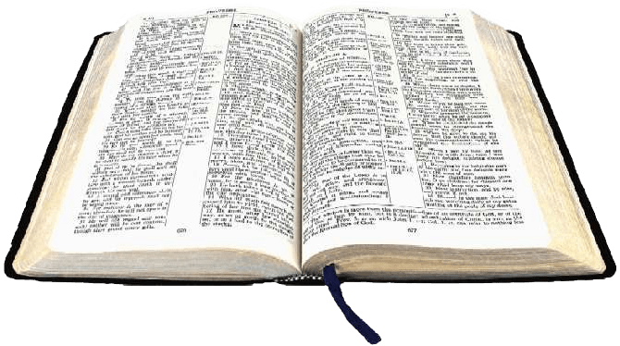
god the son: Jesus
KEY VERSES
The Son is the radiance of God’s glory and the exact representation of his being, sustaining all things by his powerful word. After he had provided purification for sins, he sat down at the right had of the Majesty in heaven.
Hebrews 1:3

Slide 4
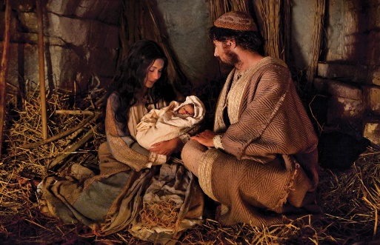
god the son: Jesus
Jesus: The Son of God
Jesus is God himself, coming to earth in human form. Jesus was conceived through the Holy Spirit and born of a virgin. His Father is God (see Luke 1:26-35). This lesson will focus on the truth that Jesus is indeed God, with no beginning and that He is a person (or part) of the Trinity. One of the names of Jesus is “the Word.”
In the beginning was the Word, and the Word was with God, and the Word was God. (John 1:1)
The four Gospels (Matthew, Mark, Luke and John) tell of Jesus’s birth, life, teachings, death and resurrection. The book of Hebrews explains his ministry in relation to the Old Testament. The entire New Testament is about people’s relationship with God through Jesus.

Slide 5
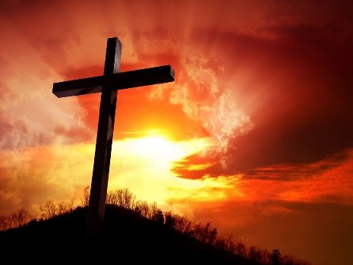
god the son: Jesus
Jesus: The Messiah
Jesus is the Messiah who was prophesied (or predicted, foretold) throughout the Old Testament. Messiah means “Christ, the anointed One.” God knew from the beginning that a Messiah would be required to save each person from his sin. Jesus’ birth, life, death and resurrection (raised from the dead) were prophesied in the Old Testament. Isaiah 42:1-4 prophesies about the coming Christ, the Messiah, and Matthew 12:17-21 tell that Jesus fulfilled that prophesy.
Read the prophesy about Jesus in Isaiah 53. Compare Isaiah 53:7 with Mark 14:61-62. Also compare Isaiah 29:18-19 and Isaiah 61:1-2 with Luke 7:20-22.
He [Jesus] said to them, “This is what I told you while I was still with you: Everything must be fulfilled that is written about me in the Law of Moses, the Prophets and the Psalms.” Then he opened their minds so they could understand the Scriptures. He told them, “This is what was written: The Christ will suffer and rise from the dead on the third, and repentance and forgiveness of sins will be preached in his name to all nations, beginning at Jerusalem.”
(Luke 24:44-47

Slide 6
god the son: Jesus
Jesus: The Messiah
Jesus—the Messiah
Prophesy about Messiah | Old Testament | New Testament
His ancestors | Jer. 23:5, Ps. 132:10--12 | Matt. 1:6, Lk. 3:23-31
Birthplace: Bethlehem | Mic. 5:2 | Matt. 2:1
Born of a virgin | Isa. 7:14 | Lk. 1:34-35
Healer of the sick | Isa. 35:5-6, 53: 4-5 | Matt. 11:4-5
Rejected, despised, hated by his own people | Ps. 69:7-8 | John 1:11
Mocked and insulted | Ps. 22:6-8 | Lk. 23:35-39
Betrayed for 30 pieces of silver | Zec. 11:12 | Matt. 26:14-15
Died by crucifixion | Ps. 22:16 | Lk. 23:33
Soldiers gambled for His clothes | Ps. 22:18 | Lk. 23:34
Raised from the dead | Ps. 16:10 | Mark 16:6

Slide 7
god the son: Jesus
Jesus: God incarnate (God in the flesh)
Attributes of God reflected in Jesus
Eternal and Infinite | “I tell you the truth,” Jesus answered, “before Abraham was born, I am!” (John 8:58) | Always present (omnipresent) | …And surely I am with you always, to the very end of the age. ( Matthew 28:20)
 | Jn. 1:1, 4, 17:5; Heb. 7:3, Rev. 1:8
All knowing (omniscient) | Yet there are some of you who do not believe, For Jesus had known from the beginning which of them did not believe and who would betray him. (John 6:64) | Changeless | Jesus Christ is the same yesterday and today and forever. (Hebrews 13:8)
 | Jn. 2:25, 13:11, 18:4 |  | Heb. 1:10-12
All Powerful (omnipotent) | He got up, rebuked the wind and said to the waves: “Quiet! Be still!” Then the wind died down and it was completely calm. (Mark 4:39) | Full of grace | The Word became flesh and made his dwelling among us. We have seen his glory, the glory of the One and Only, who came form the Father, full of grace and truth. (John 1:14)
 | Matt. 4:24, 8: 5-13, 9:18-26; Mk. 1:24-26, 5:1-17, 4:37-41, Jn. 11:11-44, 6:16-21 |  | Jn. 1:17, Rev. 22:21

Slide 8
god the son: Jesus
Jesus: God incarnate (God in the flesh)
Attributes of God reflected in Jesus
Compassionate | I have compassion for these people; they have already been with me three days and have nothing to eat. (Mark 8:2) | Loving | Greater love has no one than this, that he lay down his life for his friends. (John 15:13)
 | Mk. 9:36, Jas. 5:11 |  | Rom. 5:8, Eph. 2:4, 1 Jn. 4:9-10
Creator | Through him all thing were made; without him nothing was made that has been made. (John 1:3) | One with the Father | If you really knew me, you would know my Father as well. From now on, you do know him and have seen him. …Anyone who has seen me has seen the Father. …Believe me when I say that I am in the Father and the Father is in me. ( John 14: 7, 9, 11)
 | Jn. 1:1-18, Col. 1:15-18, Heb. 1:2 |  | Jn. 1:18, 10: 37-38, 12:45, 14:7
Wrathful (severity, anger) | Jesus entered the temple area and drove out all who were buying and selling there. He overturned the table of the money changers and the benches of those selling doves. “It is written,” he said to them, “ My house will be called a house of prayer, but you are making it a den of robbers.” (Matthew 21:12-13) | Lordship | Therefore, God exalted him t the highest place and gave him the name that is above every name, that at the name of Jesus every knee should bow, in haven and on earth and under the earth and every tongue confess that Jesus Christ is Lord, to the glory of God the Father. (Philippians 2:9-11)
 | Jn. 2:14-16 |  | Rev. 19:16, Eph. 2:6, 1 Tim. 6:15, Rev. 1:5, Matt. 28:18, Mk. 1:21-22

Slide 9
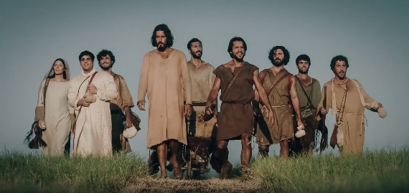
god the son: Jesus
Jesus: His mission
God the father sent Jesus to earth with a mission to enable mankind to return to the Father by having his sin cleansed and forgiven. This was accomplished by Jesus living a sinless life on earth as a man—experiencing the joys and sorrows of a man—yet providing salvation through his death and resurrection. Jesus’ life on earth provided an example of how each person is to live.
For we do not have a high priest who is unable to sympathize with our weaknesses, but we have one who has been tempted in every way, just as we are—yet was without sin. (Heb. 4:15)

Slide 10
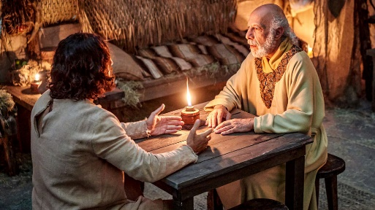
god the son: Jesus
Jesus: His mission
Jesus’ accomplishment of his mission
By giving his life as a ransom to buy us back (Redeemer)
Just as the Son of Man did not come to be served, but to serve, and to give his life as a ransom for many. (Matt. 20:28)
1 Pet. 2:24
By giving us new “birth” into God’s family
Yet to all who received him, to those who believed in his name, he gave the right to become children of God. (Jn. 1:12)
1 Jn. 3:1-2
By giving us eternal life
For God so loved the world that he gave his one and only Son, that whoever believes in him shall not perish but have eternal life. …The thief come only to steal and kill and destroy; I have come that they may have life, and have it to the full. (Jn. 3:16, 10:10)
Jn. 10:28, 14:1-3, 17:2, 1 Jn. 5:11-12

Slide 11
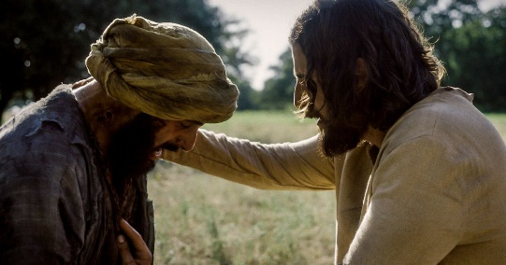
god the son: Jesus
Jesus: His mission
Jesus’ accomplishment of his mission
By destroying the works of Satan
He who does what is sinful is of the devil, because the devil has been sinning from the beginning. The reason the Son of God appeared was to destroy the devil’s work. (1 Jn. 3:8)
Acts 26:17-18, Col 1:13, Heb. 2:14
By reconciling us to fellowship with each other and with God the Father
…His purpose was to create in himself one new man out of the two, thus making peace, and in this one body to reconcile both of them to God through the cross, by which he put to death their hostility. (Eph. 2:15-16)
Eph. 2:14-18 (context), 1 Jn. 1:3
By destroying the power of death
Since the children have flesh and blood, he too shared in their humanity so that by his death he might destroy him who holds the power of death—that is, the devil. (Heb. 2:14)

Slide 12
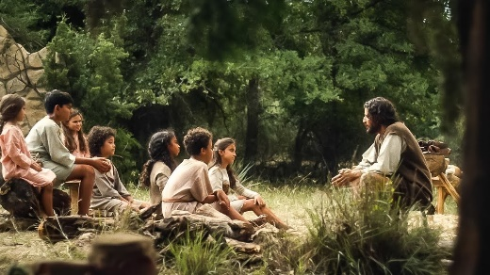
god the son: Jesus
Jesus: His mission
Jesus’ accomplishment of his mission
By being the Savior of the whole world
As for the person who hears my words but does not keep them, I do not judge him. For I did not come to judge the world, but to save it. (Jn. 12:47)
Jn. 3:17, 1 Tim. 1:15
By seeking and saving the lost
For the Son of Man came to seek and to save what was lost. (Lk. 19:10)
By calling sinners to repentance
I have not come to call the righteous, but sinners to repentance. (Lk. 5:32)
Matt. 4:17, 9:13, Lk. 24:47
By bringing healing
He himself bore our sins in his body on the tree, so that we might die to sins and live for righteousness; by his wounds you have been healed. (1 Pet. 2:24)
Matt. 8:16-17, Mk, 1:40-42, Lk. 18: 35-43

Slide 13
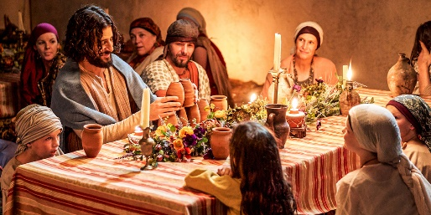
god the son: Jesus
Jesus: His mission
Jesus’ accomplishment of his mission
By being a mediator between God and man
For there is one God and one mediator between God and men, the man Christ Jesus. (1 Tim. 2:5)
By being our example and pattern for life
Whoever claims to live in him must walk as Jesus did. (1 Jn. 2:6)
Rom. 8:29, 2 Cor. 3:18, 1 Pet. 2:21
By preaching and teaching the Good News
But he said, “I must preach the good news of the kingdom of God to the other towns also, because that is why I was sent.” (Lk. 4:43)
By bringing sight to the blind (physically and spiritually)
Jesus said, “For judgment I have come into this world, so that the blind will see and those who see will become blind.” (Jn. 9:39)

Slide 14
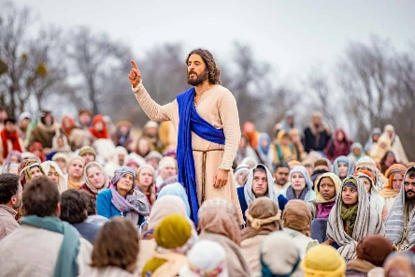
god the son: Jesus
Jesus: His mission
Jesus’ accomplishment of his mission
By doing the will of the Father
“Father, if you are willing, take this cup from me, yet not my will but yours be done.” (Lk. 22:42)
Jn. 4:34, 5:19, 17:4
By fulfilling the Law and the Prophets
Do not think that I have come to abolish the Law or the Prophets; I have not come to abolish them but to fulfill them. (Matt. 5:17)
By testifying of the truth
“You are a king, then!” said Pilate. Jesus answered, “you are right in saying I am a king. In fact, for this reason I was born, and for this I came into the world; to testify to the truth. Everyone on the side of truth listens to me.” (Jn. 18:37)
Jn. 1:17

Slide 15
god the son: Jesus
Jesus: His names
Morning Star,
Root & Offspring
of David
Light of
the World
Messiah
Son of
God
The Way,
The Truth,
& the Life
Jn. 8:12
Rev. 22:16
Matt. 26: 63-64,
Lk. 9:20,
Jn. 4:25-26
Mk. 1:1,
Lk. 22:70
Gate for the Sheep
Jn. 14:6
Wonderful Counselor,
Mighty God,
Everlasting Father,
Prince of Peace
Jn. 10:7
Lord
Bread of Life
God
Jn. 6:35
Jn. 1:1,
Rom. 9:5,
Tit. 2:13
Rom. 10:9
Isa. 9:6
Lamb of God
Jn. 1:29
King of Kings
& Lord of Lords
Vine
Emmanuel
Jn. 15:1
Matt. 1:23
1 Tim. 6:15,
Rev. 17:14, 19:16
Word
Resurrection
& the Life
Son of
Man
John 1:1
Christ
(the Anointed One)
Good Shepherd
Jn. 11:25
Jn. 10:11
Jn. 6:27
Lk . 24:46

Slide 16
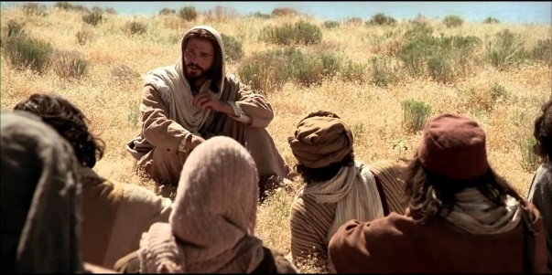
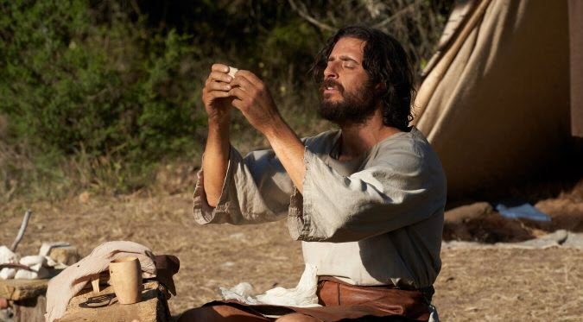
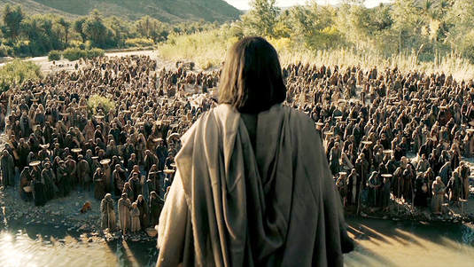
god the son: Jesus
Jesus: His offices
Prophet
He spoke God’s word to mankind. This ministry as “prophet” is seen in the Gospels.
(Matt. 21:11, 46)
Priest
He stands before God as our representative and our intercessor.
(Heb. 4:14-16, 7:15-17)
King
He rules in the hearts of those in His kingdom and the Scripture says that every knee will bow to Him.
(1 Tim. 6:15, Rev. 17:14, 19:16)

Slide 17
god the son: Jesus
DISCUSSION
QUESTIONS

Slide 18
god the son: Jesus
Who is Jesus?
What was Jesus’ purpose in coming to earth?
How does the mission of Jesus, as described in the table “Jesus’ accomplishment of His mission” provide an example for the believer to live his life?
What are the offices in which Jesus operates?
Read the Apostles Creed (on the following slide). The Apostles Creed was written in the third century (200 AD) Does this statement of belief match with your confession of faith?

Slide 19
god the son: Jesus
Apostles Creed
I believe in God, the Father almighty,
Creator of heaven and earth.
I believe in Jesus Christ, His only Song, our Lord.
He was conceived by the power of the Holy Spirit
and born of the virgin Mary.
He suffered under Pontius Pilate,
was crucified, died, and was buried.
He descended into hell.
On the third day he rose again.
He ascended into heaven,
and is seated at the right had of the Father.
He will come again to judge the living and the dead.
I believe in the Holy Spirit,
the holy universal Church,
the communion of saints,
the forgiveness of sins,
the resurrection of the body,
and the life everlasting. Amen.

Slide 20
god the son: Jesus
APPLICATION
Memorize Hebrews 1:3
Read the Gospel of Mark. Outline the major events in Jesus’ life.
Ask God to give you an opportunity this week to tell someone about Jesus.

Slide 21
god the son: Jesus
Contact: Info@Equippersgroup.org

