Slide 1
god the father
Lesson- 2

Slide 2
god the father
OBJECTIVES OF THE LESSON
1. To know that there is only one God
2. To examine the characteristics and nature of God
To understand the persons of the Godhead
Take action to know God better
DISCUSSION QUESTIONS AT END

Slide 3
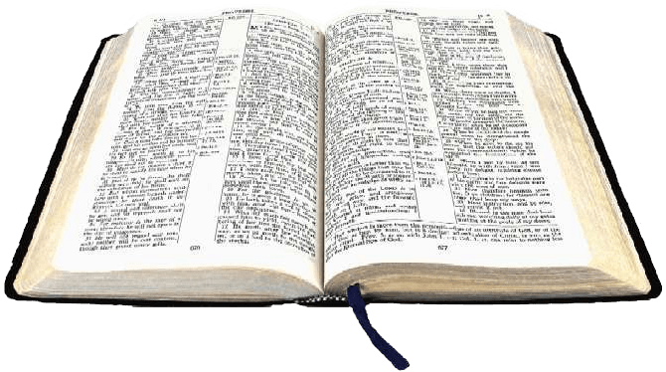
god the father
KEY VERSES
You shall have no other gods before me. You shall not make for yourself an idol in the form of anything in heaven above of on the earth beneath or in the waters below. You shall not bow down to them or worship them; for I, the LORD your god, am a jealous God.
Exodus 20:3-5
And we pray this in order that you may live a life worthy of the Lord and may please him in every way; bearing fruit in every good work, growing in the knowledge of God.
Colossians 1:10

Slide 4
god the father
Who is God?
God is an intelligent, spiritual and personal being—the creator, redeemer, preserver and ruler of the universe. Although God is above all creation, He still desires to have a relationship with people.
Come near to God and he will come near to you… (James 4:8)
The Lord is near to all who call on him, to all who call on him in truth. (Psalm 145: 18)

Slide 5
god the father
How many persons are in the Godhead?
While God is one, He exists in three persons (the Godhead)—commonly referred to as “the Trinity”—the Father, the Son and the Holy Spirit. The God head is composed of these persons of God—each with His own attributes as they relate to mankind.
God, the Father—All powerful, all loving and all wise. God is Father to those who become His children through faith in Jesus.
God, the Son—Jesus Christ, God’s Son, became a man and, through His death and resurrection, is Savior.
God, the Holy Spirit—The Spirit of God, who regenerates, indwells, baptizes, energizes and sanctifies the believer.
These three persons of God are one God—the same in substance, equal in power and glory.
The Trinity
FATHER
IS
IS
NOT
IS
NOT
GOD
IS
IS
SON
SPIRIT
IS
NOT

Slide 6
god the father
Common attributes of the Father, Son and Holy Spirit
Attribute | God the Father | God the Son | God the Holy Spirit
Eternal | Psalm 90:2 | John 1:2 Revelation 1:8, 17 | Hebrews 9:14
Omnipotent (all powerful) | 1 Peter 1:5 | 2 Corinthians 12:9 | Romans 15:19
Omniscient (all knowing) | Jeremiah 17:10 | Revelation 2:23 | 1 Corinthians 2:11
Omnipresent (always present) | Jeremiah 23:24 | Matthew 18:20 | Psalm 139:7
Holy | Revelation 15:4 | Acts 3:14 | Acts 1:8
Truth | Psalm 31:5 | John 14:6 | John 14:16-17
Kindness & Goodness | Romans 2:4 | Ephesians 5:25 | Nehemiah 9:20

Slide 7
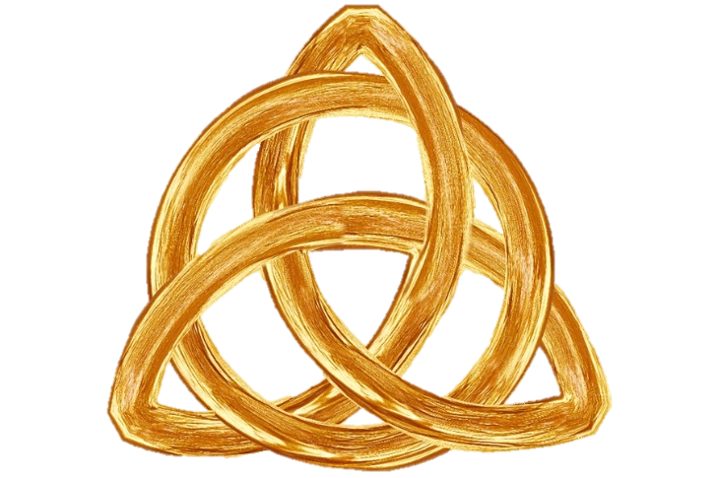
god the father
Activities involving the Father, Son and Holy Spirit
Activity | God the Father | God the Son | God the Holy Spirit
Creation of the world | Psalm 102:25 | Colossians 1:16 | Genesis 1:2 Job 26:13
Creation of Man | Genesis 2:7 | Colossians 1:16 | Job 33:4
Baptism of Jesus | Matthew 3:17 | Mark 1:11 | John 1:32
Death of Jesus | Hebrews 9:14 | Hebrews 9:14 | Hebrews 9:14

Slide 8
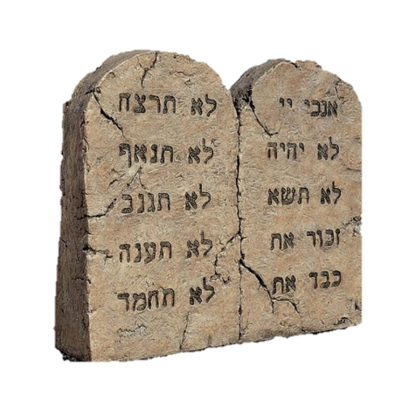
god the father
Is there more than one God?
NO! There is only one God—the living and true God. Many Scriptures point to this fact.
This is what the Lord says—Israel’s King and Redeemer, the Lord Almighty: I am the first and I am the last; apart from me there is no God. (Isaiah 44:6)
How great you are, O Sovereign Lord! There is no one like you and there is no God but you, as we have heard with our own ears. (2 Samuel 7:22)
Also read Deuteronomy 6:4 and Isaiah 43: 10-13

Slide 9
god the father
Why knowing God is so important
Eternal life (salvation) is rooted in relationship with God.
We know also that the Son of God has come and has given us understanding, so that we may know him who is true. And we are in him who is true—even in his Son Jesus Christ. He is the true God and eternal life. (1 John 5:20)
Now this is eternal life: that they may know you, the only true God, and Jesus Christ,, whom you have sent. (John 17:3)
We are commanded to pursue the knowledge of God.
Let us know, let us pursue the knowledge of the Lord.
(Hosea 6:3 NKJV)
Knowing God is more important than gaining wisdom, strength or riches.
This is what the Lord says: “Let not the wise boast of his wisdom or the strong man boast of his strength or the rich man boast of his riches, but let him who boasts boast about this: that he understands and knows me, that I am the Lord, who exercises kindness, justice and righteousness on earth, for in these I delight.”
(Jeremiah 9:23-24)
Strength in battle comes from knowing God.
…but the people who know their God shall be strong and carry out great exploits.
(Daniel 11:32 NKJV)

Slide 10
god the father
God
is a loving
father
Attributes of God the Father
All Powerful
(omnipotent)
Spirit
Eternal
& Infinite
Ps. 147:5,
1 Ch. 29:11,
Eph. 3:20
1 Jn. 3:1,
Isa. 63:16,
Mal. 2:10,
Rom. 8:15,
Jas. 1:17
All Knowing
(omniscient)
John 4:24,
Genesis 1:2
Deut. 33:27 & 32:40,
Job 11:7, Psalm 90:2
& 139:1-9,
Isa. 57:15
John 16:30,
Ps. 139:1-6,
Acts 1:23-26,
Heb. 4:13,
1 John 3:20
Always Present
(omnipresent)
Ps. 139:7 & 8-12
God created
us in his image--
But is not like us
Changeless
God does not live
in temples—but in
the hearts of men
Holy
Loving
Jas. 1:17,
Mal. 3:6
Isa. 55:8, Gen. 1:26-27,
Num. 23:19
Rev. 4:8
1 Jn. 4:16, Jer. 31:3,
Rom. 5:8 & 8: 38-39,
Eph. 2:4-5
1 Cor. 3:16,
Acts 17:24-25
Gracious
Wrathful
(severity, anger)
God can be known by us
Ex. 34:6-7
Rom. 1:18, Ps. 95:11,
Heb. 12:28-29,
Rev. 6:16
Heb. 8:11, Ez. 38:23,
John 16:14-15 & 17:25-26

Slide 11
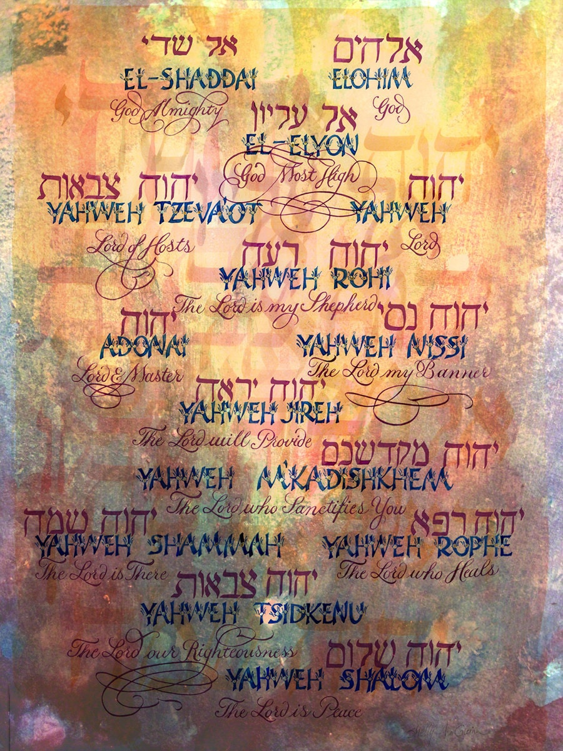
god the father
Names of God the Father
God has many names which are associated with His different character traits. These names are the English translation from Hebrew. Several are shown in the following table.
Note that Jehovah is a translation for the word Yahweh.

Slide 12
god the father
Names of God the Father
Hebrew names and meanings of God the Father
God’s Name | Meaning & Significance | Reference
Elohim | God-refers to God’s power and might. He is the only supreme and true God. | Genesis 1:1, 26 Psalm 42:2
Yahweh (Jehovah) | The Lord—the self-existent One, I Am That I Am—the proper name of the divine person. | Genesis 2:4 Exodus 3:13-16, 6:2-3
El Elyon | God Most High—He is above all gods; nothing in life is more sacred. | Genesis 14:19-20 Psalm 7:17, 57:2
El Roi | God Who Sees—God oversees all creation and affairs of people. | Genesis 16:13
El Shaddai | God Almighty—the all sufficient One, God is all powerful. | Genesis 17:1 Job 33:4 Psalm 91:1
Yahweh (Jehovah Yireh) | The Lord Will Provide—God will provide our real needs. | Genesis 22:13-14
Yahweh (Jehovah Nissi) | The Lord is my Banner—we should remember God for helping us. | Exodus 17:15

Slide 13
god the father
Names of God the Father
Hebrew names and meanings of God the Father
God’s Name | Meaning & Significance | Reference
Adonai | Lord—God alone is the head over all. | Genesis 15:2 Psalm 90:1
Yahweh (Jehovah Shalom) | The Lord is Peace—God gives us peace, so we need not fear. | Judges 6:24
Aabiynuw | Father—God is our Father | Isaiah 9:6, 63:16, 64:8
Yahweh (Jehovah Sabaoth) | Lord of Hosts—(host refers to armies, but also to all the heavenly powers)—God is our Savior and Protector. | 1 Samuel 17:45 2 Samuel 6:2 Isaiah 6:3
El Olam | The Everlasting God—God is eternal. He will never die. | Isaiah 40:28 Psalm 90:2
Yahweh (Jehovah Tsidkenu) | The Lord is Our Righteousness—God is our standard for right behavior. He alone can make us righteous. | Jeremiah 23:6, 33:16
Yahweh (Jehovah Shammah) | The Lord is There—God is always present with us. | Ezekiel 48:35

Slide 14
god the father
DISCUSSION
QUESTIONS

Slide 15
god the father
Describe God in your own words.
Why is it wrong to worship other gods?
Are other gods worshipped in your culture?
Which one of the attributes of God brings you the most comfort?
How is God like us?
Why is God’s attribute of wrath consistent with His love?
Which characteristic or attribute of God motivates you to serve, obey or love God?

Slide 16
god the father
APPLICATION
Memorize Exodus 20:3-5 and Colossians 1:10
Look up the additional Scriptures—think about and examine God’s character.

Slide 17
god the father
Contact: Info@Equippersgroup.org

