Slide 1




The Bible
Lesson- 1

Slide 2
The Bible
OBJECTIVES OF THE LESSON
1. To believe that the Bible is the Word of God
2. To understand the purpose of the Bible
To understand the Bible’s benefit to man
Commit to read the Bible daily as a result of this study.
DISCUSSION QUESTIONS AT END

Slide 3
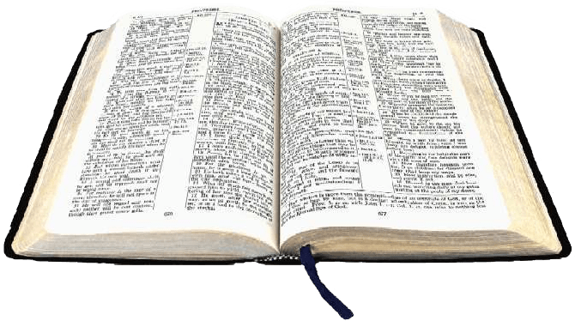

The Bible
KEY VERSE
All Scripture is God-breathed and is useful for teaching, rebuking, correcting and training in righteousness.
2 Timothy 3:16

Slide 4
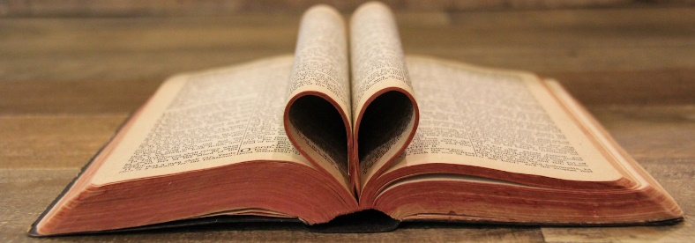
The Bible
The Bible is like no other book
God’s words are compiled into what we know as “the Bible” from the Greek word biblos meaning “a book.” It is God’s love letter to people.
The Bible is also called “Scripture,” “Word of God,” “the law,” “statutes,” or “precepts.”
Reading the Bible reveals to us God’s thoughts, plans, and promises.

Slide 5
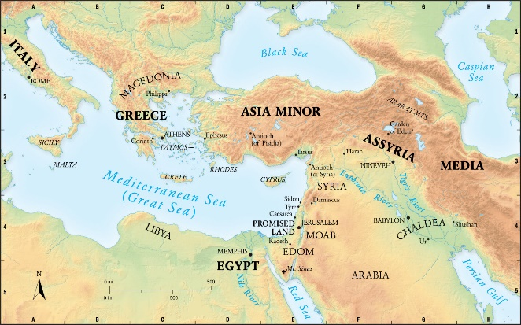
The Bible
The method in which the Scriptures were written
One of the oldest books in the world
Written on three continents (Asia, Europe and Africa) in three languages (Hebrew, Aramaic and Greek)
Written over a period of 1500 years and 40 generations
The Bible was written by men but inspired by the Holy Spirit of God. The authors came from all walks of life: kings, fishermen, poets, philosophers, peasants, physicians, shepherds, statesmen, scholars and farmers.

Slide 6
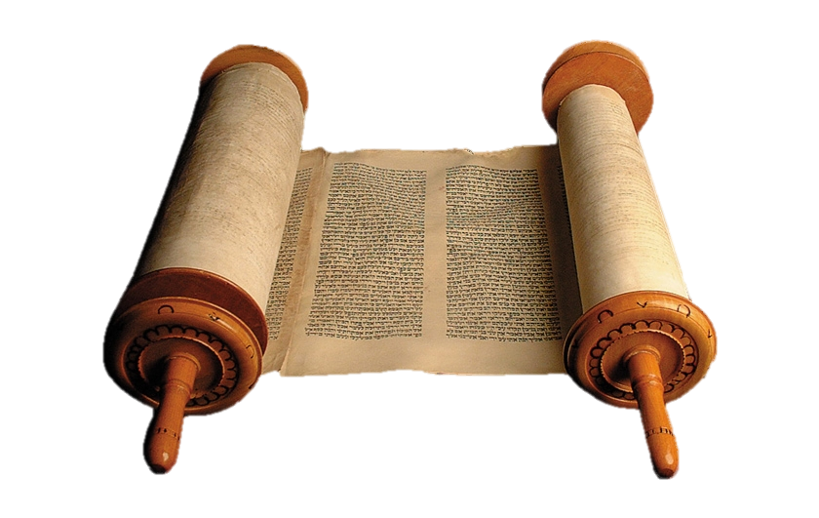
The Bible
The Bible’s unified message
The miracle is that the Bible has a unified message even though it was written over a huge span of years by people of different cultures and diversities.
The message is that God loves people and wants a relationship with them. This is accomplished through Jesus Christ, the Son of God, who came to earth to save sinful people. This message is consistent throughout the Bible—from Genesis to Revelation.
Enemies have tried to destroy the Bible, Satan has tried to defeat the Scriptures, but they have survived.

Slide 7
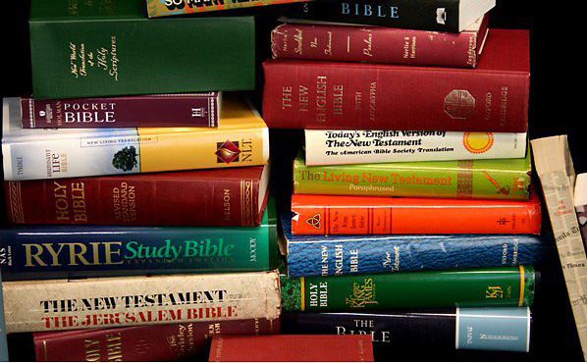
The Bible
The Bible’s popularity
It has been printed more than any other book ever written.
It is translated into more languages than any other book.
It has sold the most copies.
It is read more than any other book on earth.

Slide 8
The Bible
The Bible changes lives and answers questions
The Bible has changed the lives of all who read it with a heart to understand God. It continues to change lives today by answering the major questions of life. The Bible is the source of all spiritual truth.
Where did I come from?
Where will I go when I die?
Why am I here?

Slide 9
The Bible
How is the Bible organized?
Two main sections
Old Testament | New Testament
39 Books | 27 Books
Creation of the world | Jesus’ birth, life, ministry, death and resurrection
How God selected the Israelites to be His chosen people | Birth of the Christian church
His plan to provide a Messiah | Letters to believers
History of the Jewish nation | Prophecy

Slide 10
The Bible
The Bible: categorized by type of literature
Old Testament (39 books)
The Law (Pentateuch)
Genesis Exodus Leviticus Numbers Deuteronomy
Narrative/History
Joshua Judges Ruth 1 Samuel 2 Samuel 1 Kings | 2 Kings 1 Chronicles 2 Chronicles Ezra Nehemiah Esther
Poetry
Job Psalms Proverbs Ecclesiastes Song of Songs
Major Prophets
Isaiah Jeremiah Lamentations Ezekiel Daniel
Minor Prophets
Hosea Joel Amos Obadiah Jonah Micah | Nahum Habakkuk Zephaniah Haggai Zechariah Malachi

Slide 11
The Bible
The Bible: categorized by type of literature
New Testament (27 books)
Gospels
Matthew Mark | Luke John
Paul’s Letters
Romans 1 Corinthians 2 Corinthians Galatians Ephesians Philippians Colossians | 1 Thessalonians 2 Thessalonians 1 Timothy 2 Timothy Titus Philemon
History
Acts
Other Letters (Epistles)
Hebrews James 1 Peter | 2 Peter 1 John 2 John | 3 John Jude
Prophecy
Revelation

Slide 12
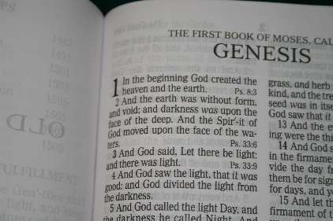
The Bible
Scripture references
The index (list of books) in the front of the Bible give the page number for the part you with you study. Translators organized the text as follows: Books—Chapters within the book—Verses within the chapter.
Scripture references are written in the following order: Name of the book, chapter number followed by “:” and then verse(s).
Scripture references
Reference | Book | Chapter | Verse(s)
Genesis 3:15 | Genesis | 3 | 15
Psalm 98:2-6 | Psalm | 98 | 2 through 6
Isaiah 10: 4, 8 | Isaiah | 4 | 4 and 8
Joel 1:1, 5:1 | Two references from the same book
Note: Occasionally, Scripture passages in a lesson may skip a verses or verses. In this case, “…” will indicate the skipped text.

Slide 13
The Bible
Abbreviations of Bible Books
Book | Abb | Book | Abb | Book | Abb | Book | Abb | Book | Abb
Genesis | Gen | Ezra | Ez | Joel | Joel | Matthew | Matt | 1 Timothy | 1 Tim
Exodus | Ex | Nehemiah | Neh | Amos | Am | Mark | Mk | 2 Timothy | 2 Tim
Leviticus | Lev | Esther | Est | Obadiah | Ob | Luke | Lk | Titus | Tit
Numbers | Num | Job | Job | Jonah | Jnh | John | Jn | Philemon | Phm
Deuteronomy | Deut | Psalms | Ps | Micah | Mic | Acts | Ac | Hebrews | Heb
Joshua | Jos | Proverbs | Pr | Nahum | Na | Romans | Rom | James | Jas
Judges | Jdg | Ecclesiastes | Ecc | Habakkuk | Hab | 1 Corinthians | 1 Cor | 1 Peter | 1 Pet
Ruth | Ru | Song of Songs | SS | Zephaniah | Zep | 2 Corinthians | 2 Cor | 2 Peter | 2 Pet
1 Samuel | 1 Sa | Isaiah | Isa | Haggai | Hag | Galatians | Gal | 1 John | 1 Jn
2 Samuel | 2 Sa | Jeremiah | Jer | Zechariah | Zec | Ephesians | Eph | 2 John | 2 Jn
1 Kings | 1 Ki | Lamentations | La | Malachi | Mal | Philippians | Php | 3 John | 3 Jn
2 Kings | 2 Ki | Ezekiel | Eze |  |  | Colossians | Col | Jude | Jude
1 Chronicles | 1 Ch | Daniel | Dan |  |  | 1 Thessalonians | 1 Thes | Revelation | Rev
2 Chronicles | 2 Ch | Hosea | Hos |  |  | 2 Thessalonians | 2 Thes

Slide 14
The Bible
What the Bible says about itself
What the Bible says about its purpose, power and benefit to mankind
Inspired by God
 | For prophesy neve ad its origin in the will of man, but men spoke from God as they were carried along by the Holy Spirit. (2 Peter 1:21)
 | See also 2 Timothy 3:16
Absolutely trustworthy
 | The law of the Lord is perfect, reviving the soul. The statutes of the Lord are trustworthy, making wise the simple. (Psalm 19:7)
 | See also Psalm 119:89, Matthew 5:18 and 1 Peter 1:25
Produces Life
 | The Spirit gives life; the flesh counts for nothing. The words I have spoken to you are spirit and they are life. (John 6:63)
Is powerful
 | For the word of God is living and active. Sharper than any double-edged sword, it penetrates even to dividing soul and spirit, joints and marrow; it judges the thoughts and attitudes of the heart. (Hebrews 4:12)
 | See also Ephesians 6:17

Slide 15
The Bible
The Bible’s benefit to mankind
Provides for faith | Helps us pray
So then faith comes by hearing, and hearing by the Word of God. (Romans 10:17 NKJV) | If you remain in me and my words remain in you, ask whatever you wish, and it will be given you. (John 15:7)
Shows the Way of Salvation | Makes us wise
But these are written that you may believe that Jesus is the Christ, the Son of God, and that by believing you may have life in his name. (John 20:31) | And how from infancy you have known the holy Scriptures, which are able to make you wise for salvation through faith in Christ Jesus. (2 Timothy 3:15)
See also John 3:16, Acts 4:12 and 2 Timothy 3:15 | See also Psalms 19:7 and 119:98-100
Cleanses the Soul | Provides healing
You are already clean because of the word I have spoken to you. (John 15:3) | He sent forth his word and healed them; he rescued them from the grave. (Psalm 107:20)
See also Psalm 119:9, 11, Ephesians 5:25-27 and 2 Peter 1:3-4 | See also Psalms 30:2 and 147:3
Shows us the way to go | Provides comfort and strength in times of trouble
Your word is a lamp to my feet and a light for my path. …The unfolding of your words gives light; it gives understanding to the simple. (Psalm 119:105, 130) | For everything that was written in the past was written to teach us, so that through endurance and the encouragement of the Scriptures we might have hope. (Romans 15:4)
See also Psalm 19:8 | See also Matthew 7: 24-7
Provides food for the soul and causes growth
Jesus answered, “It is written: Man does not live on bread alone, but on every word that comes from the mouth of God.” (Matthew 4:4)
See also Jeremiah 15:16, 1 Corinthians 3:1-2, Ephesians 4:12-15 and 1 Peter 2:2

Slide 16

The Bible
DISCUSSION
QUESTIONS

Slide 17
The Bible
How does God’s Word benefit your life?
How do you know that the Bible is inspired by God?
Explain how the Bible is relevant today.

Slide 18
The Bible
APPLICATION
Memorize 2 Timothy 3:16.
Look at your Bible. Notice how the books, chapters and verses are arranged. Count how many books are in the Old Testament and the New Testament.
Read in your Bible the “See also” Scripture references shown in Tables 1.3 and 1.4.
Be prepared to share how the Word of God helped you this week.

Slide 19

The Bible
Contact: Info@Equippersgroup.org

