Slide 1
Jesus’ return-his second coming
Lesson- 12

Slide 2
Jesus’ return-his second coming
OBJECTIVES OF THE LESSON
To realize that Jesus promised to come again
Be prepared for the second coming by being like Christ
To recognize the events of the second coming
DISCUSSION QUESTIONS AT END

Slide 3
Jesus’ return-his second coming
KEY VERSES
For the Son of Man is going to come in his Father’s glory with his angels, and then he will reward each person according to what he has done.
Matthew 16:27
“Men of Galilee,” they said, “why do you stand here looking into the sky? This same Jesus, who has been taken from you into heaven will come back in the same way you have seen him go into heaven.”
Acts 1:11

Slide 4
Jesus’ return-his second coming
What is the second coming of Jesus?
Jesus said that He would come again (Matt. 24:30, Jn. 14:2-3, Rev. 22:12), the angels foretold it (Acts 1:10-11), and the early Christians encouraged each other with it (1 Thes. 4:16-18). Titus 2:13 says the return of Jesus Christ is the “blessed hope”—and is often called the “day of the Lord.”
For you know very well that the day of the Lord will come like a thief in the night. (1 Thes. 5:2)
Scripture says that Jesus will return to earth and establish His kingdom and will judge the world. When Jesus returns, it will be sudden, personal, visible and He will be in His new body.
See also Matt. 25:31-32, Mk. 14:62, 1 Cor. 4:5

Slide 5
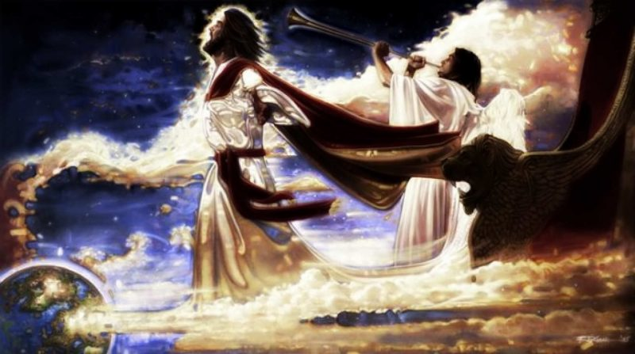
Jesus’ return-his second coming
Future events
Several major future events are prophesied throughout Scripture. Just as Jesus’ first coming was prophesied, so is His second coming. Let’s look at some of these references.

Slide 6
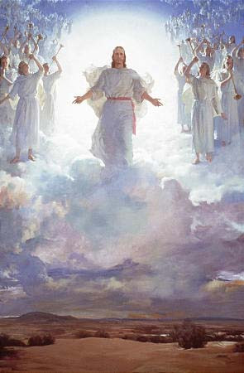
Jesus’ return-his second coming
Future events
The rapture—”to be caught up.” When Jesus claims believers dead and alive. Will happen in an instant, no one knows when. (1 Thes. 4:13-18, 1 Cor. 15:51-58)
Tribulation and reign of the antichrist—the earth will be judged for seven years during which Satan’s antichrist (beast) will rule over the earth. It will be a time of persecution and calamity. (Dan. 9:26-27, Matt. 24:15, 24-25; 1 Jn. 2:18, 4:3; 2 Jn. 7)
The second coming of Jesus—when Jesus returns to earth with His believers to establish His earthly kingdom. (Rev. 19:11-18)
Battle of Armageddon—battle between God and all the evil forces of Satan and the beast. (Rev. 19:19-21)

Slide 7
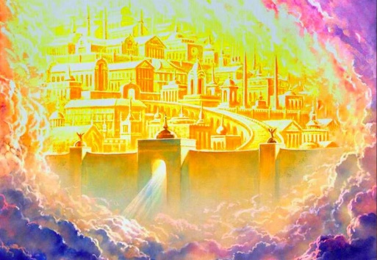
Jesus’ return-his second coming
Future events
1000-year reign of Jesus—He makes His kingdom on earth and reigns as king for 1000 years. Satan and the beast are thrown into the abyss during this time. Then Satan and all his followers are destroyed forever. (Dan. 2:44, Isa. 2:1-4, 11:1-12, 35:1-10; Rev. 20:1-7)
Judgement—when all men will be judged (both living and dead). The believer will be judged at the judgement seat of Christ (2 Cor. 5:10-11). The unbeliever will be judged at the great white throne judgement (Rev. 20:11-15)
New Heaven and New Earth—God will create this dwelling place for all believers. God will dwell there with believers in peace and security. (Rev. 21-22)
Scholars disagree as to the timing of some of these events in relation to Jesus’ second coming—but they all agree that they will occur because they are prophesied (promised) in Scripture.

Slide 8
Jesus’ return-his second coming
The description of Jesus’ return
The second coming of Jesus to earth is a very important truth for the Christian. There are many verses in the Bible which prophesy (predict) Jesus’ second coming. The prophetic books of Daniel, Zechariah, Isaiah and Revelation—and many of the Psalms—prophesy His coming. We know and believe His coming is certain!
Jesus taught about His second coming as seen in the Gospels of Matthew, Mark and Luke. (Matt. 24, Mk. 13, Lk. 21)
(See also 1 Thes. 4:13-5:11, Heb. 10:36-39, Jas. 5:7-9, 2 Peter 3:11-13)
The last book of the NT, Revelation, tells about the future events to happen on earth and prophesied the second coming.
He who testifies to these things says, yes, I am coming soon, Amen. Come, Lord Jesus. (Rev. 22:20)

Slide 9
Jesus’ return-his second coming
Jesus’ return
Jesus’ return
Unexpected | Now, brothers, about times and dates we do not need to write to you, for you know very well that the day of the Lord will come like a thief in the night. While people are saying “Peace and safety,” destruction will come upon them suddenly. (1 Thes. 5:1-3) | Like lightning | For as the lightning comes from the east and flashes to the west, so will be the coming of th Son of Man. (Matt. 24:27)
 | Matt. 24:36-50, 1 Thes. 5:4-11, Rev. 3:3, 11 |  | Lk. 17:24
Same way He left | …This same Jesus, who has been taken from you into heaven, will come back in the same way you have seen him go into heaven. (Acts 1:11) | Power and Glory | At that time they will see the Son of Man coming in a cloud with power and great glory. (Lk. 21:27)
 | Mk. 13:26-27 |  | Matt. 24:30
In Full View | Look, he is coming with the clouds, and every eye will see him, even those who pierced him, and all the peoples of the earth will mourn because of him. So shall it be! Amen. (Rev. 1:7)
Scripture tells us that Jesus will return in the same manner as He was taken up to heaven. Although it does not tell us the time of Jesus’ coming, the following table gives a glimpse of what the second coming will be like.

Slide 10
Jesus’ return-his second coming
Living in light of His return
The scriptures instruct believers in the attitude they should have and how they should behave while awaiting Jesus’ second coming.
From time to time, there has been a false idea in the church that to honor the second coming there is no need to make long-term plans. This is usually claimed by someone who says they know when He will return. The church has been waiting for over 2000 years. Since we don’t know the day or hour (Matt. 25:13), we are to live in a wise, prudent and practical way. Christians are to live a Christ-like life and fulfill the ministry God has given them to do.
So, what do we do?

Slide 11
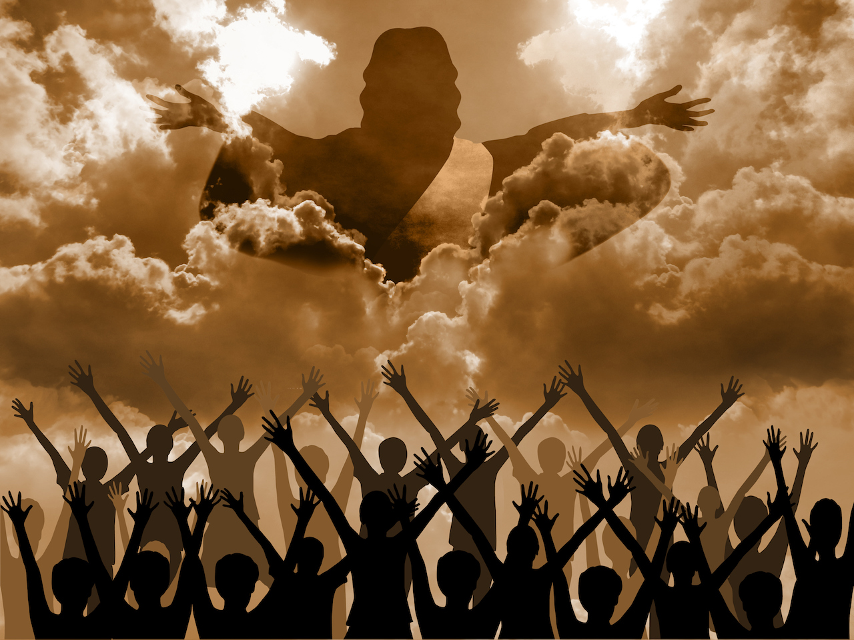
Jesus’ return-his second coming
Conduct while waiting for His return
Wait eagerly
So then, dear friends, since you are looking forward to this, make every effort to be found spotless, blameless and at peace with him.
(2 Peter 3:14)
2 Pet. 3:1-13
Do not be troubled
Peace I leave with you; my peace I give to you. I do not give to you as the world gives. Do not let your hearts be troubled and do not be afraid. “You heard me say, ‘I am going away and I am coming back for you.’ If you loved me, you would be glad that I am going to the Father, for the Father is greater than I.” (John 14:27-28)
Jn. 14:1-4
Be alert and self controlled
Therefore keep watch, because you do not know on what day our Lord will come.
(Matt. 24:42)
Matt. 25:13, Mk. 13:33, Lk. 12:40, 1 Thes. 5:6, 8

Slide 12
Jesus’ return-his second coming
Conduct while waiting for His return
Beware of scoffers
First of all, you must understand that in the last days scoffers will come, scoffing and following their own evil desires.
(2 Peter 3:3)
2 Pet. 3:4-8
Encourage each other
Therefore encourage each other with these words.
(1 Thes. 4:18)
1 Thes. 4:13-17, 5:11
Beware of false christs
Jesus answered: “Watch out that no one deceives you. For many will come in my name, claiming, ‘I am the Christ,’ and will deceive many.”
(Matt. 24:4-5)
Matt. 24:24-27, Lk. 21:8-28

Slide 13
Jesus’ return-his second coming
Conduct while waiting for His return
Remember
Remember, therefore, what you have received and heard; obey it, and repent. But if you do not wake up, I will come like a thief, and you will not know at what time I will come to you.
(Rev. 3:3)
Be patient and don’t grumble
Be patient, then, brothers, until the Lord’s coming. …You too, be patient and stand firm, because the Lord’s coming is near. Don’t grumble against each other, brothers, or you will be judged. The Judge is standing at the door!
(Jas. 5:7, 8-9)
1 Cor. 1:7
Persevere
But my righteous one will live by faith. And if he shrinks back, I will not be pleased with him. …But we are not of those who shrink back and are destroyed, but of those who believe and are saved.
(Heb. 10:37, 39)
Heb. 10:36-39, 1 Tim. 6:11-14, 1 Jn. 2:28

Slide 14
Jesus’ return-his second coming
Conduct while waiting for His return
Be holy, godly, at peace
…You ought to live holy and godly lives as you look forward to the day of God and speed its coming. That day will bring about eh destruction of the heavens by fire, and the elements will melt in the heat. But in keeping with his promise, we are looking forward to a new heaven and a new earth, the home of righteousness. So then, dear friends, since you are looking forward to this, make every effort to be found spotless, blameless and at peace with him.
(2 Pet. 3:11-14)
1 Thes. 5:23
Live sober and upright
It teaches us to say “No” to ungodliness and worldly passions, and to live self-controlled, upright and godly lives in this present age, while we wait for the blessed hope—the glorious appearing of our great God and Savior, Jesus Christ.
(Tit. 2:12-13)
Elders shepherd the flock
Be shepherds of God’s flock that is under your care, serving as overseers—not because you must, but because you are willing…And when the Chief Shepherd appears, you will receive the crown of glory that will never fade away.
(1 Pet. 5:2, 4)

Slide 15
Jesus’ return-his second coming
DISCUSSION
QUESTIONS

Slide 16
Jesus’ return-his second coming
How do we know that Jesus will come again?
List the events that will occur in the future. How might they affect you?
How will Jesus return?
What will happen when Jesus returns again?

Slide 17
Jesus’ return-his second coming
APPLICATION
Memorize Matthew 16:27 and Acts 1:11
Read what Jesus said about His second coming in Matthew 24, Mark 13 and Luke 13.
Prayerfully consider whether you are ready for Jesus’ return. Allow the Holy Spirit to lead you in correcting your life so you will be ready.

Slide 18
Jesus’ return-his second coming
Contact: Info@Equippersgroup.org

