Slide 1
grace
Lesson- 10

Slide 2
grace
OBJECTIVES OF THE LESSON
To understand the meaning of grace
Accept that God’s grace is released in your life
DISCUSSION QUESTIONS AT END

Slide 3
grace
KEY VERSES
For it is by grace you have been saved, through faith—and this not from yourselves, it is the gift of God—not by works, so that no one can boast.
Ephesians 2:8-9
Let us then approach the throne of grace with confidence, so that we may receive mercy and find grace to help us in out time of need.
Hebrews 4:16

Slide 4
grace
What is grace?
Grace flows to man from God through His generous character. One demonstration of God’s grace was when God revealed Himself to Moses (Exodus 34:1-8). God said:
The Lord, the Lord, the compassionate and gracious God, slow to anger, abounding in love and faithfulness, maintaining love to thousands, and forgiving wickedness, rebellion and sin…
(Exodus 34:6-7)
Another example is related to Jonah. Jonah recognized God’s grace toward man:
He prayed to the Lord, “O Lord, is this not what I said when I was still at home? That is why I was so quick to flee to Tarshish. I knew that you are a gracious and compassionate God, slow to anger and abounding in love, a God who relents from sending calamity.”
(Jonah 4:2)
See also Psalms 86:15 and 103:8

Slide 5
grace
What is grace?
God demonstrated the ultimate act of grace toward man by sending Jesus to die on the cross for man’s sin. The motive for grace is found in the giver—God gives grace to man because it is in His heart to do so, not because of man’s actions.
Grace has been defined in several ways:
Unmerited favor—kindness bestowed on the underserving
Free gift—the gift of being accepted before we become acceptable, cannot be earned
Divine influence—on the heart and its reflection in the life

Slide 6
grace
What is grace?
G
od’s
R
iches
A
t
C
hrist’s
E
xpense

Slide 7
grace
To whom is God’s grace given?
To all mankind (common grace)
God’s desire is for all people to know Him. This can only be accomplished through God’s grace by faith in Jesus Christ.
For the grace of God that brings salvation has appeared to all men. (Titus 2:11)

Slide 8
grace
To whom is God’s grace given?
To the believer (saving grace)
God’s grace and love for man is the only way that he can be saved from the penalty and power of sin.
But because of his great love for us, God, who is rich in mercy, made us alive with Christ even when we were dead in transgressions—it is by grace you have been saved. (Eph. 2:4-5)
See also Eph. 2:4-10, Acts 15:11, Rom. 3:24

Slide 9
grace
To whom is God’s grace given?
To the believer (empowering grace)
Our relationship with god began with grace—and continues by grace. His grace makes us acceptable to join His family and provides the power to live the Christian life. It gives us the ability to serve and do God’s work.
And God is able to make all grace abound to you, so that in all things at all times, having all that you need you will abound in every good work. (2 Cor. 9:8)
See also Rom. 12:6-8, 2 Cor. 4:15, Heb. 4:16

Slide 10
grace
To whom is God’s grace given?
To the believer (growing grace)
The believer is responsible to grow in God’s grace and encouraged to stand in that grace throughout his daily walk with Jesus.
But grow in the grace and knowledge of our Lord and Savior Jesus Christ. (2 Peter 3:18)
See also Rom. 5:2, 2 Pet. 1:2-9

Slide 11
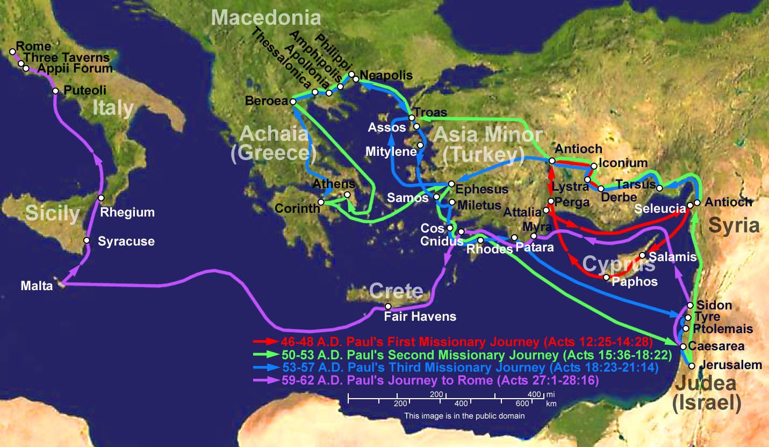
grace
To whom is God’s grace given?
To the believer (calling grace)
Paul is an example of the calling grace of God. Although he was not a believer until later, the grace of God was upon him from birth. (Read Gal. 1:15 and Acts 9) Paul was called to preach the gospel to the Gentiles so that all would come to know the God of grace.
I became a servant of this gospel by the gift of God’s grace given me through the working of his power. Although I am less than the least of all God’s people, this grace was given me: to preach to the Gentiles the unsearchable riches of Christ. (Eph. 3:7-8)
Read more about grace in Paul’s life in Acts 15:40, 2 Cor. 11:22-33 and 12:1-10

Slide 12
grace
Need for God’s grace
God’s grace is not necessary for us to know God--we do not deserve it—but without it we would be doomed to live in sin, without hope.
Reasons we need Grace
Strength is found in His grace
You then, my son, being strong in the grace that is in Christ Jesus.
(2 Timothy 2:1)
Salvation is provided as a result of His grace
For all have sinned and fall short of the glory of God, and are justified freely by his grace through the redemption that came by Christ Jesus.
(Rom. 3:23-24)
Acts 15:10-11, Eph. 2:8-9
God’s call to us is because of His grace
Who has saved us and called us to a holy life—not because of anything we have done but because of his own purpose and grace. This grace was given to us in Christ Jesus before the beginning of time.
(2 Timothy 1:9)
Eph. 1:4-7, 3:7

Slide 13
grace
Need for God’s grace
Reasons we need Grace
Spiritual gifts for works of service are the result of His grace
We have different gifts, according to the grace given us.
(Romans 12:6)
Eph. 4:7-8
Man can’t accomplish God’ work without His grace
May our lord Jesus Christ himself and God out Father who loved us and by his grace gave us eternal encouragement and good hope, encourage your hearts and strengthen you in every good deed and word.
(2 Thes. 2:16-17)
Acts 4:33, 14:3, 14:26, 2 Cor. 9:8
A man without his grace tends toward bitterness
See to it that no one misses the grace of God and that no bitter root grows up to cause trouble and defile many.
(Hebrews 12:15)
Heb. 12:1-14
Men who forget his grace fall back in living under the law
You who are trying to be justified by law have been alienated from Christ, you have fallen away from grace.
(Galatians 5:4)

Slide 14
grace
Living in grace
Man’s response to others in grace
A believer in Christ is a new creation; the old nature gone and replaced with a new one—pleasing to God and led by the Holy Spirit. For this reason, a believer should extend grace to all around him—just as God did for him.

Slide 15
grace
Living in grace
Responding to others with grace
Unmerited Kindness
Be kind and compassionate to one another, forgiving each other, just as in Christ God forgave you.
(Ephesians 4:32)
Pr. 12:25, 14:21, 14:31, 1 Cor. 13:4-7
Unmerited Acceptance
Accept one another, then, just as Christ accepted you, in order to bring praise to God.
(Romans 15:7)
With the Word We Speak
Let your conversation be always full of grace, seasoned with salt, so that you may know how to answer everyone.
(Colosssians 4:6)
Pr. 25:11, Matt. 12:36, Eph. 4:29, Phil. 2:5

Slide 16
grace
Cautions
It can be easy for believers to be deceived by Satan and fall back under the law or begin living ungodly lives. Be on guard for these traps!
Falling back under the law
Grace is a free gift and cannot be earned by works, but men naturally want to try to earn it.
You foolish Galatians! Who has bewitched you? Before your very eyes Jesus Christ was clearly portrayed as crucified. I would like to learn just one thing from you: Did you receive the Spirit by observing the law, or by believing what you heard? Are you so foolish? After beginning with the Spirit, are you now trying to attain your goal by human effort? …Does God give you his Spirit and work miracles among you because you observe the law, or because you believe what you heard? (Gal. 3:1-3, 5)
Living ungodly
God saved you by His grace. Be careful not to use this as an excuse to live or let others influence you to live in an ungodly or unpleasing manner.
For certain men…have secretly slipped in among you. They are godless men, who change the grace of our God into a license for immorality and deny Jesus Christ our only Sovereign and Lord. (Jude 4)
See also Rom. 6:14-23, Gal. 5:13, Heb. 10-26-29

Slide 17
grace
DISCUSSION
QUESTIONS

Slide 18
grace
What are the meanings of grace?
How was God’s grace show in the life of Paul?
How do we receive God’s grace in our lives?
Tell how you plan to show God’s grace to others.

Slide 19
grace
APPLICATION
Memorize Ephesians 2:8-9 and Hebrews 4:16
Read about the grace given to Paul at his conversion in Acts 9.
Write some situations when God has shown His grace to you.
Read Exodus 33:12-34:9 regarding God’s grace in the life of Moses. How did Moses use God’s grace?

Slide 20
grace
Contact: Info@Equippersgroup.org

